Slide 1
UNIT-I

Slide 2
What are fundamental capabilities and limitations of computers?
This goes back to 1930’s when mathematical logicians first began to explore the meaning of computation.
Implemented in three areas
Complexity
computer problems come in different varieties (easy / hard)
Computability
Some mathematicians¹ discovered certain problems^{e.g.} cannot be solved by computers
Automata
Deals with definitions and properties of mathematical models² of computation
Notes:
e.g. problem of determining whether a mathematical statement is true or false.
1 → Kurt Gödel, Alan Turing, and Alonzo Church
2 → Finite Automaton (used in text processing, compilers and hardware design), context free grammar (used in programming languages and artificial intelligence)

Slide 3
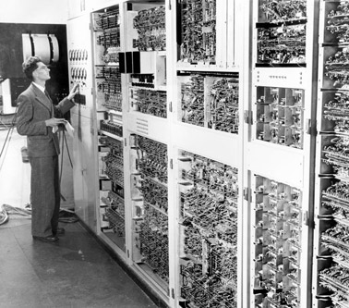
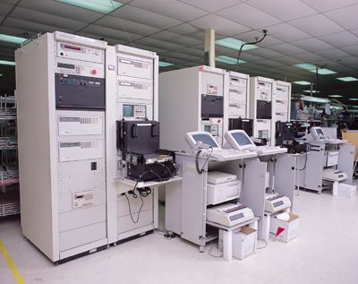
1st Generation Computer
Main Frame Computer

Slide 4
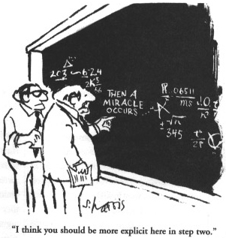

Slide 5
Mathematical Notions
SET → a group of objects¹ represented as a unit.
e.g. {7,21,57}
Є → set membership
→ subset or equal to
Set with 0 members → empty set (ɸ)
Є → set nonmembership
Notes:
1 → may includes numbers, symbols, and even other sets which are called as elements or members.

Slide 6
Mathematical Notions
Sequence and tuples
Sequence of objects → list of objects in some order usually written as (7,21,57)
In set order does not matter
As with sets we have finite or infinite sequences
Finite sequence → tuples
(7,21,57) → 3-tuple (7,21) → 2-tuple (called as pair)

Slide 7
Mathematical Notions
Set {0,1} with all elements¹ {ɸ,{0},{1},{0,1}}
Function → an object that sets up I/P – O/P relationship
Takes input and produces output
f(a) = b
Graphs →set of points with lines² connecting some of the points³
Directed and Undirected
Notes:
1 → called power sets
2 → edges 3 → vertices or nodes

Slide 8
Alphabet
Alphabet → non empty finite set
Members of alphabets are symbols of alphabets
Σ → designate alphabets
Σ₁ = {0,1}
Σ₂ = {a, b, …, z} → set of all lower case letters
Powers of alphabet
Σ⁰ = ε → only string of length 0

Slide 9
Alphabet
Let Σ = {a, b, c}
Σ¹ = {a, b, c}
Σ² = {aa, ab, ac, ba, bb, bc, ca, cb, cc}
Let Σ = {0, 1}
set of all strings → Σ*
Σ* = {ε, 0, 1, 00, 01, 10, 11, 000,… }
Σ* = Σ⁰ ᴜ Σ¹ ᴜ Σ² ᴜ …
set of nonempty strings → Σ⁺
Σ⁺ = Σ¹ᴜΣ²ᴜΣ³ᴜ …
Σ* = Σ⁺ ᴜ {ε}

Slide 10
String
String → finite sequence of symbols from Σ
Possible strings for Σ₁ are 00110,01001 for Σ₂ are abfgc, abceg, abracadabra
Let w be string
|w| → length
Length 0 → empty string (ε)
w = w₁, w_{2,} …, w_{n} → length n
w^{R} → reverse of w
w_{n}, w_{n-1}, … , w₁

Slide 11
String
Substring (z):
Z appears consecutively within w.
Example cad from abracadabra
Lexicographic ordering for alphabet {0,1}
(ε, 0, 1, 00, 01, 10, 11, 000, 0001, …)
Examples
{w | w consists of equal number of 0’s and 1’s}
{ε, 01, 10, 0011, 0101, 1001, . . .}
{w | w is a binary integer that is prime}
{10, 11, 101, 111, 1011,. . .}

Slide 12
Language
Language
set of strings
language of all strings consisting of n 0’s followed by n 1’s for some n≥0
{ ε, 01, 0011, 000111, . . . }
set of strings of 0’s and 1’s with an equal number of each
{ε, 01, 10, 0011, 0101, 1001, . . .}
Note: ɸ ≠ {ε}; the former has no strings and the later has one string.

Slide 13
Language and Operation
ɸ the empty language is a language over any alphabet.
Boolean logic → mathematical symbol built around the two values
Operation
Manipulating Boolean values with designed operations is Boolean operations
E.g. Negation or NOT (¬) , conjunction or AND (ʌ) , Disjunction or OR (V)
For combining simple statements and Implication (→)
Concatenation
Union and star

Slide 14
Finite State Machine
Also termed as Finite automaton
good models for computers with an extremely limited amount of memory
Example → controller for automatic door open.
Pads in front and rear
Front Pad
Rear Pad
Figure (a): Top View of an automatic door
Door

Slide 15
Finite State Machine
CLOSED and OPEN
Four possible input conditions
FRONT, REAR, BOTH, NEITHER
Figure (b): State diagram for automatic door controller

Slide 16
Finite State Machine
Input Signal
State |  | NEITHER | FRONT | REAR | BOTH
 | CLOSED | CLOSED | OPEN | CLOSED | CLOSED
 | OPEN | CLOSED | OPEN | OPEN | OPEN
Figure (c) : State transition table for automatic door controller

Slide 17
Finite Automata
The following figure depicts finite automaton M₁.
Has three states
Figure (d): State diagram for M₁

Slide 18
Finite Automata
Start state (q₁)
Transitions
Accept state or reject state (q₂)
Strings end with 1 → 1, 01, 11 & 0101010101
Followed by last 1 → 100, 0100, 110000 and 0101000000
Strings → 0, 10, 101000

Slide 19
Finite Automata
Has several parts
States
Rules for moving
Input alphabet
Start state
Accept states
5-tuple

Slide 20
Finite Automata
Defined as (Q, Σ, δ, q₀, F)
Q → states
Σ → alphabet
δ:Q x Σ → Q (transition function)
q₀ Є Q → start state
F Q → accept states

Slide 21
Example
0
1
1
q₁
q₂
Figure (e): State diagram of the two state finite automaton M₂
0
Find out Q , Σ, δ , start state, F
 | 0 | 1
q₁ | q₁ | q₂
q₂ | q₁ | q₂

Slide 22
ACCEPTANCE OF STRINGS & LANGUAGES
Let A be set of all strings that M accepts then we can say that A is the language of machine M.
L(M) = A
M recognizes or accepts A.
Machine accepts no strings but still recognizes one language φ (empty language)

Slide 23
Deterministic Finite Automata
Deterministic refers to on each input there is one and only one state.
DFA consists of
Finite set of states
Finite set of input symbols (Σ)
Transition function (δ)
Start state
Final or accepting state (F)

Slide 24
Deterministic Finite Automata
DFA has (Q, Σ, δ, q₀, F)
Q → states
Σ → alphabet
δ:Q x Σ → Q (transition function)
q₀ Є Q → start state
F Q → accept states

Slide 25
Notations of DFA
Two preferred notations
Transition diagram
Transition table

Slide 26
Nondeterministic Finite Automata
Has the power to be in several states at once.
Like DFA , NFA has
Finite set of states
Finite set of input symbols
One start state
Accepting states (F)
Transition function (Δ)
Δ : Q x Σ → P(Q) (P(Q) denotes the power set of Q)

Slide 27
Determine initial states, final states and the acceptability of a string?

Slide 28
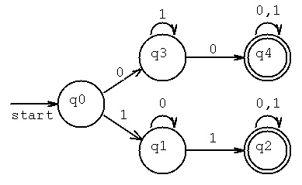

Slide 29
Determine initial states, final states and the acceptability of a string?

Slide 30
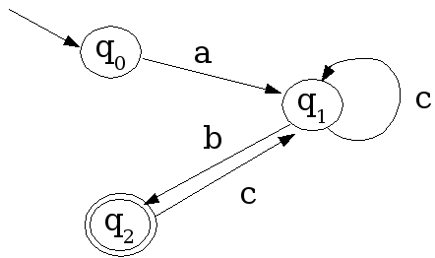

Slide 31
Determine initial states, final states and the acceptability of a string?

Slide 32
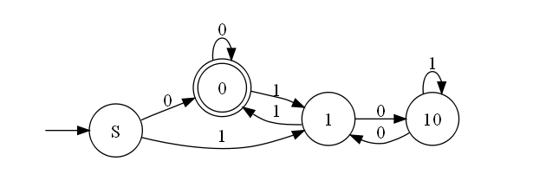
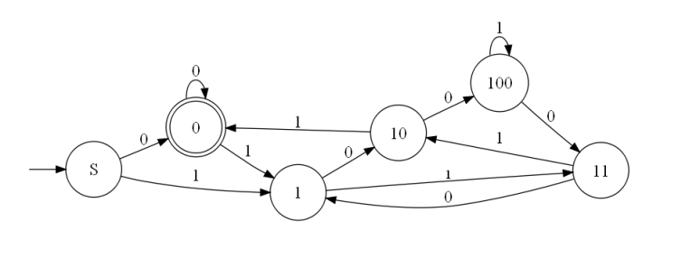

Slide 33
Determine initial states, final states and the acceptability of a string?

Slide 34
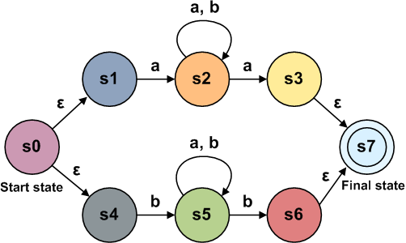

Slide 35
Determine initial states, final states and the acceptability of a string?

Slide 36
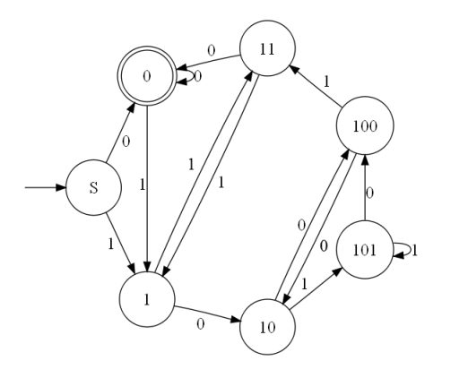

Slide 37
Determine initial states, final states and the acceptability of a string?

Slide 38
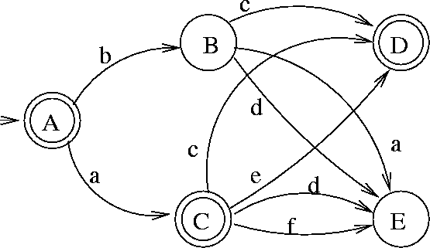

Slide 39
Design DFA

Slide 40
Design a DFA to accept the language
L1 = {w |w is of even length and begins with 01}

Slide 41
Solution
Interpretation of states:
q0: initial state
q1: state entered on reading 0 in state q0.
q2: state entered on reading 01 initially. And returns to this state whenever the substring seen so far starts with 01 and is of even length
q3: DFA enters this state whenever the substring seen so far starts with 01 and is of odd length
q4: state is entered whenever a is encountered in state q0 or a 0 is encountered in state q1

Slide 42
q₀
0
q₁
1
q₂
0,1
q₃
1
0
0,1
q₄
0,1

Slide 43
Design DFAs for the following languages over the Alphabet {0, 1}.
L2 = { w | w begins with 0}.

Slide 44
Solution
Identify
Accepted: 0, 00, 01, 000, ... .
Not accepted: ε, 1, 10, 11, 100, ... .
Note:-The language is infinite because the positive list contains infinitely many words.

Slide 45
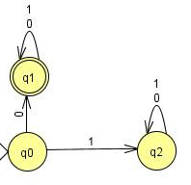
Interpretation of states:
q0 : no symbol read yet.
q1 : the first symbol is not 0.
q2 : the first symbol is 0.

Slide 46
Design DFAs for the following languages over the Alphabet {0, 1}.
L3 = { w | w ends with 0}.

Slide 47
Solution
Accepted: 0, 00, 10, 000, 010, 100, 110, 0000, ... .
Not accepted: ε, 1, 01, 11, 001, 011, 101, 111, 0001, ... .

Slide 48
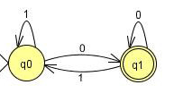
Interpretation of states:
q0 : no symbol read yet or the last symbol that has been read is not 0.
q1 : the last symbol that has been read is 0.

Slide 49
Design DFAs for the following languages over the Alphabet {0, 1}.
L4 = { w | w has a positive even number of 0}.

Slide 50
Solution
Accepted: 00, 001, 010, 100, 0000, ... .
Not accepted: e, 0, 1, 01, 10, 11, 000, 011, 101, 110, 111, 0001, ... .

Slide 51
Interpretation of states:
q0 : no 0 has been read yet.
q1 : an odd number of 0 has been read.
q2 : an even and strictly positive number of 0 has been read.

