Slide 1
UNIT-II

Slide 2
NFA with ε Transitions
From each state and a given input symbol the automaton may jump into several possible next states.
recognize only regular languages
an extension of NFA
without consuming or reading any input symbols

Slide 3
Significance
The systems whose current states are not precisely known.
NFA-ε’s are defined
certain properties can be more easily proved on them as compared to NFA
To build an NFA that recognizes a set of keywords, the strategy can be simplified further if we allow the ε-transitions.

Slide 4
For Example consider the diagram given below:

Slide 5
construct a complete sequence of states for each keyword
add a new start state with ε transition to the start states
Formally we represent an ε-NFA A by
A = (Q, Σ, Δ, q₀,F)
where (Δ : Q × (Σ ∪{ε}) → P(Q))

Slide 6
Consider the following diagram:
Fig: ε-NFA accepting decimal numbers

Slide 7
 | ε | +, - | . | 0, 1, . . . , 9
q₀ | { q₁} | { q₁} | φ | φ
q₁ | φ | φ | { q₂} | { q₁, q₄}
q₂ | φ | φ | φ | { q₃}
q₃ | { q₅} | φ | φ | { q₃}
q₄ | φ | φ | { q₃} | φ
q₅ | φ | φ | φ | φ

Slide 8
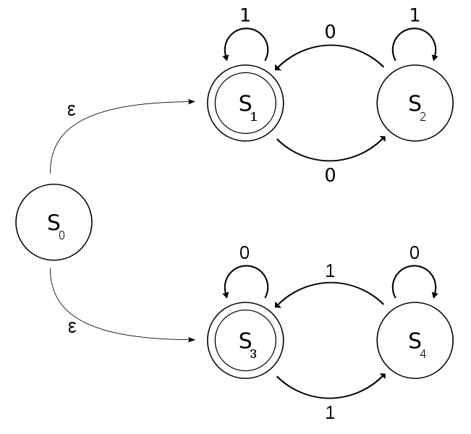
Equivalence b/n NFA with & without ε
It can be shown that NFA and NFA-ε are equivalent.
Let M be an NFA-ε with binary alphabet determines if input contains an even no. of 0s or 1s
Note: 0 occurrences is an even number of occurrences.
M can be viewed as the union of two DFAs.
(1*(01*01*)*) , (0*(10*10*)*)

Slide 9
 | 0 | 1 | ε
S₀ | φ | φ | {S₁,S₃}
S₁ | {S₂} | {S₁} | φ
S₂ | {S₁} | {S₂} | φ
S₃ | {S₃} | {S₄} | φ
S₄ | {S₄} | {S₃} | φ

Slide 10
Epsilon – Closure
ε-closure of a state q is the set of states that can be reached from q along a path in which all arcs are labeled with ε.
If q is in ε-closure then it is denoted as ε-closure(q).
If p is in ε-closure(q) and there is an ε transition from p to r, then r is in ε-closure(q).

Slide 11
ε
Example:
ε-closure(A) = {A}
ε-closure(E) = {B, C, D, E}
ε-closure(B) = {D,B}
ε
ε
Closure of a set of states = union of the closure of each state.

Slide 12
NFAs are closed under different operations
Union →
Intersection →
Concatenation
Negation
Kleene closure or Kleene star
A Unary operation performed on set of strings or symbols or characters.

Slide 13
NFA to DFA CONVERSION
Let N = (Q, Σ, δ, q₀, F) be the NFA
Now construct the DFA →M = (Q’,Σ’, δ’, q₀’,F’)
Q’ = P(Q).
For R Є Q’ and a Є Σ let δ’(R, a) = {q Є Q| q Є δ(r, a) for some r Є R}.
q₀’ = {q₀}
For R Є Q’ and a Є Σ let δ’(R, a) = {q Є Q| q Є δ(r, a) for some r Є R}.
F’ = {R Є Q’ | R contains an accept state of N}.

Slide 14
NFA
DFA
0,1
1
q₂
Ends with 01
q₀
0
q₁
1
0
0
{q₀,q₁}
1
{q₀,q₂}
{q₀ }
0
1

Slide 16
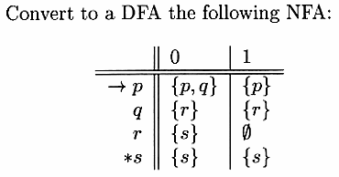

Slide 18
Minimization of Finite State Machine
we construct an automaton with minimum number of states equivalent to a given automaton M.
As our interest lies only in strings accepted by M, what really matters is whether a state is a final state or not.

Slide 19
So we define some relations in Q
q₁ q₂ (equivalent) → both δ(q₁, x) and δ(q₂, x) are final states or both of them are non final states for all x Є Σ*.
K-equivalent (k≥0) →both δ(q₁, x) and δ(q₂, x) are final states or both non final states for all strings x of length k or less.
Note: In particular any two final states are 0-equivalent and any two non final states are also 0-equivalent.

Slide 25
TESTING THE EQUIVALENCE OF STATES
When two distinct states p and q can be replaced by a single state that behaves like p and q, we say that states p and q are equivalent if:
For all input strings w, δ^(p, w) is an accepting state if and only if δ^(q, w) is an accepting state.

Slide 26
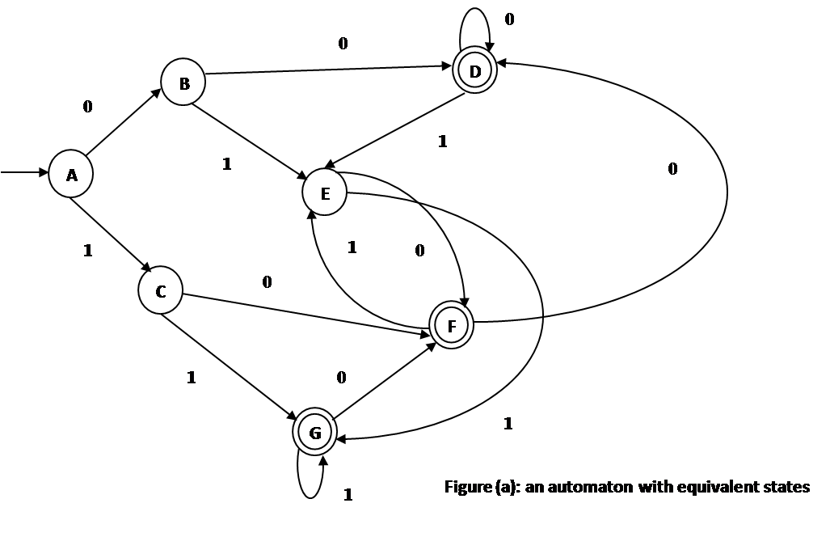
For example consider the DFA given below with equivalent states:

Slide 27
DISTINGUISHABILITY TABLE
Distinguishable
p is accepting state and q is nonaccepting state, then the pair {p, q} is distinguishable.
Let p and q be states
for some input symbol a, r = δ(p, a) and s = δ(q, a) are a pair of states know to be distinguishable.
Then {p, q} is a pair of distinguishable states.

Slide 28
For example since {E, G} is distinguishable and states B and E go to E and G on input 1 we find that {B, E} is also distinguishable.
B | X
C | X | X
D | X | X | X
E | X | X |  | X
F | X | X | X |  | X
G | X | X | X | X | X | X
 | A | B | C | D | E | F
Initially the entire table is blank

Slide 29
FINITE AUTOMATA WITH OUTPUTS
The finite automata which we considered earlier have binary output i.e. they accept the string or do not accept the string.
decided on the basis of reachability of the final state by the initial state.
Now we remove this restriction and consider the model where the outputs can be chosen from some other alphabet.

Slide 30
FINITE AUTOMATA WITH OUTPUTS
The value of the output function Z{t} is
In the most general case it is a function of the present state q(t) and the present input x(t)
Z(t) = λ(q(t), x(t)) (Mealy Machine)
λ → output function
If Z(t) depends only on the present state
Z(t) = λ(q(t)) (Moore Machine)
Moore → convenient in automata theory

Slide 31
Moore Machine
six tuple (Q, Σ, Δ, λ, δ, q₀):
Q is a finite set of states
Σ is the input alphabet
Δ is the output alphabet
δ is the transition function Σ x Q → Q.
λ is the output function mapping Q → Δ and
q₀ is the initial state

Slide 32
Present State | Next state δ |  | Output
 | a = 0 | a = 1
→q₀ | q₃ | q₁ | 0
q₁ | q₁ | q₂ | 1
q₂ | q₂ | q₃ | 0
q₃ | q₃ | q₀ | 0

Slide 33
Mealy Machine
a six tuple (Q, Σ, Δ, λ, δ, q₀)
all the symbols except λ have the same meaning
λ is the output function mapping Σ x Q → Δ

Slide 34
Present State | Next States
 | a = 0 |  | a = 1
 | State | Output | State | Output
→q₁ | q₃ | 0 | q₂ | 0
q₂ | q₁ | 1 | q₄ | 0
q₃ | q₂ | 1 | q₁ | 1
q₄ | q₄ | 1 | q₃ | 0

Slide 35
Mealy to Moore
Consider the machine described by the transition table given below:
Present State | Next State
 | input a = 0 |  | input a = 1
 | State | Output | State | Output
→q₁ | q₃ | 0 | q₂ | 0
q₂ | q₁ | 1 | q₄ | 0
q₃ | q₂ | 1 | q₁ | 1
q₄ | q₄ | 1 | q₃ | 0

Slide 36
Mealy to Moore
Solution
At the first stage develop the procedure so that both the machines accept exactly the same set of input sequences.
We look into next state column for any state (say q_{i}) and determine the number of different outputs associated with q_{i} in that column.
Now we split into several different states, the number of such states being equal to the number of different outputs associated with q_{i}.

Slide 37
Mealy to Moore
For example in this problem q₁ is associated with one output 1 and q₂ is associated with two outputs 0 and 1.
Similarly q₃ and q₄ are associated with the outputs 1 and 0, 1.
Now we split q₂ into q₂₀ and q₂₁.
Similarly q₄ is split into q₄₀ and q_{41.}

Slide 38
Mealy to Moore
Now the given table is reconstructed for the new states as given below:
Present State | Next State
 | input a = 0 |  | input a = 1
 | State | Output | State | Output
→q₁ | q₃ | 0 | q₂₀ | 0
q₂₀ | q₁ | 1 | q₄₀ | 0
q₂₁ | q₁ | 1 | q₄₀ | 0
q₃ | q₂₁ | 1 | q₁ | 1
q₄₀ | q₄₁ | 1 | q₃ | 0
q₄₁ | q₄₁ | 1 | q₃ | 0

Slide 39
Mealy to Moore
The pair of states and outputs in the next state column can be rearranged as given below:
Present State | Next State |  | Output
 | a = 0 | a = 1
→q₁ | q₃ | q₂₀ | 1
q₂₀ | q₁ | q₄₀ | 0
q₂₁ | q₁ | q₄₀ | 1
q₃ | q₂₁ | q₁ | 0
q₄₀ | q₄₁ | q₃ | 0
q₄₁ | q₄₁ | q₃ | 1

Slide 40
Mealy to Moore
Here we observe that the initial sate q₁ is associated with output 1.
This means that with input ε we get an output of 1, if the machine starts at state q1.
Moore accepts 0-length sequence but not Mealy
To overcome this
we must neglect the response of a Moore machine to input ε
(or)
we must add a new starting state q_{0.}(state transitions are identical with those of q₁ whose o/p is 0)

Slide 41
Mealy to Moore
Present State | Next State |  | Output
 | a = 0 | a = 1
→q₀ | q₃ | q₂₀ | 0
q₁ | q₃ | q₂₀ | 1
q₂₀ | q₁ | q₄₀ | 0
q₂₁ | q₁ | q₄₀ | 1
q₃ | q₂₁ | q₁ | 0
q₄₀ | q₄₁ | q₃ | 0
q₄₁ | q₄₁ | q₃ | 1

Slide 42
Moore to Mealy
Consider the Moore machine described by the transition table given the table below:
Present State | Next state δ |  | Output
 | a = 0 | a = 1
→q₀ | q₃ | q₁ | 0
q₁ | q₁ | q₂ | 1
q₂ | q₂ | q₃ | 0
q₃ | q₃ | q₀ | 0

Slide 43
Moore to Mealy
Must follow the reverse procedure of converting Mealy machine into Moore machine.
In Moore machine
For every input symbol we form the pair consisting of the next state and the corresponding output and reconstruct the table for mealy machine.

Slide 44
Moore to Mealy
For example the states q₃ and q₁ in the next state column should be associated with outputs 0 and 1 respectively.
Present State | Next State
 | input a = 0 |  | input a = 1
 | State | Output | State | Output
→q₀ | q₃ | 0 | q₁ | 1
q₁ | q₁ | 1 | q₂ | 0
q₂ | q₂ | 0 | q₃ | 0
q₃ | q₃ | 0 | q₀ | 0

