Slide 1
UNIT-VIII

Slide 2
CONTEXT SENSITIVE LANGUAGE
Context Sensitive Grammar G = (N, Σ P, S) where:
N →Set of non terminal symbols
Σ → Set of terminal symbols
S → Start symbol of the production
P → Finite set of Productions
P are of the form αAβ → αϒβ
Where α, β, ϒ Є (N U Σ)⁺ and ϒ → non empty

Slide 3
CONTEXT SENSITIVE LANGUAGE
In addition
S → ε provided
does not appear on the right hand side of any rule
language generated by the context sensitive grammar ?
CSL

Slide 4
COMPUTATIONAL PROPERTIES
CSL ≡ with linear bounded nondeterministic TM
a tape of only kn cells
Constant associated with machine
Size of input

Slide 5
LBA
model of LBA is important because
set of CSL is accepted by the model
infinite storage is restricted in size but not in accessibility to the storage
Called as LBA because
a linear function is used in restrict (to bound) the length of the tape
LBA
Nondeterministic TM with single tape of finite length bounded by a linear function of the length of i/p string

Slide 6
LBA
LBA M = (Q, Σ, Γ, δ, q₀, b, ₵, $, F)
Q → finite set of states
∑ → finite set of input symbols
Γ → complete set of tape symbols
δ → transition function
q₀ → initial state
b → blank
₵ → left end marker
$ → right end marker
F → set of final states / accepting states

Slide 7
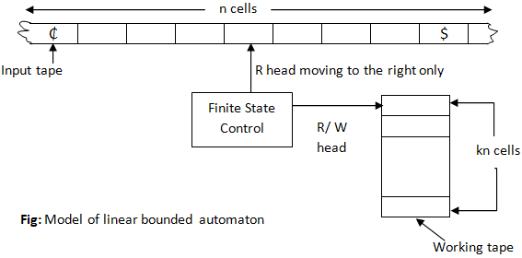
Model of LBA

Slide 8
Model of LBA
Two tapes
i/p tape
head never prints and never moves left
Working tape
head can modify the contents in any way without restriction

Slide 9
Instantaneous Description
In LBA
ID → (q, w, k)
q Є Q
w Є Γ
k is integer between 1 to n
transition of ID’s is similar except that
k changes
k-1 → R/W head moves left
k+1 → R/W head moves right

Slide 10
Language
language accepted by the LBA is defined as the set
{w Є (Σ – {₵, $})* | (q₀, ₵w$, 1) (q, α, i) for some q Є F and for some integer i between 1 & n}

Slide 11
LR (0) Grammar
A grammar is said to be LR grammar,
it is sufficient that a left-to-right shift-reduce parser be able to recognize the handles of right-sentential forms when they appear on top of stack.
L stands for Left-to-right
R stands for Right most derivation

Slide 12
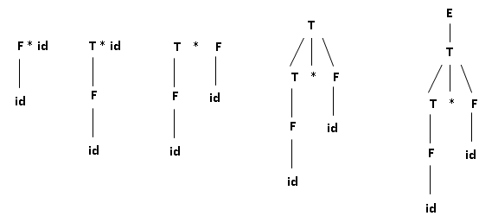
LR(0) Grammar
To understand shift reduce parsing
let us consider the construction of the string id* id for grammar “E→E+T | T, T→T*F | F, F →(E) | id”

Slide 13
DECIDABILITY PROBLEMS
We begin with certain computational problems concerning finite automata
we give algorithms for testing whether
a finite automaton accepts a string
language of a finite automaton is empty
whether two finite automata are equivalent
For example the acceptance problem for DFA’s of testing whether a particular DFA accepts a given string can be expressed as a language, A_{DFA}.
Let A_{DFA} = {<B, w>| B is a DFA that accepts input string w}

Slide 14
DECIDABILITY PROBLEMS
DECIDABLE PROBLEMS CONCERNING REGULAR LANGUAGES
DECIDABLE PROBLEMS CONCERNING CONTEXT-FREE LANGUAGES

Slide 15
DECIDABLE PROBLEMS CONCERNING REGULAR LANGUAGES
Theorem 6.1: A_{DFA} is a decidable language.
Proof Idea:
We need to present a TM M that decides A_{DFA}.
M =
“On input <B, w>, where B is a DFA and w is a string:
Simulate B on input w.
If the simulation ends in an accept state, accept. If it ends in a nonaccepting state, reject.”

Slide 16
DECIDABLE PROBLEMS CONCERNING REGULAR LANGUAGES
Theorem 6.2: A_{NFA} is a decidable language.
We present a TM N that decides A_{NFA}.
N =
“On input <B, w> where B is an NFA, and w is a string:
Convert NFA B to an equivalent DFA C.
Run TM M from theorem 6.1 on input <C, w>.
If M accepts, accept; otherwise, reject.”
Running TM M in stage 2 means incorporating M into the design of N as a sub procedure.

Slide 17
DECIDABLE PROBLEMS CONCERNING REGULAR LANGUAGES
Similarly we can determine whether a regular expression generates a given string.
Let
A_{REX} = {<R, w>| R is a regular expression that generates string w}.

Slide 18
DECIDABLE PROBLEMS CONCERNING REGULAR LANGUAGES
Theorem 6.3: A_{REX} is a decidable language.
Proof:
The following TM P decides A_{REX}.
P =
”On input <R, w> where R is a regular expression and w is a string:
Convert regular expression R to an equivalent NFA A.
Run TM N on input <A, w>.
If N accepts, accept; if N rejects, reject.”

Slide 19
DECIDABLE PROBLEMS CONCERNING CONTEXT-FREE LANGUAGES
Theorem: A_{CFG} is a decidable language.
Proof: The TM S for A_{CFG} follows.
S =
“On input <G, w>, where G is a CFG and w is a string:
Convert G to an equivalent grammar in Chomsky normal form.
List all derivations with 2n–1 steps, where n is the length of w, except if n = 0, then instead list all derivations with 1 step.
If any of these derivations generate w, accept; if not reject”

Slide 20
UNIVERSAL TURING MACHINE
Theorem: A_{TM} is undecidable.
Proof:
Before we get to the proof, let’s first observe that A_{TM} is Turing-recognizable.
The following Turing machine U recognizes A_{TM}.
U =
“On input <M, w>, where M is a TM and w is a string:
Simulate M on input w.
If M ever enters it’s accept state, accept; if M ever enters its reject state, reject.”

Slide 21
UNIVERSAL TURING MACHINE
machine is called universal because it is capable of simulating any other Turing machine from the description of that machine.

Slide 22
POST CORRESPONDENCE PROBLEM
we show
phenomenon of undecidability is not confined to problems concerning automata.
an example of an undecidable problem concerning simple manipulations of strings
PCP
describe this problem easily as a type of puzzle

Slide 23
POST CORRESPONDENCE PROBLEM
We begin with a collection of dominos(pack) each containing two strings, one on each side
Individual domino looks like
a collection of dominos looks like

Slide 24
POST CORRESPONDENCE PROBLEM
What’s the task is?
make a list of these dominos (repetitions permitted)
string we get by reading off the symbols on the top is the same as the string of symbols on the bottom.
Called match for e.g.

Slide 25
POST CORRESPONDENCE PROBLEM
Reading of the top string we get abcaaabc, which is the same as reading off the bottom
For some collections of dominos finding a match may not be possible.
E.g.
PCP is to determine whether a collection of dominos has a match.

Slide 26
TURING REDUCIBILITY
Reduction
way of converting one problem to another problem such a way that a solution to the second problem can be used to solve the first problem.
Definition
An oracle for a language B is an external device that is capable of reporting whether any string w is a member of B

Slide 27
Definition of P
class of languages that are decidable in polynomial time on a deterministic single-tape Turing machine.
In other words

Slide 28
Definition of NP
class of languages that have polynomial time verifiers.
P versus NP:
major unsolved problem in computer science
the class of languages for which membership can be decided quickly
NP = the class of languages for which membership can be verified quickly

Slide 29
NP-COMPLETENESS
If a polynomial time algorithm exists for any of these problems
all problems in NP would be polynomial time solvable.
called NP-complete.

Slide 30
NP-HARD
NP-hard is called as non-deterministic polynomial-time hard.
A problem H is NP-hard if and only if there is an NP-complete problem L that is polynomial time Turing-reducible to H (i.e., L ≤ _{T}H).
Informally
can think of an algorithm that can call such an oracle machine as a subroutine for solving H, and solves L in polynomial time
If that call takes only one step to compute.
NP-hard problems may be of any type: decision problems, search problems, or optimization problems.

