Slide 1
UNIT-V
INTER-PROCESS COMMUNICATION AND SOCKETS

Slide 2
INDEX
Pipe
Process Pipes
The Pipe Call
Parent and Child Processes
Named Pipes
FIFOs
Semaphores
semget, semop, semctl, Message
Message Queues
msgget, msgsnd, msgrcv, msgctl
Shared Memory
shmget, shmat, shmdt, shmctl
IPC Status Commands
Socket
Socket Connections
Socket Attributes,
Socket Addresses,
socket, connect, bind, listen, accept,
Socket Communications

Slide 3
PIPES
Oldest form – IPC
def:
Passing information – program process → another
Data flow – process → other
Output → input →another
Limitations (2)
Half duplex
Used between processes – common ancestors
Most commonly used
Half duplex – IPC

Slide 4
BACK
NEXT

Slide 5
PROCESS PIPES
Process → pipes
popen
pclose
#include <stdio.h>
FILE *popen(const char *command, const char *open_mode);
int pclose(FILE *stream_to_close);
popen
Invoke another program
As → new process
pass data to / receive data from it
Command string
Program name → run
Together → parameters
r / w

Slide 6
PROCESS PIPES
If
r
o/p ← invoked program
Available →invoking program
W
Program send data → invoked command
Then Read data on standard input

Slide 7
THE PIPE CALL
int pipe(int filedes[2]);
filedes[0] → read
filedes[1] → write
filedes[1] o/p → filedes[0] i/p
Return
0 → OK
-1 → error
Sets errno → reason (failure)
EMFILE → Too many file descriptors are in use by the process.
ENFILE → The system file table is full.
EFAULT → The file descriptor is not valid.

Slide 8
THE PIPE CALL
BACK
NEXT

Slide 9
PARENT AND CHILD PROCESSES
Pipe call
Allow child process to be a different program from its parent
Rather than
Different process
Achieve this?
exec call

Slide 10
NAMED PIPES: FIFOs
So far
Data passed between programs
Related i.e. programs started → same ancestor process
If not related how can we pass data ?
FIFO (also called Named Pipes)
FIFO / Named Pipe?
Special type of file
Exists as name in file system
Behaves → unnamed pipes

Slide 11
NAMED PIPES: FIFOs
Create named pipes
Two ways
From command line
$ mknod filename p (some versions)
Or
$ mkfifo filename (All)
With in a program
Two calls
#include <sys/types.h>
#include <sys/stat.h>
int mkfifo(const char *filename, mode_t mode);
int mknod(const char *filename, mode_t mode | S_IFIFO, (dev_t) 0);
dev_t → ID of device containing file, S_IFIFO → FIFO Special File Type)

Slide 12
NAMED PIPES: FIFOs
Accessing FIFO
Try to
$ Reading (empty file)
Now try writing
$ echo “Hello World” > /tmp/my_fifo
Ctrl + c
Example:
$ cat < /tmp/my_fifo &
[1] 1316
$ echo “Hello World” > /tmp/my_fifo
Hello World
[1]+ Done cat </tmp/my_fifo
$
→ one Terminal
→ Another terminal

Slide 13
OPENING A FIFO WITH OPEN
Restriction on opening FIFO
O_RDWR
Difference → Regular & FIFO file
open_flag bit – option → O_NONBLOCK
four legal combinations
open(const char *path, O_RDONLY);
Open call will block until process opens the same FIFO for writing
open(const char *path, O_RDONLY | O_NONBLOCK);
Open call will now succeed and return immediately, even if FIFO has not been opened for writing

Slide 14
OPENING A FIFO WITH OPEN
open(const char *path, O_WRONLY);
Open call will block until process opens the same FIFO for reading
open(const char *path, O_WRONLY | O_NONBLOCK);
always Return immediately but –
If no process has FIFO open for reading
-1
Else file descriptor (→writing for FIFO)
Note: Size of FIFO → imposed by system

Slide 15
SEMAPHORES
Programs use
Multiprocessing systems
Multiuser systems
Combination of above 2
Critical section
Single process has exclusive access → resource (shared)
Prevent problems caused
More than one program simultaneously accessing a shared resource
Generate token that grant access to only one thread of execution in critical section at a time.
Control access to critical sections in a threaded program → semaphores

Slide 16
SEMAPHORES
Definition
A variable = 0 or 1 (binary)
A variable = many +ve Values (general)
Semaphore functions operates
arrays of general rather than binary
Types of functions
semget()
semop()
semctl()

Slide 17
SEMAPHORES
semget
Create new or obtain semaphore key
int semget(key_t key, int num_sems, int sem_flags);
Key (integral value) → Unrelated process(s) to access same semaphore
Num_sems → no. of semaphores required
Almost always →1
Sem_flags → set of flags (like open function → reading / writing)
In addition → bitwise ORed with IPC_CREAT
returns
Positive value (semaphore Identifier)→ success
-1 error

Slide 18
SEMAPHORES
semop
Changing value → semaphore
int semop(int sem_id, struct sembuf *sem_ops, size_t num_sem_ops);
Sem_id → returned by semget
*sem_ops →pointer to array of structures
Contains
struct sembuf
{ short sem_num; short sem_op; short sem_flg; }
sem_num → semaphore number
sem_op → value (-1 wait/+1 signal) by which semaphore should be changed
sem_flg → usually set to SEM_UNDO → causes OS to track changes made to semaphore

Slide 19
SEMAPHORES
semctl
control
int semctl(int sem_id, int sem_num, int command, ...);
sem_id → returned by semget
sem_num → semaphore number
command → action to take
SETVAL → initializing semaphore → known value
IPC_RMID → for deleting sem_id → no longer required
Returns different values
Depending on SETVAL & IPC_RMID
0 → success
-1 → error

Slide 20
MESSAGE QUEUE
easy and efficient way
Pass data → 2 unrelated process
Block of data → process → other
Passing messages
Avoid problems
Synchronization
Blocking
Maximum size limit imposed on each block of data
Maximum total size of all blocks
Advantage
Disadvantage

Slide 21
MESSAGE QUEUE
msgget():
int msgget(key_t key, int msgflg);
key value
Like IPC facilities → names particular message queue
msgflg
9 permission flags → like mode flags for creating file
return
Message queue ID (negative integer)
-1

Slide 22
MESSAGE QUEUE
msgsnd():
int msgsnd(int msqid, const void *msg_ptr, size_t msg_sz, int msgflg);
msqid → returned → msgget()
msg_ptr → pointer → message → sent
msg_sz → size → message
msgflg → controls (message queue → full or limit reached)
Returns
0
-1

Slide 23
MESSAGE QUEUE
msgrcv():
int msgrcv(int msqid, void *msg_ptr, size_t msg_sz, long int msgtype, int msgflg);
msqid → returned → msgget()
msg_ptr → pointer → message → received
msg_sz → size → message
msgtype → type → message
0 → available message in message queue is retrieved
>0 → first message with same type → retrieved
<0 → first message same or less than the type → retrieved
msgflg
Control
Returns
No. of bytes placed in receive buffer
-1

Slide 24
MESSAGE QUEUE
msgctl():
int msgctl(int msqid, int command, struct msqid_ds *buf);
msqid → returned → msgget()
Command → action taken
IPC_STAT
Retrieves msqid_ds structure for a queue, and stores it in the address of the buf argument.
IPC_SET
Sets the value of the ipc_perm member of the msqid_ds structure for a queue. Takes the values from the buf argument.
IPC_RMID
Removes the queue from the kernel
return
0
-1
struct msqid_ds {
uid_t msg_perm.uid;
uid_t msg_perm.gid
mode_t msg_perm.mode;
}

Slide 25
SHARED MEMORY
Unrelated process access
Same logical memory
Efficient
Synchronization facilities
All processes
Access memory locations → memory allocated ( malloc())
Special range of address created by IPC
For one process appears in another (address space)
As no synchronization facilities
Use another mechanism to synchronize access to shared memory
pass small messages

Slide 26
SHARED MEMORY
shmget():
create
int shmget(key_t key, size_t size, int shmflg);
key
Names the shared memory segment
Size
memory required → bytes
Shmflg
9 permission flags → like mode flags for creating file
IPC_CREAT | (OR) with permissions

Slide 27
SHARED MEMORY
Shmat():
Shared memory attachment
Enable Access → other process – exclusively attach
Address space → shared memory (current process)
void *shmat(int shm_id, const void *shm_addr, int shmflg);
shm_id → id returned by shmget()
shm_addr → address → attach → current process
shmflg → set of bitwise flags
Two possible values are
SHM_RND → in conjunction with shm_addr controls address at which shared memory is attached
SHM_RDONLY → makes attached memory read-only
Return
Pointer → First byte of shared memory
-1

Slide 28
SHARED MEMORY
Shmdt():
Detaches shared memory (current process)
Takes pointer to address(shmat)
Returns
0
-1
Note: detaching means making memory unavailable (deleting)

Slide 29
SHARED MEMORY
Shmctl():
Contrl functions (shared memory)
int shmctl(int shm_id, int command, struct shmid_ds *buf);
shm_id → id (shmget)
command → action taken
IPC_STAT
IPC_SET
IPC_RMID
buf →pointer → structure containing modes & permissions for shared memory
Return
0
-1
struct shmid_ds {
uid_t shm_perm.uid;
uid_t shm_perm.gid;
mode_t shm_perm.mode;
}

Slide 30
IPC STATUS COMMANDS
Drawbacks
Poorly written programs
Programs fail for some reason
Resources wait long after program completes
overcome → Checking IPC facilities:
ipcs → status
ipcrm → remove

Slide 31
IPC STATUS COMMANDS
Displaying semaphore status
$ ./ipcs -s
Sample o/p
key semid owner perms nsems
0x4d00df1a 768 rick 666 1
Removing semaphores
$ ./ipcrm -s 768

Slide 32
IPC STATUS COMMANDS
Displaying shared memory status
$ ./ipcs -m
Sample o/p
key shmid owner perms bytes nattch status
0x00000000 384 rick 666 4096 2 dest
Removing shared memory
$ ./ipcrm –m 384

Slide 33
IPC STATUS COMMANDS
Displaying message queue status
$ ./ipcs -q
Sample o/p
Key msqid owner perms used-bytes messages
0x000004d2 3384 rick 666 2048 2
Removing message queue
$ ./ipcrm -q 3384

Slide 34
SOCKET
communication mechanism → b/n 2 systems on n/w (combination of IP address and port number)
Client & server developed
Locally (single machine)
Across networks
end points bound to ports before communication is possible
Applications ← socket
Printing
Connecting to databases
Serving web pages
rlogin

Slide 35
SOCKET CONNECTIONS
Three attributes
Domain (family)
Network medium →socket communication (use)
Most common domain → AF_INET (→inter networking)
Underlying protocol → IP
Type
Domain → Number of ways to communicate
IP provides 2 communication mechanisms
Streams
provides connection i.e. sequenced & reliable two-way byte stream (data sent → guaranteed)
Datagrams
Establish and maintain connection
Protocol
Selecting specific protocol → socket

Slide 36
SOCKET ADDRESSES
Each socket
Two widely used address domains
Unix Domain → AF_UNIX
two processes which share a common file system communicate
Internet Domain → AF_INET
two processes running on any two hosts on the Internet communicate
Example:
AF_INET → format
struct sockaddr_in {
short int sin_family; /* AF_INET */
unsigned short int sin_port; /* Port number */
struct in_addr sin_addr; /* Internet address */
};
struct sockaddr_un {
sa_family_t sun_family;
/* AF_UNIX */
char sun_path[UNIX_PATH_MAX];
/* pathname */
};

Slide 37
socket()
perform network I/O
First thing a process can do
call socket
socket()
#include <sys/types.h>
#include <sys/socket.h>
int socket (int family, int type, int protocol);
Return
File descriptor
-1

Slide 38
socket()
Family | Description
AF_INET | IPv4 protocols
AF_INET6 | IPv6 protocols
AF_LOCAL | Unix domain protocols
AF_ROUTE | Routing Sockets
Type | Description
SOCK_STREAM | Stream socket
SOCK_DGRAM | Datagram socket
SOCK_SEQPACKET | Sequenced packet socket
SOCK_RAW | Raw socket
Note → raw socket is an internet socket that allows direct sending and receiving of Internet Protocol packets without any protocol-specific transport layer formatting.
Protocol | Description
IPPROTO_TCP | TCP transport protocol
IPPROTO_UDP | UDP transport protocol
IPPROTO_SCTP | SCTP transport protocol

Slide 39
bind()
Naming a Socket
int bind(int socketfd, const struct sockaddr *address, size_t address_len);
Return
0
-1 and set errno → one of the values
ERRNO VALUE | DESCRIPTION
EBADF | The file descriptor is invalid.
ENOTSOCK | The file descriptor doesn’t refer to a socket.
EINVAL | The file descriptor refers to an already-named socket.
EADDRNOTAVAIL | The address is unavailable.
EADDRINUSE | The address has a socket bound to it already.

Slide 40
listen()
accept incoming connections on a socket
a socket is first created with a willingness to accept incoming connections
a queue limit for incoming connections are specified with listen()
then the connections are accepted with accept().
listen() call applies only to sockets of type
SOCK_STREAM
OR
SOCK_SEQPACKET
#include <sys/socket.h>
int listen(int socketfd, int backlog);
Return
0
-1

Slide 41
accept()
Accepting Connections
#include <sys/socket.h>
int accept(int socketfd, struct sockaddr *address, size_t *address_len);
Returns
nonnegative integer that is a file descriptor for the accepted socket – new file descriptor
-1

Slide 42
connect()
Requesting Connections / initiate a connection on a socket
#include <sys/socket.h>
int connect(int socketfd, const struct sockaddr *address, size_t address_len);
Returns
0
-1

Slide 43
SOCKET FUNCTIONS
Closing a Socket
int close( int sockfd );
Returns
0
-1

Slide 44
SOCKET COMMUNICATIONS
steps involved in establishing a socket on the client side
Create a socket with the socket() system call
Connect the socket to the address of the server using the connect() system call
Send and receive data. There are a number of ways to do this, but the simplest is to use the read() and write() system calls.

Slide 45
SOCKET COMMUNICATIONS
Create a socket for the client:
sockfd = socket(AF_INET, SOCK_STREAM, 0);
struct sockaddr_in address;
Name the socket, as agreed with the server:
address.sin_family = AF_INET;
address.sin_addr.s_addr = inet_addr(“127.0.0.1”);
address.sin_port = 9734;
len = sizeof(address);

Slide 46
SOCKET COMMUNICATIONS
Connect your socket to the server’s socket:
result = connect(sockfd, (struct sockaddr *)&address, len);
You can now read and write via sockfd:
write(sockfd, &ch, 1);
read(sockfd, &ch, 1);

Slide 47
SOCKET COMMUNICATIONS
steps involved in establishing a socket on the server side
Create a socket with the socket() system call
Bind the socket to an address using the bind() system call. For a server socket on the Internet, an address consists of a port number on the host machine.
Listen for connections with the listen() system call
Accept a connection with the accept() system call. This call typically blocks until a client connects with the server.
Send and receive data

Slide 48
SOCKET COMMUNICATIONS
Create an unnamed socket for the server:
server_sockfd = socket(AF_INET, SOCK_STREAM, 0);
struct sockaddr_in server_address;
struct sockaddr_in client_address;
Name the socket:
server_address.sin_family = AF_INET;
server_address.sin_addr.s_addr = inet_addr(“127.0.0.1”);
server_address.sin_port = 9734;
server_len = sizeof(server_address);
bind(server_sockfd, (struct sockaddr *)&server_address, server_len);

Slide 49
SOCKET COMMUNICATIONS
Create a connection queue and wait for clients
listen(server_sockfd, 5);
Accept a connection
client_len = sizeof(client_address);
client_sockfd = accept(server_sockfd, (struct sockaddr *)&client_address, &client_len);
Read and write to client on client_sockfd:
read(client_sockfd, &ch, 1);
write(client_sockfd, &ch, 1);

Slide 50
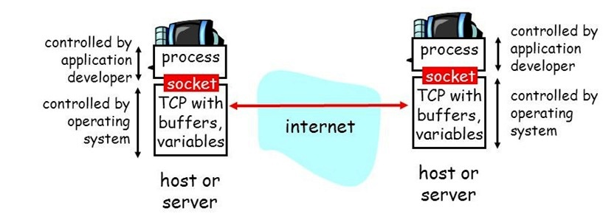

Slide 51
Beyond syllabus

Slide 52
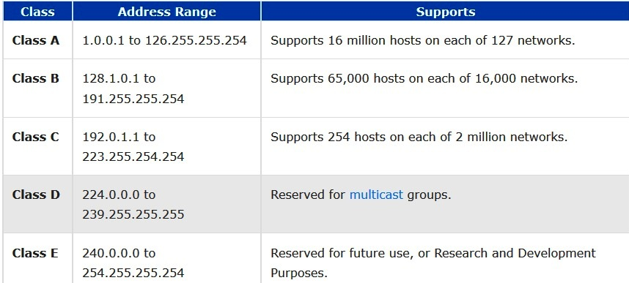
Class of IP Addresses
send (data) across a computer network to several users at the same time.

Slide 53
