Slide 1
I/O Systems
I/O Hardware
Application I/O Interface
Kernel I/O Subsystem
Goals of Protection
Principles of Protection
Domain of Protection
Access Matrix
Implementation of Access Matrix
Access Control
Revocation of Access Rights

Slide 2
I/O Hardware
Computers operate a great many kinds of devices.
Categories of Devices:
storage devices
transmission devices (network connections, Bluetooth)
human-interface devices (screen, keyboard, mouse, audio in and out)
A device communicates
with a computer system by sending signals over a cable or even through the air.
with the machine via a connection point, or port—for example, a serial port.
If devices share a common set of wires, the connection is called a bus.
is a set of wires and a rigidly defined protocol that specifies a set of messages that can be sent on the wires.
In terms of the electronics
the messages are conveyed by patterns of electrical voltages applied to the wires with defined timings.

Slide 3
I/O Hardware
Buses are used widely in computer architecture and vary in their signaling methods, speed, throughput, and connection methods.
A typical PC bus structure appears in Figure
PCI bus
connects the processor–memory subsystem to fast devices
Expansion bus
connects relatively slow devices, such as the keyboard, serial and USB ports.
SCSI bus
disks are connected together, plugged into a SCSI controller.
Other common buses used to interconnect main parts of a computer include
PCI Express (PCIe), with throughput of up to 16 GB per second.
Hyper Transport, with throughput of up to 25 GB per second.

Slide 4
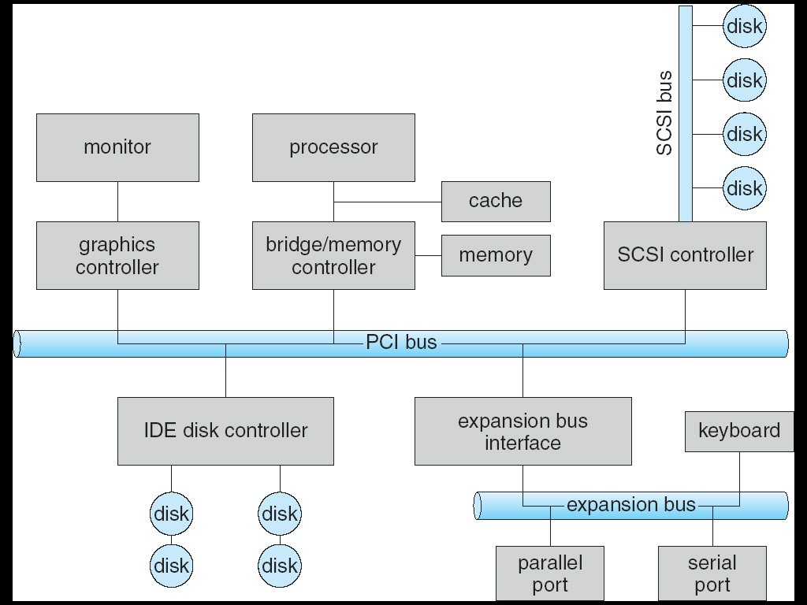
A Typical PC Bus Structure

Slide 5
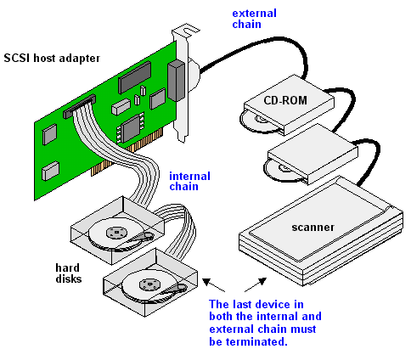

Slide 6
I/O Hardware
A controller is a collection of electronics that can operate a port, a bus, or a device.
A serial-port controller is a simple device controller.
It is a single chip (or portion of a chip) in the computer that controls the signals on the wires of a serial port.
By contrast, a SCSI bus controller is not simple. Because the SCSI protocol is complex, the SCSI bus controller is often implemented as a separate circuit board that plugs into the computer.
It typically contains a processor, microcode, and some private memory to enable it to process the SCSI protocol messages.
How can the processor give commands and data to a controller to accomplish an I/O transfer?
Short answer → the controller has one or more registers for data and control signals.

Slide 7
I/O Hardware
The processor communicates with the controller by reading and writing bit patterns in these registers.
One way in which this communication can occur
is through the use of special I/O instructions that specify the transfer of a byte or word to an I/O port address.
An I/O port typically consists of four registers, called the status, control, data-in, and data-out registers.
is read by the host to get input.
is written by the host to send output.
contains bits that can be read by the host.
can be written by host → to start a command or to change the mode of a device.

Slide 8
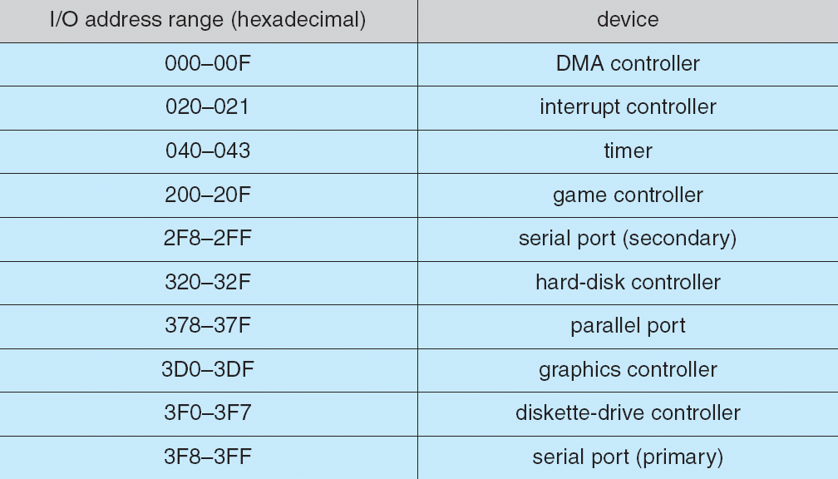
Device I/O Port Locations on PCs (partial)

Slide 9
Polling
The complete protocol for interaction between the host and a controller can be difficult, but the basic handshaking notion is simple.
Example → Assume that 2 bits are used to coordinate the producer–consumer relationship between the controller and the host.
The controller indicates its state through the busy bit (set a bit → write a 1 in to the bit and clear a bit → write a 0 in the bit) in the status register.
The controller sets the busy bit when it is busy working and clears the busy bit when it is ready to accept the next command.
The host signals its wishes via the command-ready bit in the command register.
The host sets the command-ready bit when a command is available for the controller to execute.
In many computer architectures, three CPU-instruction cycles are sufficient to poll a device: read a device register, logical and to extract a status bit, and branch if not zero.
The basic polling operation is efficient. But polling becomes inefficient when it is attempted repeatedly yet rarely finds a device ready for service, while other useful CPU processing remains undone.
In such instances, it may be more efficient to arrange for the hardware controller to notify the CPU when the device becomes ready for service.
The hardware mechanism that enables a device to notify the CPU is called an interrupt.

Slide 10
Interrupts
The basic interrupt mechanism works as follows:
CPU hardware has a wire called the Interrupt-request line which senses after executing every instruction.
When CPU detects that a controller has asserted a signal on the interrupt-request line, the CPU performs a state save and jumps to the interrupt-handler routine at a fixed address in memory.
Interrupt handler determines the cause of the interrupt
performs the necessary processing
performs a state restore and
executes a return from interrupt instruction to return the CPU to the execution state prior to the interrupt.
The basic interrupt mechanism
The device controller raises an interrupt by asserting a signal on the interrupt request line
The CPU catches the interrupt and dispatches it to the interrupt handler and
The handler clears the interrupt by servicing the device.
enables the CPU to respond to an asynchronous event, as when a device controller becomes ready for service.

Slide 11
Interrupts
In a modern operating system
we need more sophisticated interrupt-handling features.
We need the ability to defer interrupt handling during critical processing.
We need an efficient way to dispatch to the proper interrupt handler
We need multilevel interrupts so that the operating system can distinguish between high- and low-priority interrupts
these three features are provided by the CPU and by the interrupt-controller hardware

Slide 12
Interrupts
Most CPUs have two interrupt request lines.
One is the nonmaskable interrupt
which is reserved for events such as unrecoverable memory errors.
The second interrupt line is maskable
it can be turned off by the CPU before the execution of critical instruction sequences that must not be interrupted.
The interrupt mechanism accepts an address
a number that selects a specific interrupt-handling routine from a small set.
In most architectures, this address is an offset in a table called the interrupt vector.
purpose of a vectored interrupt mechanism is
to reduce the need for a single interrupt handler to search all possible sources of interrupts to determine which one needs service.
The interrupt mechanism also implements a system of interrupt priority levels.
enable the CPU to defer the handling of low-priority interrupts without masking all interrupts and makes it possible for a high priority interrupt to preempt the execution of a low-priority interrupt.

Slide 13
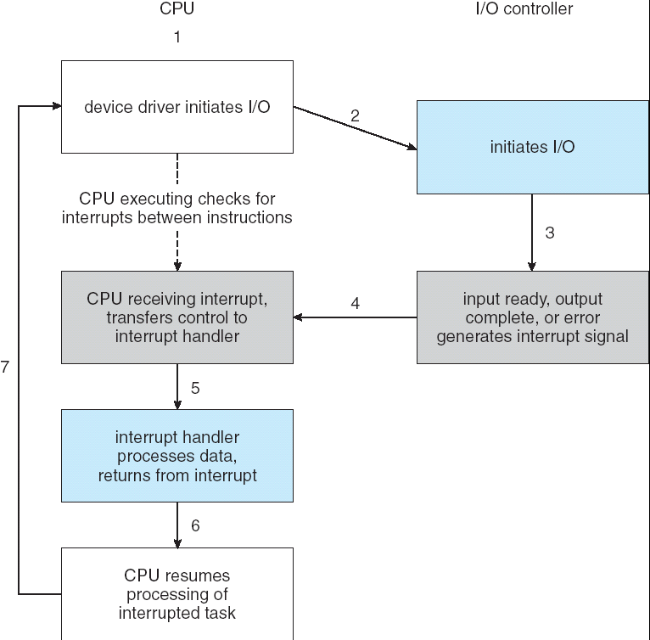
Interrupt-Driven I/O Cycle

Slide 14
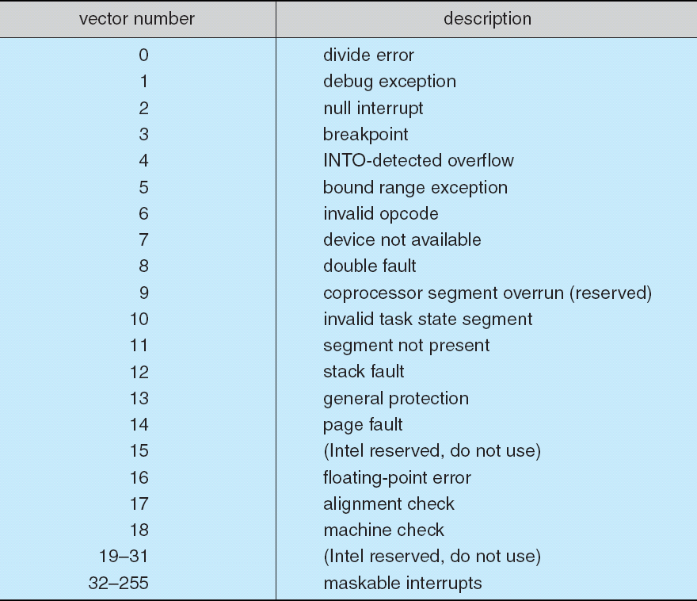
Intel Pentium Processor Event-Vector Table
Note:- In the above vector table from 0-31 are of non-maskable type
and 32-255 are maskable type.

Slide 15
Application I/O Interface
Here we discuss
structuring techniques and
interfaces for the operating system that enable I/O devices to be treated in a standard, uniform way.
for instance,
how an application can open a file on a disk without knowing
what kind of disk it is and
how new disks and other devices can be added to a computer without disruption of the operating system.
Like other complex software-engineering problems,
the approach here involves abstraction, encapsulation, and software layering.
Specifically, we can abstract away the detailed differences in I/O devices by identifying a few general kinds which is accessed through a standardized set of functions—an interface.

Slide 16
Application I/O Interface
differences are encapsulated in kernel modules called device drivers that internally are custom-tailored to specific devices but that export one of the standard interfaces.
Figure illustrates
how the I/O-related portions of the kernel are structured in software layers.
purpose of the device-driver layer is to hide the differences among device controllers from the I/O subsystem of the kernel
It also benefits the hardware manufacturers.
They either design new devices to be compatible with an existing host controller interface or
they write device drivers to interface the new hardware to popular operating systems.

Slide 17
Application I/O Interface
Devices vary on many dimensions
Character-stream or block
character-stream device
transfers bytes one by one
block device
transfers a block of bytes as a unit
Sequential or random-access
sequential device transfers data in a fixed order determined by the device
random-access device can instruct the device to seek to any of the available data storage locations.
Sharable or dedicated
sharable device can be used concurrently by several processes or threads
dedicated device cannot.
Speed of operation
Device speeds range from a few bytes per second to a few gigabytes per second.
read-write, read only, or write only
Some devices perform both input and output, but others support only one data transfer direction.
Synchronous or asynchronous
synchronous device performs data transfers with predictable response times, in coordination with other aspects of the system.
asynchronous device exhibits irregular or unpredictable response times not coordinated with other computer events.

Slide 18
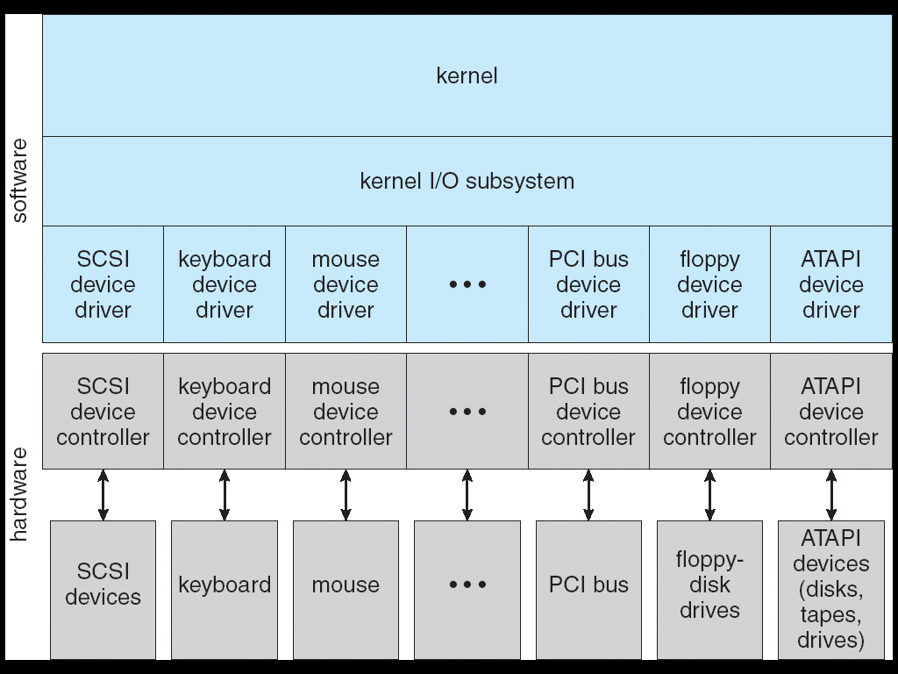
A Kernel I/O Structure
Notes:
ATAPI → Advanced Technology Attachment Packet Interface

Slide 19
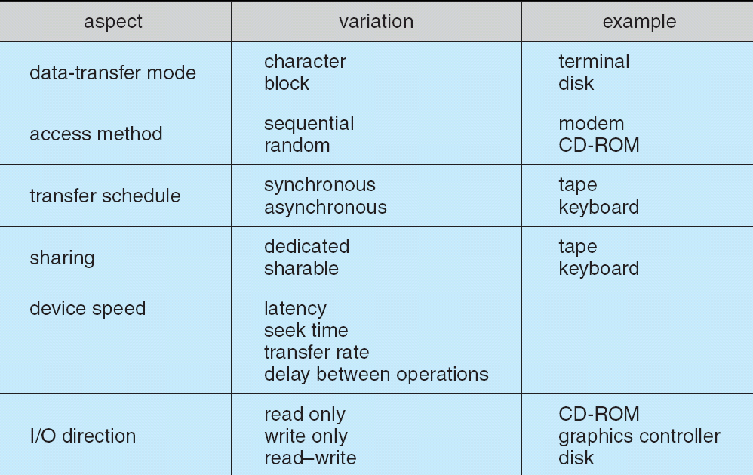
Characteristics of I/O Devices

Slide 20
Kernel I/O Subsystem
Kernel provides many services related to I/O like
I/O Scheduling
To schedule a set of I/O requests means to determine a good order in which to execute them.
The order in which applications issue system calls rarely is the best choice.
Scheduling can improve the overall system performance.
When a kernel supports asynchronous I/O
it must be able to keep track of many I/O requests at the same time.
For this purpose → OS might attach the wait queue to a device-status table.
Kernel manages this table
which contains an entry for each I/O device
Buffering
is a memory area that stores data being transferred between two devices or between a device and an application
is done for different reasons
To cope with device speed mismatch
To cope with devices having different data-transfer sizes

Slide 21
Figure: Device Status Table

Slide 22
Kernel I/O Subsystem
Caching
is a region of fast memory that holds the copy of data.
Access to cached copy is more efficient than access to original
For instance → the instructions of the currently running process are
stored on disk
cached in physical memory and
copied again in the CPU’s secondary and primary caches
Difference between a buffer and a cache is
Buffer → holds only the existing copy of a data item
Cache → holds a copy on faster storage of an item that resides elsewhere.
Caching and buffering are distinct functions, but sometimes a region of memory can be used for both purposes.

Slide 23
Kernel I/O Subsystem
Spooling
hold output for a device
a device can serve only one request at a time i.e., Printing
In some OS’s
spooling is managed by a system daemon process.
In others, it is handled by an in-kernel thread
In either case
OS provides a control interface that enables users and system administrators to
display the queue
remove unwanted jobs before those jobs print
suspend printing while the printer is serviced, and so on.
Device reservation
Another way to deal with concurrent device access → to provide explicit facilities for coordination.
Some operating systems provide support for exclusive device access by enabling a process to
allocate an idle device and
deallocate that device when it is no longer needed.

Slide 24
Kernel I/O Subsystem
Error Handling
OS can recover from disk read, device unavailable, transient write failures
Most return an error number or code when I/O request fails
System error logs hold problem reports

Slide 25
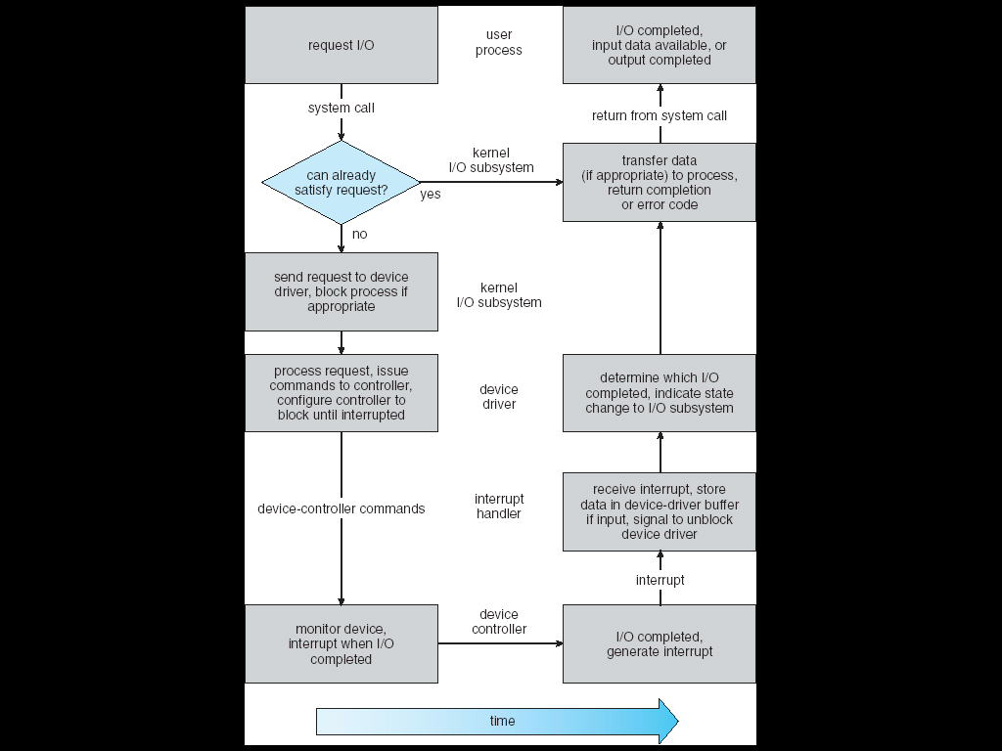
Life Cycle of An I/O Request (for your reference)

Slide 26
Protection and Goals of Protection
Protection → refers to a mechanism for controlling the access of the
Programs
Processes or
Users
to the resources defined by a computer system.
Goals of protection are:
Protection → needed to prevent the misuse of an application or a resource.
Using protection → improve reliability by detecting latent errors at the interfaces between component subsystem.
Protection → needed to prevent the mischievous and intentional violations of access restrictions by a user.
Protection → prevent contamination of the healthy subsystem by a malfunctioning subsystem.

Slide 27
Principles of Protection
Main principle of protection is
Need-To-Know principle or the principle of least privilege
means the Programs, users and systems should be given just enough privileges to perform their tasks.
Managing users with the principle of least privilege entails
creating a separate account for each user, with just the privileges that the user needs.
The principle of least privilege can help produce a more secure computing environment.

Slide 28
Domain of Protection
OS consists → collection of objects(like hardware, software).
Hardware objects
CPU, memory segments, printers, disks & tape drives.
Software objects
files, programs, semaphores.
Each object has a unique name
can be accessed through a well-defined set of operations that may depend on the object.
For example
a CPU can only be executed
memory segment can be used to read and write
DVD ROM can be used as read-only, etc…
A process should be allowed to access only those resources for which it has authorization.
Domain is defined as
set of access-rights each of which → an ordered pair
<object-name , rights-set>
Example: <file F, {read,write}>

Slide 29
Domain of Protection
A domain can be realized in a variety of ways:
Each user may be a domain
the set of objects that can be accessed depends on the identity of the user.
Domain switching occurs when the user is changed—generally when one user logs out and another user logs in.
Each process may be a domain
the set of objects that can be accessed depends on the identity of the process.
Domain switching occurs when one process sends a message to another process and then waits for a response.
Each procedure may be a domain
the set of objects that can be accessed corresponds to the local variables defined within the procedure.
Domain switching occurs when a procedure call is made.

Slide 30
Domain structure

Slide 31
Access Matrix
General model of protection → can be viewed abstractly → as a matrix, called as access matrix
contains access permissions for the users or programs or process (objects) within their domain.
Access-right is represented as <object-name, rights-set>
rights-set → a subset of all valid operations that can be performed on the object
Rows → domain, Columns → objects.
Access(i, j) → set of operations that a process executing in Domain_{i} can invoke on Object_{j} (Figure: Access Matrix) (4 domains 4 objects 3 files 1 printer)
process executing in domain D1 can read files F1 and F3.
process executing in domain D4 has the same privileges as one executing in domain D1; but in addition, it can also write onto files F1 and F3.
printer can be accessed only by a process executing in domain D2.
scheme provides us with the mechanism for specifying a variety of policies.
we must ensure that a process executing in domain D_{i} can access only those objects specified in row i, and then only as allowed by the access-matrix entries.

Slide 32
Access Matrix

Slide 33
Access Matrix
Processes → able to switch from one domain to another. (Figure)
Switching from domain D_{i} to domain D_{j} is allowed
if and only if the access right switch ∈ access(i, j).
Allowing controlled change in the contents of the access-matrix entries requires three additional operations
Copy right
ability to copy an access right from one domain (or row) of the access matrix to another is denoted by an asterisk (*) appended to the access right.
copy right allows the access right to be copied only within the column for which (object) the right is defined.
Owner right
a mechanism to allow addition of new rights and removal of some rights
copy and owner rights allow a process to change the entries in a column.
Control right
mechanism also needed to change the entries in a row.
control right is applicable only to domain objects.

Slide 34
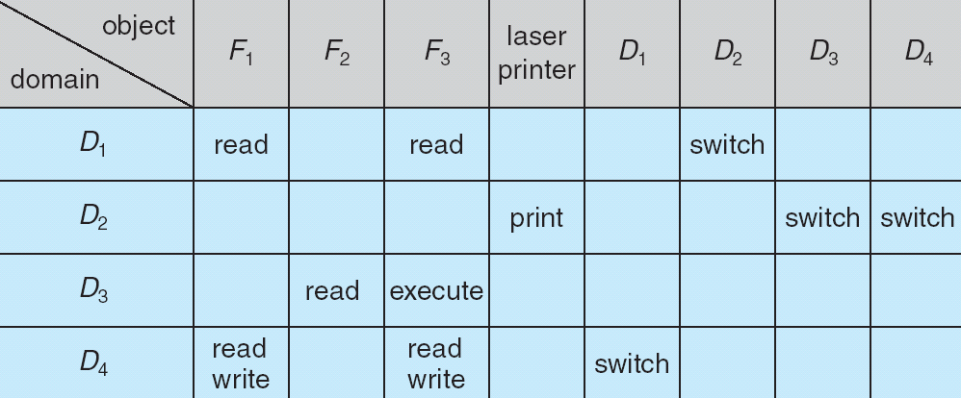
Access Matrix With Domain switching

Slide 35
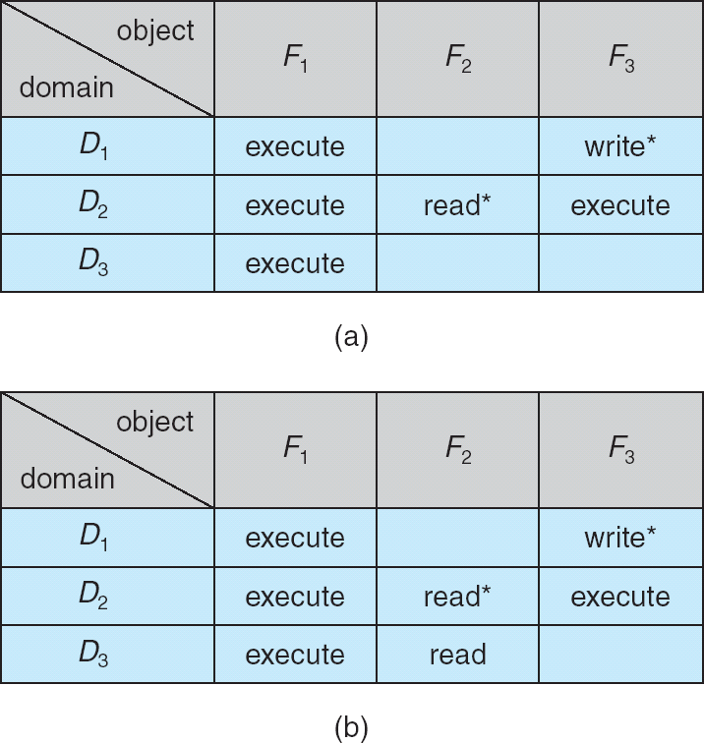
Access Matrix with Copy Rights

Slide 36
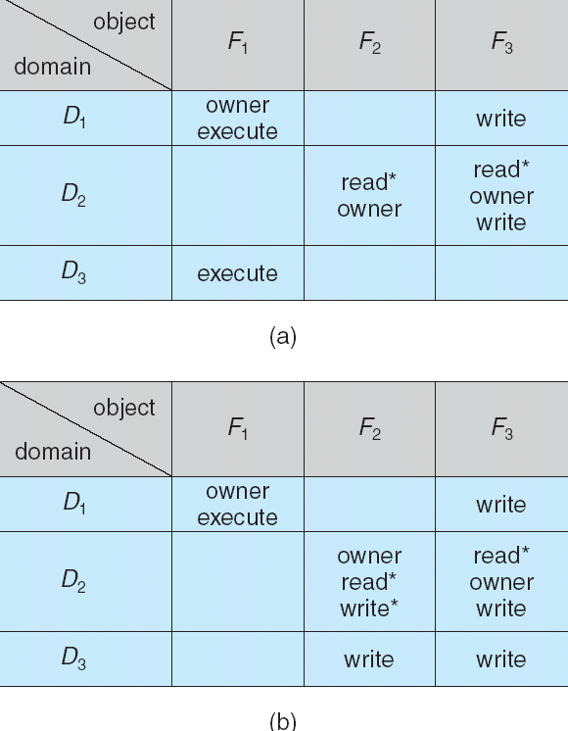
Access Matrix With Owner Rights

Slide 37
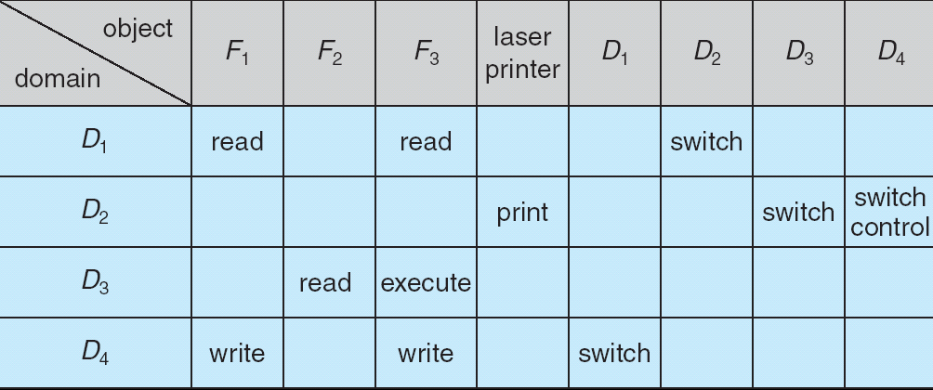
Access Matrix Control Rights

Slide 38
Implementation of Access Matrix
several methods → implement the access matrix
Global Table
simplest implementation of the access matrix
Consisting of a set of ordered triples <domain, object, rights-set>
Whenever an operation M is executed on an object O_{j} within domain D_{i}
is searched for a triple <D_{i} , O_{j} , R_{k}>, with M ∈ R_{k}
found → operation is allowed to continue
Otherwise → exception (or error) condition → raised
Drawbacks:
table → large → cannot be kept in main memory

Slide 39
Implementation of Access Matrix
Access Lists for Objects
Each column in access matrix → implemented as access list for one object
empty entries → discarded
resulting list for each object consists of ordered pairs <domain, rights-set>
define all domains with a nonempty set of access rights for that object
When an operation M on an object O_{j} is attempted in domain D_{i}
search the access list for object O_{j} , looking for an entry <Di , Rk> with M ∈ Rk
Found → allow this operation
Otherwise → check default set

Slide 40
Implementation of Access Matrix
Capability Lists for Domains
Rather than associating the columns of the access matrix with the objects as access lists
We can associate each row with its domain
capability list for a domain → a list of objects together with the operations allowed on those objects
object → often represented by its physical name or address, called a capability
Capability list is associated with a domain but it is never directly accessible to a process executing in that domain.
Rather → capability list is itself a protected object, maintained by OS & accessed by the user only indirectly

Slide 41
Implementation of Access Matrix
A Lock–Key Mechanism
Lock – Key scheme
a compromise between access lists and capability lists
Each
object has a list of unique bit patterns, called locks.
domain has a list of unique bit patterns, called keys.
A process executing in a domain
can access an object only
if that domain has a key that matches one of the locks of the object

Slide 42
Access Control
Each file and directory is assigned
an owner, a group, or possibly a list of users
for each of those entities, access-control information → assigned.
Protection can be applied to non-file resources
Solaris 10 provides role-based access control (RBAC) by implementing least privilege
Privilege
Is a right to execute system call or
to use an option within a system call (opening file with write access)
Can be assigned to processes limiting them exactly the access they need to perform their work
Privileges and programs can also be assigned to roles.
Users are assigned roles or can take roles based on passwords to the roles.

Slide 43
Role-based Access Control in Solaris 10

Slide 44
Revocation of Access Rights
In a dynamic protection system
we may sometimes need to revoke access rights to objects shared by different users.
Various questions about revocation may arise:
Immediate versus delayed
Does revocation occur immediately, or is it delayed?
Selective versus general
When an access right to an object is revoked,
does it affect all the users who have an access right to that object, or can we specify a select group of users whose access rights should be revoked?

Slide 45
Revocation of Access Rights
Partial versus total
Can a subset of the rights associated with an object be revoked, or must we revoke all access rights for this object?
Temporary versus permanent
Can access be revoked permanently (i.e. revoked access right will never again be available), or can access be revoked and later be obtained again?
With an access-list scheme, revocation is easy.
The access list is searched for any access rights to be revoked, and they are deleted from the list.
Capabilities, however, present a much more difficult revocation problem
Since the capabilities are distributed throughout the system
we must find them before we can revoke them

Slide 46
Revocation of Access Rights
Schemes that implement revocation for capabilities include the following:
Reacquisition
Periodically, capabilities are deleted from each domain.
If a process wants to use a capability, it may find that that capability has been deleted.
The process may then try to reacquire the capability. If access has been revoked, the process will not be able to reacquire the capability.
Back-pointers
A list of pointers is maintained with each object, pointing to all capabilities associated with that object.
When revocation is required, we can follow these pointers, changing the capabilities as necessary.

Slide 47
Revocation of Access Rights
Indirection
Capabilities point indirectly, not directly, to the objects.
Each capability points to a unique entry in a global table, which in turn points to the object.
Key
a unique bit pattern that can be associated with a capability.
is defined when the capability is created, and it can be neither modified nor inspected by the process that owns the capability
key-based schemes → the operations of defining keys, inserting them into lists, and deleting them from lists should not be available to all users.

