Slide 1
UNIT-II
REQUIREMENTS ENGINEERING AND MODELING
By
Mr. T. M. Jaya Krishna _{M.Tech}

Slide 2
Requirements Engineering

Slide 3
Requirements Engineering (RE)
Requirements ← a system r the descriptions = what
system should do
services that it provides &
constraints on its operation.
These requirements reflect the needs = customers ← system that serves a certain purpose such as
Controlling a device,
Placing an order or
finding information
The process = finding out, analyzing, documenting & checking these services & constraints is called RE.
Notes:
The requirements for a system are the descriptions of what the system should do – the services that it provides and the constraints on its operation. These requirements reflect the needs of customers for a system that serves a certain purpose such as controlling a device, placing an order, or finding information. The process of finding out, analyzing, documenting and checking these services and constraints is called Requirements Engineering (RE).
The term ‘requirement’ is not used consistently in the software industry. In some cases, a requirement is simply a high-level, abstract statement of a service that a system should provide or a constraint on a system. At the other extreme, it is a detailed, formal definition of a system function.

Slide 4
Requirements Engineering (RE)
Problems that arise during RE process r:
User requirements r statements, in a natural language plus diagrams, = what services the system is expected → provide → system users & the constraints under which it must operate.
System requirements r more detailed descriptions = the s/w system’s functions, services, and operational constraints.
This document (sometimes called a functional specification) should define exactly what - - → be implemented.
It may be part = the contract between the system buyer & the s/w developers.
Notes:
Some of the problems that arise during the requirements engineering process are a result of failing to make a clear separation between these different levels of description. I distinguish between them by using the term ‘user requirements’ to mean the high-level abstract requirements and ‘system requirements’ to mean the detailed description of what the system should do. User requirements and system requirements may be defined as follows:
User requirements are statements, in a natural language plus diagrams, of what services the system is expected to provide to system users and the constraints under which it must operate.
System requirements are more detailed descriptions of the software system’s functions, services, and operational constraints. The system requirements document (sometimes called a functional specification) should define exactly what is to be implemented. It may be part of the contract between the system buyer and the software developers.

Slide 5
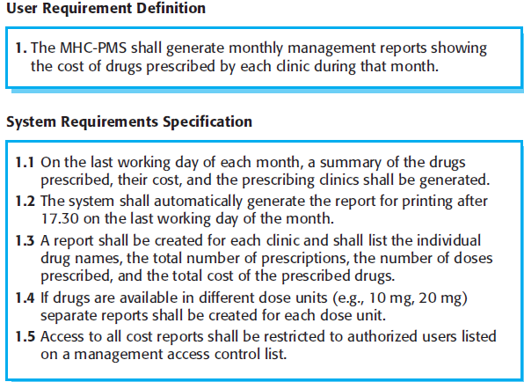
Requirements Engineering (RE)
Different levels = requirements r useful
Reason?
they communicate information about the system → different types = reader
Figure illustrates the distinction between user & system requirements.
This example ➔ a mental health care patient management system (MHC-PMS) shows how a user requirement may be expanded in → several system requirements.
Notes:
Different levels of requirements are useful because they communicate information about the system to different types of reader.
Figure above illustrates the distinction between user and system requirements. This example from a mental health care patient management system (MHC-PMS) shows how a user requirement may be expanded into several system requirements.

Slide 6
Functional & non-functional requirements
Functional requirements:
statements = services the system should
provide
react → particular i/p’s &
behave in particular situations
Non-Functional requirements:
constraints on the services | functions offered by the system. They include
timing constraints
constraints on the development process &
constraints imposed by standards.
Notes:
Software system requirements are often classified as functional requirements or nonfunctional requirements:
Functional requirements: These are statements of services the system should provide, how the system should react to particular inputs, and how the system should behave in particular situations. In some cases, the functional requirements may also explicitly state what the system should not do.
Non-functional requirements: These are constraints on the services or functions offered by the system. They include timing constraints, constraints on the development process, and constraints imposed by standards. Non-functional requirements often apply to the system as a whole, rather than individual system features or services.

Slide 7
Functional & non-functional requirements Functional Requirements
Describe what the system should do.
These depend on the
type = s/w being developed
expected users = s/w &
general approach taken by the organization when writing requirements.
When expressed as user requirements?
These r described in an abstract way
Notes:
The functional requirements for a system describe what the system should do. These requirements depend on the type of software being developed, the expected users of the software, and the general approach taken by the organization when writing requirements. When expressed as user requirements, functional requirements are usually described in an abstract way that can be understood by system users. However, more specific functional system requirements describe the system functions, its inputs and outputs, exceptions, etc., in detail.
Functional system requirements vary from general requirements covering what the system should do to very specific requirements reflecting local ways of working or an organization’s existing systems. For example, here are examples of functional requirements for the MHC-PMS system, used to maintain information about patients receiving treatment for mental health problems:
1. A user shall be able to search the appointments lists for all clinics.
2. The system shall generate each day, for each clinic, a list of patients who are expected to attend appointments that day.
3. Each staff member using the system shall be uniquely identified by his or her eight-digit employee number.
These functional user requirements define specific facilities to be provided by the system. These have been taken from the user requirements document and they show that functional requirements may be written at different levels of detail.

Slide 8
Functional & non-functional requirements Non-Functional Requirements
requirements that r not directly concerned w→ the specific services delivered by the system → its users.
They may relate → emergent system properties:
reliability
response time &
store occupancy
Non-functional requirements like:
performance
security or
availability
usually specify or constrain characteristics = the system as a whole cont.
Notes:
Non-functional requirements, as the name suggests, are requirements that are not directly concerned with the specific services delivered by the system to its users. They may relate to emergent system properties such as reliability, response time, and store occupancy. Alternatively, they may define constraints on the system implementation such as the capabilities of I/O devices or the data representations used in interfaces with other systems.
cont. Non-functional requirements, such as performance, security, or availability, usually specify or constrain (meaning compel or force or contain) characteristics of the system as a whole. Non-functional requirements are often more critical than individual functional requirements.
System users can usually find ways to work around a system function that doesn’t really meet their needs. However, failing to meet a non-functional requirement can mean that the whole system is unusable. For example, if an aircraft system does not meet its reliability requirements, it will not be certified as safe for operation; if an embedded control system fails to meet its performance requirements, the control functions will not operate correctly.
Although it is often possible to identify which system components implement specific functional requirements, it is often more difficult to relate components to non-functional requirements. The implementation of these requirements may be diffused (meaning scatter or spread or distributed) throughout the system.
There are two reasons for this:
Non-functional requirements may affect the overall architecture of a system rather than the individual components.
A single non-functional requirement, such as a security requirement, may generate a number of related functional requirements that define new system services that are required. In addition, it may also generate requirements that restrict existing requirements.

Slide 9
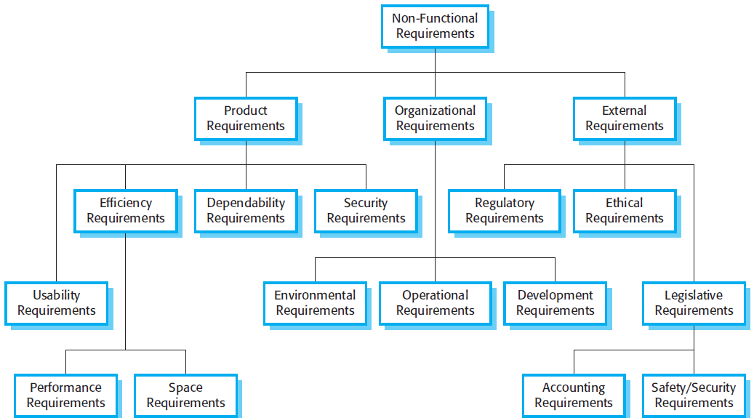
Functional & non-functional requirements Non-Functional Requirements
Non functional requirements arise thru user needs (reason)
Budget constraints, Organizational policies
Need ← interoperability w→ other s/w | h/w systems or
External factors
Fig: shows classification = non-functional requirements
Notes:
Non-functional requirements arise through user needs, because of budget constraints, organizational policies, the need for interoperability with other software or hardware systems, or external factors such as safety regulations or privacy legislation. Figure above is a classification of non-functional requirements.
Product requirements: These requirements specify the behavior of the software.
Organizational requirements: These requirements are broad system requirements derived from policies and procedures in the customer’s and developer’s organization.
External requirements: This broad heading covers all requirements that are derived from factors external to the system and its development process.

Slide 10
The software requirements document
Also called SRS
It - - an official stmt = what the system developers should implement
It should +de both the user requirements ← system and a detailed specification = system requirements.
Sometimes, the user & system requirements r integrated → a single description.
In other cases, the user requirements r defined in an introduction → the system requirements specification.
If there r a large no. = requirements, the detailed system requirements may be presented in a separate document.
Notes:
The software requirements document (sometimes called the software requirements specification or SRS) is an official statement of what the system developers should implement. It should include both the user requirements for a system and a detailed specification of the system requirements. Sometimes, the user and system requirements are integrated into a single description. In other cases, the user requirements are defined in an introduction to the system requirements specification. If there are a large number of requirements, the detailed system requirements may be presented in a separate document.
Note: Requirements documents are essential when an outside contractor is developing the software system.
However, agile development methods argue that requirements change so rapidly that a requirements document is out of date as soon as it is written, so the effort is largely wasted. Rather than a formal document, approaches such as Extreme Programming collect user requirements incrementally and write these on cards as user stories. The user then prioritizes requirements for implementation in the next increment of the system.
For business systems where requirements are unstable, I think that this approach is a good one. However, I think that it is still useful to write a short supporting document that defines the business and dependability requirements for the system; it is easy to forget the requirements that apply to the system as a whole when focusing on the functional requirements for the next system release.

Slide 11
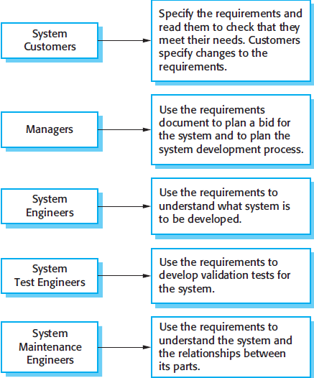
The software requirements document
It has diverse set = users, ranging ➔ the senior management = organization i.e. paying ← the system → engineers responsible ← developing the s/w.
Figure shows possible users = document & how they use it.
Notes:
The requirements document has a diverse set of users, ranging from the senior management of the organization that is paying for the system to the engineers responsible for developing the software. Figure above shows possible users of the document and how they use it.

Slide 12
Requirements specification
It - - process = writing down the user and system requirements in a requirements document.
It should be
clear, unambiguous, easy →understand, complete, & consistent.
In practice it - - difficult → achieve cont.
Notes:
Requirements specification is the process of writing down the user and system requirements in a requirements document. Ideally, the user and system requirements should be clear, unambiguous, easy to understand, complete, and consistent.
cont. In practice, this is difficult to achieve as stakeholders interpret the requirements in different ways and there are often inherent conflicts and inconsistencies in the requirements.
The user requirements for a system should describe the functional and nonfunctional requirements so that they are understandable by system users who don’t have detailed technical knowledge. Ideally, they should specify only the external behavior of the system.
The requirements document should not include details of the system architecture or design. Consequently, if you are writing user requirements, you should not use software jargon, structured notations, or formal notations. You should write user requirements in natural language, with simple tables, forms, and intuitive diagrams.
System requirements are expanded versions of the user requirements that are used by software engineers as the starting point for the system design.
They add detail and explain how the user requirements should be provided by the system. They may be used as part of the contract for the implementation of the system and should therefore be a complete and detailed specification of the whole system.
Ideally, the system requirements should simply describe the external behavior of the system and its operational constraints. They should not be concerned with how the system should be designed or implemented.

Slide 13
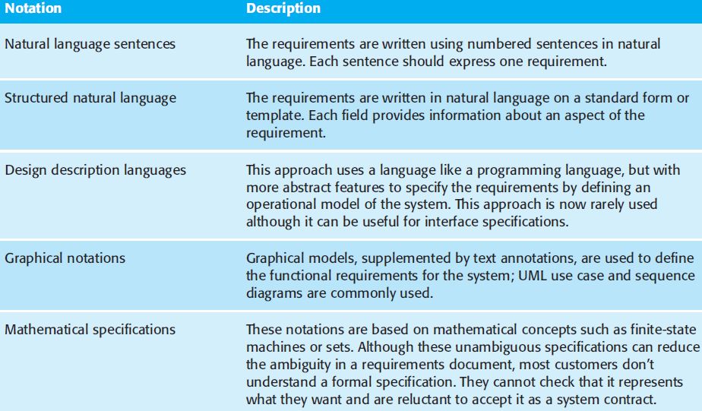
Requirements specification
Notes:
User requirements are almost always written in natural language supplemented by appropriate diagrams and tables in the requirements document. System
requirements may also be written in natural language but other notations based on forms, graphical system models, or mathematical system models can also be used. Figure above summarizes the possible notations that could be used for writing system requirements.
Graphical models are most useful when you need to show how a state changes or when you need to describe a sequence of actions. UML sequence charts and state charts, show the sequence of actions that occur in response to a certain message or event. Formal mathematical specifications are sometimes used to describe the requirements for safety- or security-critical systems, but are rarely used in other circumstances.

Slide 14
Requirements engineering processes
may include 4 high-level activities focus on assessing:
Feasibility study
System - - useful → business?
Elicitation & analysis
discovering requirements
Specification
Converting these → some standard form
Validation
Requirements engineering - - an iterative process
activities r interleaved
Notes:
Requirements engineering processes may include four high-level activities. These focus on assessing if the system is useful to the business (feasibility study), discovering requirements (elicitation and analysis), converting these requirements into some standard form (specification), and checking that the requirements actually define the system that the customer wants (validation).
Requirements engineering is an iterative process in which the activities are interleaved (meaning insert or between the pages of book).

Slide 15
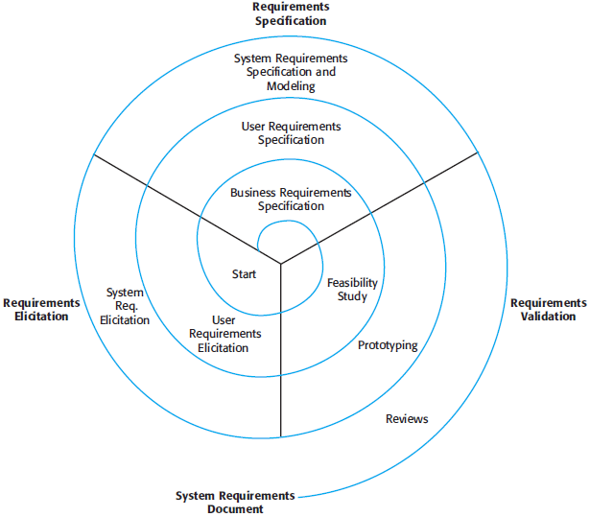
Requirements engineering processes
Figure shows this interleaving
Activities organized
Iterative process around spiral
o/p - - system requirements document
Figure: A spiral view of the requirements engineering process
Notes:
The activities are organized as an iterative process around a spiral, with the output being a system requirements document. The amount of time and effort devoted to each activity in each iteration depends on the stage of the overall process and the type of system being developed.
Early in the process, most effort will be spent on understanding high-level business and non-functional requirements, and the user requirements for the system.
Later in the process, in the outer rings of the spiral, more effort will be devoted (meaning dedicated) to eliciting (meaning obtaining) and understanding the detailed system requirements.
The number of iterations around the spiral can vary so the spiral can be exited after some or all of the user requirements have been obtained. Agile development can be used instead of prototyping so that the requirements and the system implementation are developed together.
Some people consider requirements engineering to be the process of applying a structured analysis method, such as object-oriented analysis. This involves analyzing the system and developing a set of graphical system models, such as use case models, which then serve as a system specification.
The set of models describes the behavior of the system and is annotated with additional information describing, for example, the system’s required performance or reliability.

Slide 16
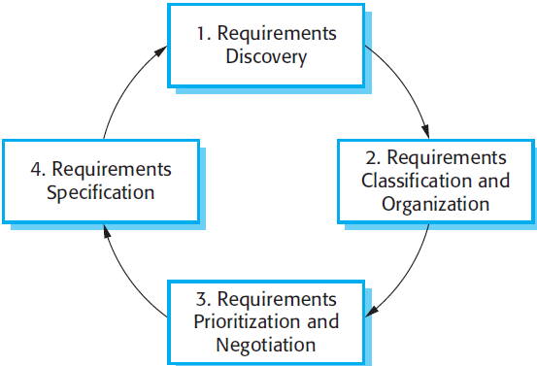
Requirements elicitation and analysis
In this activity
S/W Engg.’s work w→ customers & system end-users
find out about the application domain
what services the system should provide
required performance of the system
hardware constraints, and so on.
Requirements elicitation
May involve diff kinds = people in an organization
System stakeholder – direct | indirect influence on system requirements
Stakeholders +de
End users
Engineers developing other related systems
Business managers
Domain experts
Trade union representatives etc..
Notes:
In this activity, software engineers work with customers and system end-users to find out about the application domain, what services the system should provide, the required performance of the system, hardware constraints, and so on.
+de include
Requirements elicitation and analysis may involve a variety of different kinds of people in an organization. A system stakeholder is anyone who should have some direct or indirect influence on the system requirements.
Stakeholders include end users who will interact with the system and anyone else in an organization who will be affected by it. Other system stakeholders might be engineers who are developing or maintaining other related systems, business managers, domain experts, and trade union representatives. A process model of the elicitation and analysis process is shown in Figure above.
Each organization will have its own version or instantiation of this general model depending on local factors such as the expertise of the staff, the type of system being developed, the standards used, etc.

Slide 17
Requirements elicitation and analysis
Process activities r:
Requirements discovery
Requirements classification & organization
Requirements prioritization & negotiation
Requirements specification
figure shows
Requirement elicitation & analysis - - an iterative process. Cont.
Notes:
The process activities are:
Requirements discovery – This is the process of interacting with stakeholders of the system to discover their requirements. Domain requirements from stakeholders and documentation are also discovered during this activity.
Requirements classification and organization – This activity takes the unstructured collection of requirements, groups related requirements, and organizes them into coherent clusters.
Requirements prioritization and negotiation – This activity is concerned with prioritizing requirements and finding and resolving requirements conflicts through negotiation.
Requirements specification – The requirements are documented and input into the next round of the spiral. Formal or informal requirements documents may be produced.
Cont. Figure above shows that requirements elicitation and analysis is an iterative process with continual feedback from each activity to other activities. The process cycle starts with requirements discovery and ends with the requirements documentation. The analyst’s understanding of the requirements improves with each round of the cycle. The cycle ends when the requirements document is complete.

Slide 18
Requirements elicitation and analysis
Eliciting & understanding requirements ➔ system stakeholders - - a difficult process ← several reasons:
Stakeholders often don’t know what they want ➔ a computer system
Stakeholders express requirements in their own terms.
Different stakeholders have different requirements & they may express these in different ways. Cont.
Notes:
Eliciting and understanding requirements from system stakeholders is a difficult process for several reasons:
Stakeholders often don’t know what they want from a computer system except in the most general terms; they may find it difficult to articulate what they want the system to do; they may make unrealistic demands because they don’t know what is and isn’t feasible.
Stakeholders in a system naturally express requirements in their own terms and with implicit knowledge of their own work. Requirements engineers, without experience in the customer’s domain, may not understand these requirements.
Different stakeholders have different requirements and they may express these in different ways. Requirements engineers have to discover all potential sources of requirements and discover commonalities and conflict.
Cont.
Political factors may influence the requirements of a system. Managers may demand specific system requirements because these will allow them to increase their influence in the organization.
The economic and business environment in which the analysis takes place is dynamic. It inevitably changes during the analysis process. The importance of particular requirements may change. New requirements may emerge from new stakeholders who were not originally consulted.
It is impossible to completely satisfy every stakeholder but if some stakeholders feel that their views have not been properly considered then they may deliberately attempt to undermine (meaning weaken) the RE process.

Slide 19
Requirements elicitation and analysis
Eliciting & understanding requirements ➔ system stakeholders - - a difficult process ← several reasons:
Stakeholders often don’t know what they want ➔ a computer system
Stakeholders express requirements in their own terms.
Different stakeholders have different requirements & they may express these in different ways. Cont.
Notes:
At the requirements specification stage, the requirements that have been elicited so far are documented in such a way that they can be used to help with requirements discovery. At this stage, an early version of the system requirements document may be produced with missing sections and incomplete requirements.
Alternatively, the requirements may be documented in a completely different way (e.g., in a spreadsheet or on cards). Writing requirements on cards can be very effective as these are easy for stakeholders to handle, change, and organize.

Slide 20
Requirements elicitation and analysis Requirements Discovery
sometime called requirements elicitation
It - - process = gathering info.
Sources = info. during requirements discovery r:
Documentation
System stake holders
Range ➔ end-users = system thru managers → external stakeholders
specifications = similar systems
Notes:
➔ from
Requirements discovery (sometime called requirements elicitation) is the process of gathering information about the required system and existing systems, and distilling the user and system requirements from this information.
Sources of information during the requirements discovery phase include documentation, system stakeholders, and specifications of similar systems. You interact with stakeholders through interviews and observation and you may use scenarios and prototypes to help stakeholders understand what the system will be like.
Stakeholders range from end-users of a system through managers to external stakeholders such as regulators, who certify the acceptability of the system. For example, system stakeholders for the mental healthcare patient information system include:
1. Patients whose information is recorded in the system.
2. Doctors who are responsible for assessing and treating patients.
3. Nurses who coordinate the consultations with doctors and administer some treatments.
4. Medical receptionists who manage patients’ appointments. etc. .

Slide 21
Requirements elicitation and analysis Interviewing
Formal | Informal interviews
Part = most RE process
Two types:
Closed interviews
Open interviews
Are good ← getting an overall understanding = what stake holders do cont.
Notes:
Formal or informal interviews with system stakeholders are part of most Requirements Engineering (RE) processes. In these interviews, requirements engineering team puts questions to stakeholders about the system that they currently use and the system to be developed. Requirements are derived from the answers to these questions. Interviews may be of two types:
Closed interviews, where the stakeholder answers a pre-defined set of questions.
Open interviews, in which there is no pre-defined agenda. The requirements engineering team explores a range of issues with system stakeholders and hence develop a better understanding of their needs.
cont. Interviews are good for getting an overall understanding of what stakeholders do, how they might interact with the new system, and the difficulties that they face with current systems.
However, interviews are not so helpful in understanding the requirements from the application domain. It can be difficult to elicit domain knowledge through interviews for two reasons:
All application specialists use terminology and jargon that are specific to a domain. It is impossible for them to discuss domain requirements without using this terminology. They normally use terminology in a precise and subtle way that is easy for requirements engineers to misunderstand.
Some domain knowledge is so familiar to stakeholders that they either find it difficult to explain or they think it is so fundamental that it isn’t worth mentioning.
Effective interviewers have two characteristics:
They are open-minded, avoid pre-conceived ideas about the requirements, and are willing to listen to stakeholders. If the stakeholder comes up with surprising requirements, then they are willing to change their mind about the system.
They prompt the interviewee to get discussions going using a springboard question, a requirements proposal, or by working together on a prototype system. Saying to people ‘tell me what you want’ is unlikely to result in useful information. They find it much easier to talk in a defined context rather than in general terms.

Slide 22
Requirements elicitation and analysis Scenarios
People usually find it easier → relate → real-life examples ↔ abstract descriptions
Can understand & criticize a scenario
RE gained ➔ this discussion → formulate actual system requirements.
Scenarios c→ particularly useful ← adding detail → an outline requirements description.
It starts w→ an outline = interaction.
Notes:
↔ rather than
People usually find it easier to relate to real-life examples rather than abstract descriptions. They can understand and criticize a scenario of how they might interact with a software system. Requirements engineers can use the information gained from this discussion to formulate the actual system requirements.
Scenarios can be particularly useful for adding detail to an outline requirements description. They are descriptions of example interaction sessions. Different forms of scenarios are developed and they provide different types of information at different levels of detail about the system.
A scenario starts with an outline of the interaction. During the elicitation process, details are added to this to create a complete description of that interaction. At its most general, a scenario may include:
A description of what the system and users expects when the scenario starts.
A description of the normal flow of events in the scenario.
A description of what can go wrong and how this is handled.
Information about other activities that might be going on at the same time.
A description of the system state when the scenario finishes.
Scenario-based elicitation involves working with stakeholders to identify scenarios and to capture details to be included in these scenarios. Scenarios may be written as text, supplemented by diagrams, screen shots, etc. Alternatively, a more structured approach such as event scenarios or use cases may be used.

Slide 23
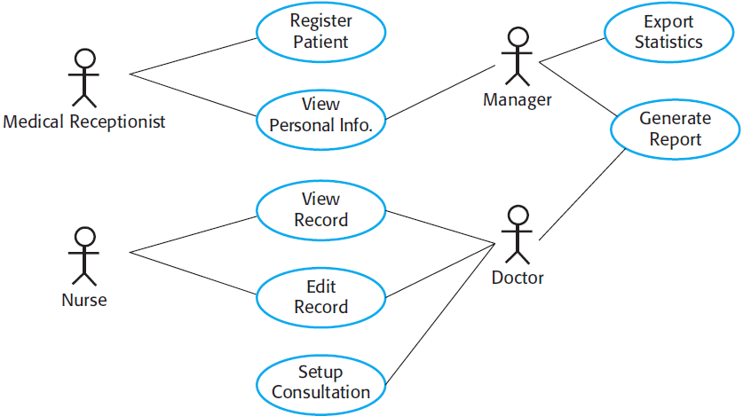
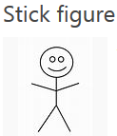
Requirements elicitation and analysis Use Cases
It identifies
Actors involved in an interaction & names the type = interaction
These
r documented using a high-level use case diagram illustrated in figure:
Notes:
Use cases are a requirements discovery technique that were first introduced in the Objectory method. They have now become a fundamental feature of the unified modeling language.
In their simplest form, a use case identifies the actors involved in an interaction and names the type of interaction. This is then supplemented by additional information describing the interaction with the system.
The additional information may be a textual description or one or more graphical models such as UML sequence or state charts. Use cases are documented using a high-level use case diagram. The set of use cases represents all of the possible interactions that will be described in the system requirements.
Actors in the process, who may be human or other systems, are represented as stick figures. Each class of interaction is represented as a named ellipse.
Lines link the actors with the interaction. Optionally, arrowheads may be added to lines to show how the interaction is initiated. This is illustrated in Figure above, which shows some of the use cases for the patient information system.

Slide 24
Requirements elicitation and analysis Ethnography
an observational technique
→ understand operational processes
→ help derive support requirements ← these processes.
- - particularly effective ← discovering 2 types = requirements:
Cont.
c→ combined w→ prototyping as shown in figure:
Notes:
Ethnography (meaning is the systematic study of people and cultures). ← for = of → to c→ can be w→ with
Ethnography is an observational technique that can be used to understand operational processes and help derive support requirements for these processes. An analyst immerses himself or herself in the working environment where the system will be used. The day-to-day work is observed and notes made of the actual tasks in which participants are involved.
The value of ethnography is that it helps discover implicit system requirements that reflect the actual ways that people work, rather than the formal processes defined by the organization.
People often find it very difficult to articulate details of their work because it is second nature to them. They understand their own work but may not understand its relationship to other work in the organization. Social and organizational factors that affect the work, but which are not obvious to individuals, may only become clear when noticed by an unbiased observer.
Ethnography is particularly effective for discovering two types of requirements: (Cont.)
Requirements that are derived from the way in which people actually work, rather than the way in which process definitions say they ought to work.
Requirements that are derived from cooperation and awareness of other people’s activities.
Ethnography can be combined with prototyping as shown in figure above.

Slide 25
Requirements validation
It - - process = checking that requirements actually define the system
It - - important
Reason?
errors in a requirements document can lead → extensive rework costs wn? these problems r discovered Cont.
The cost = fixing these problem by making a system change - - usually much >than repairing design | coding errors.
During requirements validation
Different types checks:
Validity checks
Consistency checks
Completeness checks
Realism checks
Verifiability
Notes:
Requirements validation is the process of checking that requirements actually define the system that the customer really wants. It overlaps with analysis as it is concerned with finding problems with the requirements.
Cont. Requirements validation is important because errors in a requirements document can lead to extensive rework costs when these problems are discovered during development or after the system is in service.
The cost of fixing a requirements problem by making a system change is usually much greater than repairing design or coding errors. The reason for this is that a change to the requirements usually means that the system design and implementation must also be changed. Furthermore the system must then be re-tested.
During the requirements validation process, different types of checks should be carried out on the requirements in the requirements document. These checks include:
Validity checks: A user may think that a system is needed to perform certain functions. However, further thought and analysis may identify additional or different functions that are required.
Consistency checks: Requirements in the document should not conflict.
Completeness checks: The requirements document should include requirements that define all functions and the constraints intended by the system user.
Realism checks: Using knowledge of existing technology, the requirements should be checked to ensure that they can actually be implemented.
Verifiability: To reduce the potential for dispute between customer and contractor, system requirements should always be written so that they are verifiable.

Slide 26
Requirements validation
Validation Techniques:
Requirements reviews
Prototyping
Test-case generation
Notes:
There are a number of requirements validation techniques that can be used individually or in conjunction with one another:
Requirements reviews: The requirements are analyzed systematically by a team of reviewers who check for errors and inconsistencies.
Prototyping: In this approach to validation, an executable model of the system in question is demonstrated to end-users and customers. They can experiment with this model to see if it meets their real needs.
Test-case generation: Requirements should be testable. If the tests for the requirements are devised as part of the validation process, this often reveals requirements problems. If a test is difficult or impossible to design, this usually means that the requirements will be difficult to implement and should be reconsidered.

Slide 27
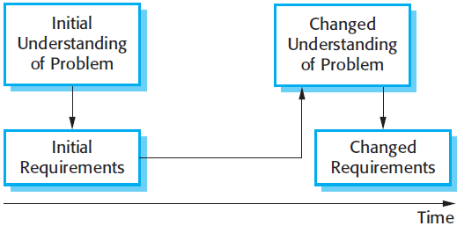
Requirements management
Requirements ← large s/w systems r changing (always)
Reason?
Systems r usually developed → address ‘wicked’ problems.
During s/w process
Stakeholders understanding problem - - constantly changing (figure)
It - - the process = understanding & controlling changes → system requirements
Notes:
The requirements for large software systems are always changing. One reason for this is that these systems are usually developed to address ‘wicked’ (meaning morally wrong) problems—problems that cannot be completely defined. Because the problem cannot be fully defined, the software requirements are bound to be incomplete. During the software process, the stakeholders’ understanding of the problem is constantly changing as shown in figure above. The system requirements must then also evolve to reflect this changed problem view.
Once a system has been installed and is regularly used, new requirements inevitably emerge. It is hard for users and system customers to anticipate what effects the new system will have on their business processes and the way that work is done. Once end-users have experience of a system, they will discover new needs and priorities. There are several reasons why change is inevitable:
The business and technical environment of the system always changes after installation. New hardware may be introduced, it may be necessary to interface the system with other systems etc..
The people who pay for a system and the users of that system are rarely the same people. System customers impose requirements because of organizational and budgetary constraints.
Large systems usually have a diverse (meaning very different) user community, with many users having different requirements and priorities that may be conflicting or contradictory.
Requirements management is the process of understanding and controlling changes to system requirements.

Slide 28
Requirements management Requirements management planning
Planning
essential stage
Establishes level = requirements management detail i.e. required
During this stage you have → decide on:
Requirements identification
A change management process
Traceability policies
Tool support
Notes:
Requirements management is the process of understanding and controlling changes to system requirements.
You need to keep track of individual requirements and maintain links between dependent requirements so that you can assess the impact of requirements changes. You need to establish a formal process for making change proposals and linking these to system requirements. The formal process of requirements management should start as soon as a draft version of the requirements document is available. However, you should start planning how to manage changing requirements during the requirements elicitation process.
Requirements management planning:
Planning is an essential first stage in the requirements management process. The planning stage establishes the level of requirements management detail that is required. During the requirements management stage, you have to decide on:
Requirements identification: Each requirement must be uniquely identified so that it can be cross-referenced with other requirements and used in traceability assessments.
A change management process: This is the set of activities that assess the impact and cost of changes.
Traceability policies: These policies define the relationships between each requirement and between the requirements and the system design that should be recorded. The traceability policy should also define how these records should be maintained.
Tool support: Requirements management involves the processing of large amounts of information about the requirements. Tools that may be used range from specialist requirements management systems to spreadsheets and simple database systems.

Slide 29
Requirements management Requirements management planning
Needs automated support
s/w tools ← this should be chosen
Tool support for:
Requirements storage
Change management (figure)
Traceability management
Notes:
Requirements management needs automated support and the software tools for this should be chosen during the planning phase. You need tool support for:
Requirements storage: The requirements should be maintained in a secure, managed data store that is accessible to everyone involved in the requirements engineering process.
Change management: The process of change management as shown in figure above is simplified if active tool support is available.
Traceability management: Tool support for traceability allows related requirements to be discovered.
For small systems, it may not be necessary to use specialized requirements management tools.

Slide 30
Requirements management Requirements change management
Principles → change management process:
Problem analysis and change specification
Change analysis and costing
Change implementation
Notes:
There are three principal stages to a change management process:
Problem analysis and change specification: The process starts with an identified requirements problem or, sometimes, with a specific change proposal. During this stage, the problem or the change proposal is analyzed to check that it is valid. This analysis is fed back to the change requestor who may respond with a more specific requirements change proposal, or decide to withdraw the request.
Change analysis and costing: The effect of the proposed change is assessed using traceability information and general knowledge of the system requirements. The cost of making the change is estimated both in terms of modifications to the requirements document and, if appropriate, to the system design and implementation. Once this analysis is completed, a decision is made whether or not to proceed with the requirements change.
Change implementation: The requirements document and, where necessary, the system design and implementation, are modified. You should organize the requirements document so that you can make changes to it without extensive rewriting or reorganization. As with programs, changeability in documents is achieved by minimizing external references and making the document sections as modular as possible. Thus, individual sections can be changed and replaced without affecting other parts of the document.
Agile development processes, such as extreme programming, have been designed to cope with requirements that change during the development process. In these processes, when a user proposes a requirements change, this change does not go through a formal change management process. Rather, the user has to prioritize that change and, if it is high priority, decide what system features that were planned for the next iteration should be dropped.

Slide 31
Requirements Modeling
Data modeling concepts,
Flow-oriented modeling,
Case study on requirements modeling for WebApps

Slide 32
Requirements Modeling
This action results in one or more = the following types = models:
Scenario-based models
Data models
Class-oriented models
Flow-oriented models
Behavioral models
Notes:
The requirements modeling action results in one or more of the following types of models:
Scenario-based models of requirements from the point of view of various system “actors”
Data models that depict the information domain for the problem
Class-oriented models that represent object-oriented classes (attributes and operations) and the manner in which classes collaborate to achieve system requirements
Flow-oriented models that represent the functional elements of the system and how they transform data as it moves through the system
Behavioral models that depict how the software behaves as a consequence of external “events”
These models provide a software designer with information that can be translated to architectural, interface, and component-level designs. Finally, the requirements model (and the software requirements specification) provides the developer and the customer with the means to assess quality once software is built.

Slide 33
DATA MODELING CONCEPTS
If s/w requirements +de the need →
Create,
Extend or
Interface with database
or
If Complex data structures m→ constructed & manipulated
s/w team choose → create data model
A s/w engineer or analyst defines
All data objects (processed within the system)
Relationships b/n them &
Other info. pertinent → it
ERD addresses these issues &
All data objects (entered, stored, transformed, & produced w→ in an application)
Notes:
m→ must be
If software requirements include the need to create, extend, or interface with a database or if complex data structures must be constructed and manipulated, the software team may choose to create a data model as part of overall requirements modeling.
A software engineer or analyst defines all data objects that are processed within the system, the relationships between the data objects, and other information that is pertinent to the relationships.
The entity-relationship diagram (ERD) addresses these issues and represents all data objects that are entered, stored, transformed, and produced within an application.

Slide 34
DATA MODELING CONCEPTS Data Objects
It - - a representation = composite info. that m→ understood by s/w
Composite info.?
No. of different properties or attributes
Width (single value) valid data object
Dimensions (incorporating height, width, and depth) valid
data object c→
external entity (e.g., anything that produces or consumes information)
a thing (e.g., a report or a display)
an occurrence (e.g., a telephone call)
event (e.g., an alarm)
role (e.g., salesperson)
organizational unit (e.g., accounting department)
a place (e.g., a warehouse)
or a structure (e.g., a file)
Notes:
A data object is a representation of composite information that must be understood by software. By composite information, I mean something that has a number of different properties or attributes. Therefore, width (a single value) would not be a valid data object, but dimensions (incorporating height, width, and depth) could be defined as an object.
A data object can be an external entity (e.g., anything that produces or consumes information), a thing (e.g., a report or a display), an occurrence (e.g., a telephone call) or event (e.g., an alarm), a role (e.g., salesperson), an organizational unit (e.g., accounting department), a place (e.g., a warehouse), or a structure (e.g., a file). For example, a person or a car can be viewed as a data object in the sense that either can be defined in terms of a set of attributes. The description of the data object incorporates the data object and all of its attributes.

Slide 35
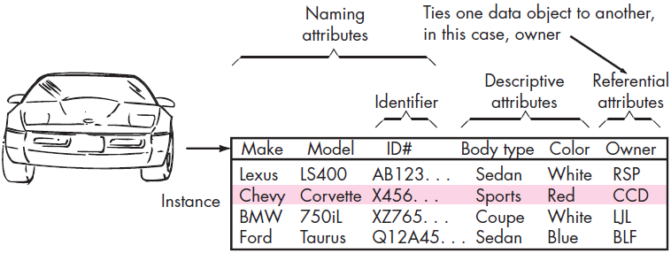
DATA MODELING CONCEPTS Data Objects
Encapsulates data only
reference w→ in data object → operations that act on data
Data object representation (figure)
Notes:
A data object encapsulates data only—there is no reference within a data object to operations that act on the data. Therefore, the data object can be represented as a table as shown in Figure above.

Slide 36
DATA MODELING CONCEPTS Data Attributes
Define properties = data object
Take on one = three characteristics
Name an instance = data object
Describe the instance
Make reference → another instance in another table
In addition
1 | more attributes
Defined as identifier (key) → find instance = data object
Notes:
Data attributes define the properties of a data object and take on one of three different characteristics.
They can be used to (1) name an instance of the data object, (2) describe the instance, or (3) make reference to another instance in another table.
In addition, one or more of the attributes must be defined as an identifier—that is, the identifier attribute becomes a “key” when we want to find an instance of the data object. Referring to the data object car (figure shown above), a reasonable identifier might be the ID number.

Slide 37
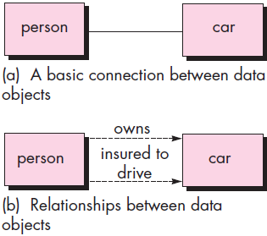
DATA MODELING CONCEPTS Relationships
Data objects connected → one another
Consider person and car
Represented in simple notation (figure)
Connection - - established
Relationship?
Understand role = people & car w→ in the context = s/w → built.
Example:
A person owns a car.
A person - - insured → drive a car.
Notes:
Data objects are connected to one another in different ways. Consider the two data objects, person and car. These objects can be represented using the simple notation illustrated in Figure above.
A connection is established between person and car because the two objects are related. But what are the relationships?
To determine the answer, you should understand the role of people (owners, in this case) and cars within the context of the software to be built.

Slide 38
FLOW-ORIENTED MODELING
187
Notes:
Although data flow-oriented modeling is perceived as an outdated technique by some software engineers, it continues to be one of the most widely used requirements analysis notations in use today. Although the data flow diagram (DFD) and related diagrams and information are not a formal part of UML, they can be used to complement UML diagrams and provide additional insight into system requirements and flow.

Slide 40
Case Study on REQUIREMENTS MODELING FOR WEBAPPS
Requirement analysis (time)
Solving wrong problem (more time)
Question ← WebApp developer - - simple
r you sure you understand requirements = problem?
Answer
Yes
skip requirements modeling
No
Perform it
How Much Analysis Is Enough?
Size & complexity = WebApp increment
No. = stakeholders
WebApp team (size)
Degree → which members = WebApp team have worked together before
Degree → which the organization’s success - - directly dependent on the success = WebApp.
Notes:
Requirements analysis does take time, but solving the wrong problem takes even more time. The question for every WebApp developer is simple—are you sure you understand the requirements of the problem? If the answer is an unequivocal “yes,” then it may be possible to skip requirements modeling, but if the answer is “no,” then requirements modeling should be performed.
The degree to which requirements modeling for WebApps is emphasized depends on the following factors:
Size and complexity of WebApp increment.
Number of stakeholders (analysis can help to identify conflicting requirements coming from different sources).
Size of the WebApp team.
Degree to which members of the WebApp team have worked together before (analysis can help develop a common understanding of the project).
Degree to which the organization’s success is directly dependent on the success of the WebApp.

Slide 41
Case Study on REQUIREMENTS MODELING FOR WEBAPPS
Requirements Modeling Input
Inputs → requirements modeling:
Stakeholders & user categories
Business context
Defined informational and applicative goals
General WebApp requirements &
Usage scenarios
Notes:
Requirements Modeling Input:
An agile version of the generic software process can be applied when WebApps are engineered, which incorporates a communication activity that identifies
stakeholders and user categories
the business context
defined informational and applicative goals
general WebApp requirements &
Usage scenarios
information that becomes input to requirements modeling. This information is represented in the form of natural language descriptions, rough outlines, sketches, and other informal representations.
Analysis takes this information, structures it using a formally defined representation scheme (where appropriate), and then produces more rigorous models as an output. The requirements model provides a detailed indication of the true structure of the problem and provides insight into the shape of the solution.

Slide 42
Case Study on REQUIREMENTS MODELING FOR WEBAPPS
Requirements Modeling Output
Requirements analysis ➔ mechanism ← representing & evaluating WebApp content & function
modes = interaction that users will encounter &
Environment & infrastructure in which WebApp resides
Each c→ be represented as set = models
5 classes = models:
Content model
Interaction model
Function model
Navigation model &
Configuration model
Notes:
Requirements Modeling Output:
Requirements analysis provides (➔) a disciplined mechanism for representing and evaluating WebApp content and function, the modes of interaction that users will encounter, and the environment and infrastructure in which the WebApp resides. Each of these characteristics can be represented as a set of models that allow the WebApp requirements to be analyzed in a structured manner. While the specific models depend largely upon the nature of the WebApp, there are five main classes of models:
Content model: identifies the full spectrum (meaning wide range) of content to be provided by the WebApp. Content includes text, graphics and images, video, and audio data.
Interaction model: describes the manner in which users interact with the WebApp.
Function model: defines the operations that will be applied to WebApp content and describes other processing functions that are independent of content but necessary to the end user.
Navigation model: defines the overall navigation strategy for the WebApp.
Configuration model: describes the environment and infrastructure in which the WebApp resides.

Slide 43
Case Study on REQUIREMENTS MODELING FOR WEBAPPS
Content Model for WebApps
Contains structural elements→ view content requirements ← WebApps
Content c→ developed
prior → implementation = WebApp
While WebApp - - being built |
long after WebApp - - operational
In every case
Content (incorporated)
navigational reference in → the overall WebApp structure
Content object
Textual description = product
Article describing news event
Action photograph taken (sport event)
User response on discussion forum etc. .
Content object (Stored)
As separate files
Embedded directly → web pages |
Obtained dynamically ⬅ database
Notes:
The content model contains structural elements that provide an important view of content requirements for a WebApp. These structural elements encompass content objects and all analysis classes—user-visible entities that are created or manipulated as a user interacts with the WebApp.
Content can be developed prior to the implementation of the WebApp, while the WebApp is being built, or long after the WebApp is operational. In every case, it is incorporated via navigational reference into the overall WebApp structure.
A content object might be a textual description of a product, an article describing a news event, an action photograph taken at a sporting event, a user’s response on a discussion forum, an animated representation of a corporate logo, a short video of a speech, or an audio overlay for a collection of presentation slides.
The content objects might be stored as separate files, embedded directly into Web pages, or obtained dynamically from (⬅) a database. In other words, a content object is any item of cohesive information that is to be presented to an end user.

Slide 44
Case Study on REQUIREMENTS MODELING FOR WEBAPPS
Interaction Model for WebApps
Composed = 1 | more elements:
use cases
sequence diagrams
state diagrams & / |
User interface prototypes
Functional Model for WebApps
addresses 2 processing elements = WebApp
Each representing different level = procedural abstraction
user-observable functionality i.e. delivered → end user
Operations contained
Activity diagram (used)
Notes:
Interaction model for WebApps:
The vast majority of WebApps enable a “conversation” between an end user and application functionality, content, and behavior. This conversation can be described using an interaction model that can be composed of one or more of the following elements:
use cases
sequence diagrams
state diagrams & / |
User interface prototypes
Functional model for WebApps:
Many WebApps deliver a broad array of computational and manipulative functions that can be associated directly with content (either using it or producing it) and that are often a major goal of user-WebApp interaction. For this reason, functional requirements must be analyzed, and when necessary, modeled.
The functional model addresses two processing elements of the WebApp, each representing a different level of procedural abstraction:
user-observable functionality that is delivered by the WebApp to end users
it encompasses any processing functions that are initiated directly by the user. For example, a financial WebApp might implement a variety of financial functions (e.g., a college tuition savings calculator or a retirement savings calculator). These functions may actually be implemented using operations within analysis classes, but from the point of view of the end user, the function (more correctly, the data provided by the function) is the visible outcome.
the operations contained within analysis classes that implement behaviors associated with the class
At a lower level of procedural abstraction, the requirements model describes the processing to be performed by analysis class operations. These operations manipulate class attributes and are involved as classes collaborate with one another to accomplish some required behavior. Regardless of the level of procedural abstraction, the UML activity diagram can be used to represent processing details.

Slide 45
Case Study on REQUIREMENTS MODELING FOR WEBAPPS
Configuration Model for WebApps
nothing more than a list = server-side & client-side attributes
Variety = configuration complexities (complex WebApps):
distributing load among multiple servers
caching architectures
remote databases
multiple servers serving various objects on the same Web page
Deployment diagram (used)
Notes:
In some cases, the configuration model is nothing more than a list of server-side and client-side attributes. However, for more complex WebApps, a variety of configuration complexities (e.g., distributing load among multiple servers, caching architectures, remote databases, multiple servers serving various objects on the same Web page) may have an impact on analysis and design. The UML deployment diagram can be used in situations in which complex configuration architectures must be considered.

Slide 46
Case Study on REQUIREMENTS MODELING FOR WEBAPPS
Navigation Modeling
H? each user category will navigate from one WebApp element → another
Notes:
Navigation modeling considers how (H?) each user category will navigate from one WebApp element (e.g., content object) to another. The mechanics of navigation are defined as part of design. At this stage, you should focus on overall navigation requirements. The following questions should be considered:
• Should certain elements be easier to reach (require fewer navigation steps) than others? What is the priority for presentation?
• Should certain elements be emphasized to force users to navigate in their direction?
• How should navigation errors be handled?
• Should navigation to related groups of elements be given priority over navigation to a specific element?
• Should navigation be accomplished via links, via search-based access, or by some other means?
• Should certain elements be presented to users based on the context of previous navigation actions?
• Should a navigation log be maintained for users?
• Should a full navigation map or menu (as opposed to a single “back” link or directed pointer) be available at every point in a user’s interaction?
• Should navigation design be driven by the most commonly expected user behaviors or by the perceived importance of the defined WebApp elements?
• Can a user “store” his previous navigation through the WebApp to expedite future usage?
• For which user category should optimal navigation be designed?
• How should links external to the WebApp be handled? Overlaying the existing browser window? As a new browser window? As a separate frame?
These and many other questions should be asked and answered as part of navigation analysis.

Slide 47
187

