Slide 1
UNIT-III
DESIGN ENGINEERING AND METRICS
By
Mr. T. M. Jaya Krishna _{M.Tech}

Slide 2
DESIGN ENGINEERING
Notes:
Software design encompasses the set of principles, concepts, and practices that lead to the development of a high-quality system or product. Design principles establish an overriding philosophy that guides you in the design work you must perform. Design concepts must be understood before the mechanics of design practice are applied, and design practice itself leads to the creation of various representations of the software that serve as a guide for the construction activity that follows.
The goal of design is to produce a model or representation that exhibits firmness, commodity, and delight. To accomplish this, you must practice diversification (meaning enlarging) and then convergence (meaning similar characteristics ఏకీభవించటం).
Belady states that “diversification is the acquisition of a repertoire (meaning collection) of alternatives, the raw material of design: components, component solutions, and knowledge, all contained in catalogs, textbooks, and the mind.” Once this diverse set of information is assembled, you must pick and choose elements from the repertoire that meet the requirements defined by requirements engineering and the analysis model.
As this occurs, alternatives are considered and rejected and you converge (meaning develop something in common) on “one particular configuration of components, and thus the creation of the final product”.
Diversification and convergence combine intuition (meaning అంతర్ దృష్టి|వాస్తవాన్ని తెలుసుకొనుట) and judgment based on experience in building similar entities, a set of principles and/or heuristics that guide the way in which the model evolves, a set of criteria that enables quality to be judged, and a process of iteration that ultimately leads to a final design representation.
Software design changes continually as new methods, better analysis, and broader understanding evolve. Even today, most software design methodologies lack the depth, flexibility, and quantitative nature that are normally associated with more classical engineering design disciplines. However, methods for software design do exist, criteria for design quality are available, and design notation can be applied.

Slide 3
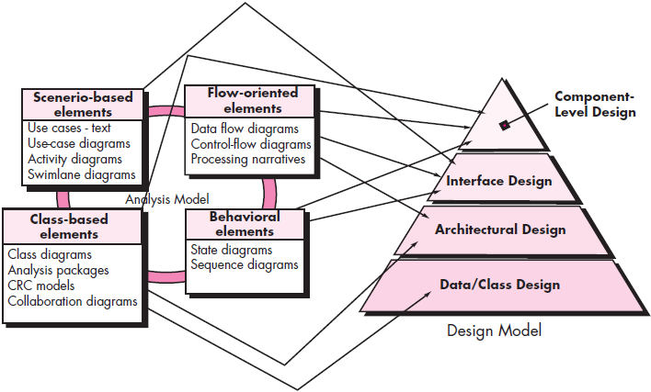
Design within the context of software engineering
s/w design sits at technical kernel = s/w engg. & - - applied regardless = s/w process model i.e. used
It - - last s/w engg. action & Sets stages ← construction
Each element = requirements model provides info. i.e. necessary → create 4 design models ← complete specification = design
Flow = info. during s/w design (figure)
Notes:
Software design sits at the technical kernel of software engineering and is applied regardless of the software process model that is used. Beginning once software requirements have been analyzed and modeled, software design is the last software engineering action within the modeling activity and sets the stage for construction (code generation and testing).
Each of the elements of the requirements model provides information that is necessary to create the four design models required for a complete specification of design. The flow of information during software design is illustrated in Figure above.
The requirements model, manifested (meaning demonstrate or indicate) by scenario-based, class-based, flow-oriented, and behavioral elements, feed the design task. Using design notation and design methods, design produces
Data/Class Design: Transforms class models into design class realizations (meaning achievement) and the requisite (meaning necessary) data structures required to implement the software.
Architectural Design: Defines the relationship between major structural elements of the software, the architectural styles and design patterns that can be used to achieve the requirements defined for the system, and the constraints that affect the way in which architecture can be implemented.
Interface Design: Describes how the software communicates with systems that interoperate with it, and with humans who use it.
Component Design: Transforms structural elements of the software architecture into a procedural description of software components.

Slide 4
Design within the context of software engineering
s/w design sits at technical kernel = s/w engg. & - - applied regardless = s/w process model i.e. used
It - - last s/w engg. action & Sets stages ← construction
Each element = requirements model provides info. i.e. necessary → create 4 design models ← complete specification = design
Flow = info. during s/w design (figure)
Notes:
During design you make decisions that will ultimately affect the success of software construction and, as important, the ease with which software can be maintained. But why is design so important?
The importance of software design can be stated with a single word—quality. Design is the place where quality is fostered (meaning assisted or strengthen) in software engineering.
Design provides you with representations of software that can be assessed for quality.
Design is the only way that you can accurately translate stakeholder’s requirements into a finished software product or system.
Software design serves as the foundation for all the software engineering and software support activities that follow.
Without design, you risk building an unstable system—one that will fail when small changes are made; one that may be difficult to test; one whose quality cannot be assessed until late in the software process, when time is short and many dollars have already been spent.

Slide 5
THE DESIGN PROCESS
An iterative process thru
Requirements r translated → blueprint ← constructing s/w.
Software Quality Guidelines and Attributes:
Quality = design - - assessed w→ technical reviews
McGlaughlin suggests (3 characteristics)
Design must | must be
Implement all explicit requirements & accommodate all implicit requirements (stakeholders)
Readable, understandable guide ← those who test & support s/w
Provide complete picture = s/w, addressing data, functional & behavioral domains
Notes:
Software design is an iterative process through which requirements are translated into a “blueprint” for constructing the software. Initially, the blueprint depicts a holistic (meaning whole) view of software. That is, the design is represented at a high level of abstraction – a level that can be directly traced to the specific system objective and more detailed data, functional, and behavioral requirements.
As design iterations occur, subsequent refinement leads to design representations at much lower levels of abstraction. These can still be traced to requirements, but the connection is more subtle (meaning precise).
Software Quality Guidelines and Attributes:
Throughout the design process, the quality of the evolving design is assessed with a series of technical reviews. McGlaughlin suggests three characteristics that serve as a guide for the evaluation of a good design:
The design must implement all of the explicit requirements contained in the requirements model, and it must accommodate all of the implicit requirements desired by stakeholders.
The design must be a readable, understandable guide for those who generate code and for those who test and subsequently support the software.
The design should provide a complete picture of the software, addressing the data, functional, and behavioral domains from an implementation perspective.

Slide 6
THE DESIGN PROCESS
An iterative process thru
Requirements r translated → blueprint ← constructing s/w.
Software Quality Guidelines and Attributes:
Quality = design - - assessed w→ technical reviews
McGlaughlin suggests (3 characteristics)
Design must | must be
Implement all explicit requirements & accommodate all implicit requirements (stakeholders)
Readable, understandable guide ← those who test & support s/w
Provide complete picture = s/w, addressing data, functional & behavioral domains
Notes:
Each of these characteristics is actually a goal of the design process. But how is each of these goals achieved?
Quality Guidelines. In order to evaluate the quality of a design representation, you and other members of the software team must establish technical criteria for good design.
Guidelines:
A design should exhibit an architecture that
1) has been created using recognizable architectural styles or patterns
2) is composed of components that exhibit good design characteristics
3) can be implemented in an evolutionary fashion
thereby facilitating implementation and testing.
A design should be modular; that is, the software should be logically partitioned into elements or subsystems.
A design should contain distinct representations of data, architecture, interfaces, and components.
A design should lead to data structures that are appropriate for the classes to be implemented and are drawn from recognizable data patterns.
A design should lead to components that exhibit independent functional characteristics.
A design should lead to interfaces that reduce the complexity of connections between components and with the external environment.
A design should be derived using a repeatable method that is driven by information obtained during software requirements analysis.
A design should be represented using a notation that effectively communicates its meaning.
These design guidelines are not achieved by chance. They are achieved through the application of fundamental design principles, systematic methodology, and thorough review.

Slide 7
THE DESIGN PROCESS
An iterative process thru
Requirements r translated → blueprint ← constructing s/w.
Software Quality Guidelines and Attributes:
Quality = design - - assessed w→ technical reviews
McGlaughlin suggests (3 characteristics)
Design must | must be
Implement all explicit requirements & accommodate all implicit requirements (stakeholders)
Readable, understandable guide ← those who test & support s/w
Provide complete picture = s/w, addressing data, functional & behavioral domains
Notes:
Quality Attributes:
Hewlett-Packard developed a set of software quality attributes that has been given the acronym FURPS—functionality, usability, reliability, performance, and supportability. The FURPS quality attributes represent a target for all software design:
Functionality is assessed by evaluating the feature set and capabilities of the program, the generality of the functions that are delivered, and the security of the overall system.
Usability is assessed by considering human factors, overall aesthetics, consistency, and documentation.
Reliability is evaluated by measuring the frequency and severity of failure, the accuracy of output results, the mean-time-to-failure (MTTF), the ability to recover from failure, and the predictability of the program.
Performance is measured by considering processing speed, response time, resource consumption, throughput, and efficiency.
Supportability combines the ability to extend the program (extensibility), adaptability, serviceability—these three attributes represent a more common term, maintainability—and in addition, testability, compatibility, configurability (the ability to organize and control elements of the software configuration), the ease with which a system can be installed, and the ease with which problems can be localized.
Not every software quality attribute is weighted equally as the software design is developed. One application may stress functionality with a special emphasis on security.
Another may demand performance with particular emphasis on processing speed. A third might focus on reliability. Regardless of the weighting, it is important to note that these quality attributes must be considered as design commences, not after the design is complete and construction has begun.

Slide 8
THE DESIGN PROCESS
An iterative process thru
Requirements r translated → blueprint ← constructing s/w.
Software Quality Guidelines and Attributes:
Quality = design - - assessed w→ technical reviews
McGlaughlin suggests (3 characteristics)
Design must | must be
Implement all explicit requirements & accommodate all implicit requirements (stakeholders)
Readable, understandable guide ← those who test & support s/w
Provide complete picture = s/w, addressing data, functional & behavioral domains
Notes:
The Evolution of Software Design:
It is a continuing process that has now spanned almost six decades. Early design work concentrated on criteria for the development of modular programs and methods for refining software structures in a top down manner. Procedural aspects of design definition evolved into a philosophy called structured programming.
Later work proposed methods for the translation of data flow or data structure into a design definition. Newer design approaches proposed an object-oriented approach to design derivation.
More recent emphasis in software design has been on software architecture and the design patterns that can be used to implement software architectures and lower levels of design abstractions.
Growing emphasis on aspect-oriented methods, model-driven development, and test-driven development emphasize techniques for achieving more effective modularity and architectural structure in the designs that are created.
Each software design method introduces unique heuristics (meaning is any approach to problem solving or self-discovery that employs a practical method, not guaranteed to be optimal, perfect, logical, or rational, but instead sufficient for reaching an immediate goal.) and notation, as well as a somewhat parochial (meaning restricted or limited) view of what characterizes design quality.
Yet, all of these methods have a number of common characteristics:
a mechanism for the translation of the requirements model into a design representation
a notation for representing functional components and their interfaces
heuristics for refinement and partitioning
guidelines for quality assessment

Slide 9
DESIGN CONCEPTS
Design concepts
s/w designer → answer the following questions
What criteria c→ used → partition software → individual components?
How - - function | data structure detail separated ➔ conceptual representation = s/w?
What uniform criteria define the technical quality = s/w design?
Overview = imp. s/w design concepts:
Abstraction
Architecture
Patterns
Separation of Concerns
Modularity
Information Hiding
Functional Independence
Refinement
Aspects
Refactoring
Object-Oriented Design Concepts
Design Classes
Notes:
A set of fundamental software design concepts has evolved over the history of software engineering. Each provides the software designer with a foundation from which more sophisticated design methods can be applied. Each helps you answer the following questions:
What criteria can be used to partition software into individual components?
How is function or data structure detail separated from (➔) a conceptual representation of the software?
What uniform criteria define the technical quality of a software design?
M. A. Jackson once said: “The beginning of wisdom for a [software engineer] is to recognize the difference between getting a program to work, and getting
it right.” Fundamental software design concepts provide the necessary framework for “getting it right.”
A brief overview of important software design concepts that span both traditional and object-oriented software development are as follows:
Abstraction: When you consider a modular solution to any problem, many levels of abstraction can be posed. At the highest level of abstraction, a solution is stated in broad terms using the language of the problem environment. At lower levels of abstraction, a more detailed description of the solution is provided. A data abstraction is a named collection of data that describes a data object.
Architecture: Software architecture alludes (meaning refer) to “the overall structure of the software and the ways in which that structure provides conceptual integrity for a system”. In its simplest form, architecture is the structure or organization of program components (modules), the manner in which these components interact, and the structure of data that are used by the components. One goal of software design is to derive an architectural rendering of a system. This rendering serves as a framework from which more detailed design activities are conducted.
Patterns: Brad Appleton defines a design pattern in the following manner: “A pattern is a named nugget of insight which conveys the essence of a proven solution to a recurring problem within a certain context amidst (meaning మధ్య) competing concerns”. Stated in another way, a design pattern describes a design structure that solves a particular design problem within a specific context and amid (meaning surrounded by | middle of) “forces” that may have an impact on the manner in which the pattern is applied and used. The intent of each design pattern is to provide a description that enables a designer to determine (1) whether the pattern is applicable to the current work, (2) whether the pattern can be reused (hence, saving design time), and (3) whether the pattern can serve as a guide for developing a similar, but functionally or structurally different pattern.

Slide 10
DESIGN CONCEPTS
Design concepts
s/w designer → answer the following questions
What criteria c→ used → partition software → individual components?
How - - function | data structure detail separated ➔ conceptual representation = s/w?
What uniform criteria define the technical quality = s/w design?
Overview = imp. s/w design concepts:
Abstraction
Architecture
Patterns
Separation of Concerns
Modularity
Information Hiding
Functional Independence
Refinement
Aspects
Refactoring
Object-Oriented Design Concepts
Design Classes
Notes:
Separation of Concerns: Separation of concerns is a design concept that suggests that any complex problem can be more easily handled if it is subdivided into pieces that can each be solved and/or optimized independently.
A concern is a feature or behavior that is specified as part of the requirements model for the software. By separating concerns into smaller, and therefore more manageable pieces, a problem takes less effort and time to solve. Separation of concerns is manifested in other related design concepts: modularity, aspects, functional independence, and refinement.
Modularity: It is the most common manifestation of separation of concerns. Software is divided into separately named and addressable components, sometimes called modules, that are integrated to satisfy problem requirements. It has been stated that “modularity is the single attribute of software that allows a program to be intellectually manageable”.
Monolithic software (i.e., a large program composed of a single module) cannot be easily grasped by a software engineer. The number of control paths, span of reference, number of variables, and overall complexity would make understanding close to impossible. In almost all instances, you should break the design into many modules, hoping to make understanding easier and, as a consequence, reduce the cost required to build the software.
Information Hiding: The concept of modularity leads you to a fundamental question: “How do I decompose a software solution to obtain the best set of modules?” The principle of information hiding [Par72] suggests that modules be “characterized by design decisions that (each) hides from all others.” In other words, modules should be specified and designed so that information (algorithms and data) contained within a module is inaccessible to other modules that have no need for such information. Hiding implies that effective modularity can be achieved by defining a set of independent modules that communicate with one another only that information necessary to achieve software function.

Slide 11
DESIGN CONCEPTS
Design concepts
s/w designer → answer the following questions
What criteria c→ used → partition software → individual components?
How - - function | data structure detail separated ➔ conceptual representation = s/w?
What uniform criteria define the technical quality = s/w design?
Overview = imp. s/w design concepts:
Abstraction
Architecture
Patterns
Separation of Concerns
Modularity
Information Hiding
Functional Independence
Refinement
Aspects
Refactoring
Object-Oriented Design Concepts
Design Classes
Notes:
Functional Independence: The concept of functional independence is a direct outgrowth of separation of concerns, modularity, and the concepts of abstraction and information hiding. Functional independence is achieved by developing modules with “singleminded” function and an “aversion” to excessive interaction with other modules. Stated another way, you should design software so that each module addresses a specific subset of requirements and has a simple interface when viewed from other parts of the program structure. It is fair to ask why independence is important.
Independence is assessed using two qualitative criteria:
Cohesion is an indication of the relative functional strength of a module. Coupling is an indication of the relative interdependence among modules.
Refinement: Stepwise refinement is a top-down design strategy originally proposed by Niklaus Wirth Refinement is actually a process of elaboration. You begin with a statement of function (or description of information) that is defined at a high level of abstraction. That is, the statement describes function or information conceptually but provides no information about the internal workings of the function or the internal structure of the information. You then elaborate on the original statement, providing more and more detail as each successive refinement (elaboration) occurs.
Aspects: (meaning a particular part) As requirements analysis occurs, a set of “concerns” is uncovered. These concerns “include requirements, use cases, features, data structures, quality-of-service issues, variants, intellectual property boundaries, collaborations, patterns and contracts” . Ideally, a requirements model can be organized in a way that allows you to isolate each concern (requirement) so that it can be considered independently. In practice, however, some of these concerns span the entire system and cannot be easily compartmentalized.
Refactoring: An important design activity suggested for many agile methods, refactoring is a reorganization technique that simplifies the design (or code) of a component without changing its function or behavior. According to Fowler, Refactoring is the process of changing a software system in such a way that it does not alter the external behavior of the code yet improves its internal structure.
Object-Oriented Design Concepts: The object-oriented (OO) paradigm is widely used in modern software engineering.

Slide 12
DESIGN CONCEPTS
Design concepts
s/w designer → answer the following questions
What criteria c→ used → partition software → individual components?
How - - function | data structure detail separated ➔ conceptual representation = s/w?
What uniform criteria define the technical quality = s/w design?
Overview = imp. s/w design concepts:
Abstraction
Architecture
Patterns
Separation of Concerns
Modularity
Information Hiding
Functional Independence
Refinement
Aspects
Refactoring
Object-Oriented Design Concepts
Design Classes
Notes:
Design Classes: The requirements model defines a set of analysis classes. Each describes some element of the problem domain, focusing on aspects of the problem that are user visible. The level of abstraction of an analysis class is relatively high.
As the design model evolves, you will define a set of design classes that refine the analysis classes by providing design detail that will enable the classes to be implemented, and implement a software infrastructure that supports the business solution. Five different types of design classes, each representing a different layer of the design architecture, can be developed:
User interface classes define all abstractions that are necessary for human computer interaction (HCI).
Business domain classes are often refinements of the analysis classes. The classes identify the attributes and services (methods) that are required to implement some element of the business domain.
Process classes implement lower-level business abstractions required to fully manage the business domain classes.
Persistent classes represent data stores (e.g., a database) that will persist beyond the execution of the software.
System classes implement software management and control functions that enable the system to operate and communicate within its computing environment and with the outside world.

Slide 13
Software architecture
What is Architecture?
Consider architecture = building
Many different attributes come → mind
Overall shape = physical structure
Way in which building fits
Aesthetic feel = structure
Visual impact = building etc...
Also
It - - thousands = decisions (big & small)
What is S/W Architecture?
Bass, Clements & Kazman:
s/w architecture = Prog. | computing system - - the structure(s) = the system, comprises =
S/W components
Externally visible properties = it &
Relationships
Notes:
What Is Architecture?
When you consider the architecture of a building, many different attributes come to mind. At the most simplistic level, you think about the overall shape of the physical structure. But in reality, architecture is much more. It is the manner in which the various components of the building are integrated to form a cohesive whole.
It is the way in which the building fits into its environment and meshes with other buildings in its vicinity. It is the degree to which the building meets its stated purpose and satisfies the needs of its owner. It is the aesthetic (meaning decorative) feel of the structure – the visual impact of the building – and the way textures, colours, and materials are combined to create the external facade and the internal “living environment.” It is small details – the design of lighting fixtures, the type of flooring, the placement of wall hangings, the list is almost endless. And finally, it is art.
But architecture is also something else. It is “thousands of decisions, both big and small”. Some of these decisions are made early in design and can have a profound impact on all other design actions. Others are delayed until later, thereby eliminating overly restrictive constraints that would lead to a poor implementation of the architectural style.
But what about software architecture? Bass, Clements, and Kazman define this elusive term in the following way:
“The software architecture of a program or computing system is the structure or structures of the system, which comprise software components, the externally visible properties of those components, and the relationships among them”.

Slide 14
Software architecture
Architecture - - operational s/w ↔ it - - a representation that enables you:
Analyze effectiveness = design in meeting its requirements
Consider architectural alternatives (wn? making design changes)
Reduce risks (construction = s/w)
Notes:
The architecture is not the operational software. Rather, it is a representation that enables you to (1) analyze the effectiveness of the design in meeting its stated requirements, (2) consider architectural alternatives at a stage when making design changes is still relatively easy, and (3) reduce the risks associated with the construction of the software.
This definition emphasizes the role of “software components” in any architectural representation. In the context of architectural design, a software component can be something as simple as a program module or an object-oriented class, but it can also be extended to include databases and “middleware” that enable the configuration of a network of clients and servers.
The properties of components are those characteristics that are necessary for an understanding of how the components interact with other components. At the architectural level, internal properties (e.g., details of an algorithm) are not specified. The relationships between components can be as simple as a procedure call from one module to another or as complex as a database access protocol.
Some members of the software engineering community make a distinction between the actions associated with the derivation of a software architecture (what I call “architectural design”) and the actions that are applied to derive the software design.
There is a distinct difference between the terms architecture and design. A design is an instance of an architecture similar to an object being an instance of a class. For example, consider the client-server architecture.
I can design a network-centric software system in many different ways from this architecture using either the Java platform (Java EE) or Microsoft platform (.NET framework). So, there is one architecture, but many designs can be created based on that architecture. Therefore, you cannot mix “architecture” and “design” with each other.

Slide 15
Software architecture
Why Is Architecture Important?
Bass and his colleagues:
Representations = s/w architecture r enabler ← communication between all parties
highlights early design decisions
Constitutes relatively small, graspable model
Architectural Descriptions:
set = work products
Reflects different views = system
Notes:
Why Is Architecture Important?
In a book dedicated to software architecture, Bass and his colleagues identify three key reasons that software architecture is important:
• Representations of software architecture are an enabler for communication between all parties (stakeholders) interested in the development of a computer-based system.
• The architecture highlights early design decisions that will have a profound impact on all software engineering work that follows and, as important, on the ultimate success of the system as an operational entity.
• Architecture “constitutes a relatively small, intellectually graspable model of how the system is structured and how its components work together”.
Architectural Descriptions:
Each of us has a mental image of what the word architecture means. In reality, however, it means different things to different people. The implication is that different stakeholders will see an architecture from different viewpoints that are driven by different sets of concerns. This implies that an architectural description is actually a set of work products that reflect different views of the system.
For example, the architect of a major office building must work with a variety of different stakeholders. The primary concern of the owner of the building (one stakeholder) is to ensure that it is aesthetically pleasing and that it provides sufficient office space and infrastructure to ensure its profitability. Therefore, the architect must develop a description using views of the building that address the owner’s concerns.
The viewpoints used are a three-dimensional drawings of the building (to illustrate the aesthetic view) and a set of two-dimensional floor plans to address this stakeholder’s concern for office space and infrastructure.

Slide 16
Software architecture
Architectural Descriptions:
set = work products
Reflects different views = system
IEEE computer society proposed
IEEE-Std-1471-2000 standard w→ some objectives:
Establish conceptual framework
Provide detailed guidelines
Encourage design practices
Architectural Decisions:
view = architectural description
Specific stake holder concern
→ develop each view system architect considers variety = alternatives & decides on specific architectural features.
Notes:
Architectural Descriptions: (cont..)
The IEEE Computer Society has proposed IEEE-Std-1471-2000, Recommended Practice for Architectural Description of Software-Intensive Systems, with the following objectives:
to establish a conceptual framework and vocabulary for use during the design of software architecture
to provide detailed guidelines for representing an architectural description
to encourage sound architectural design practices.
The IEEE standard defines an architectural description (AD) as “a collection of products to document an architecture.” The description itself is represented using multiple views, where each view is “a representation of a whole system from the perspective of a related set of [stakeholder] concerns.” A view is created according to rules and conventions defined in a viewpoint—“a specification of the conventions for constructing and using a view”.
Architectural Decisions:
Each view developed as part of an architectural description addresses a specific stakeholder concern. To develop each view (and the architectural description as a whole) the system architect considers a variety of alternatives and ultimately decides on the specific architectural features that best meet the concern.
Therefore, architectural decisions themselves can be considered to be one view of the architecture. The reasons that decisions were made provide insight into the structure of a system and its conformance to stakeholder concerns. As a system architect, you can use the template suggested in the sidebar to document each major decision.
By doing this, you provide a rationale for your work and establish an historical record that can be useful when design modifications must be made.

Slide 17
Software architecture

Slide 18
Architectural styles
Architectural style (in terms = builder):
a descriptive mechanism → differentiate the house from other styles
S/W i.e. built ← computer-based systems also exhibits one = many architectural styles
Each style describes a system category that encompasses:
Components
Connectors
Constraints
Semantic models
Notes:
When a builder uses the phrase “center hall colonial” to describe a house, most people familiar with houses in the United States will be able to conjure a general image of what the house will look like and what the floor plan is likely to be. The builder has used an architectural style as a descriptive mechanism to differentiate the house from other styles.
But more important, the architectural style is also a template for construction. Further details of the house must be defined, its final dimensions must be specified, customized features may be added, building materials are to be determined, but the style—a “center hall colonial”—guides the builder in his work.
The software that is built for computer-based systems also exhibits one of many architectural styles. Each style describes a system category that encompasses
a set of components (e.g., a database, computational modules) that perform a function required by a system
a set of connectors that enable “communication, coordination and cooperation” among components
constraints that define how components can be integrated to form the system
semantic models that enable a designer to understand the overall properties of a system by analyzing the known properties of its constituent parts
Cont..

Slide 19
Architectural styles
Architectural style (in terms = builder):
a descriptive mechanism → differentiate the house from other styles
S/W i.e. built ← computer-based systems also exhibits one = many architectural styles
Each style describes a system category that encompasses:
Components
Connectors
Constraints
Semantic models
Notes:
Cont..
An architectural style is a transformation that is imposed on the design of an entire system. The intent is to establish a structure for all components of the system.
An architectural pattern, like an architectural style, imposes a transformation on the design of an architecture.
However, a pattern differs from a style in a number of fundamental ways:
The scope of a pattern is less broad, focusing on one aspect of the architecture rather than the architecture in its entirety.
A pattern imposes a rule on the architecture, describing how the software will handle some aspect of its functionality at the infrastructure level.
Architectural patterns tend to address specific behavioral issues within the context of the architecture (e.g., how real-time applications handle synchronization or interrupts).
Patterns can be used in conjunction with an architectural style to shape the overall structure of a system.

Slide 20
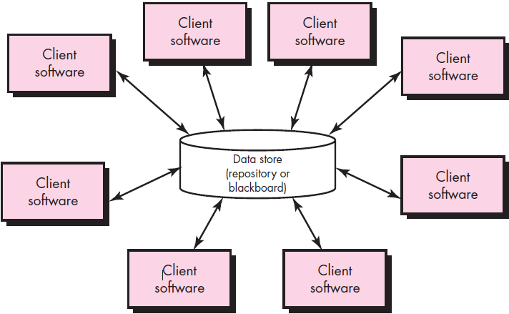
Architectural styles A Brief Taxonomy of Architectural Styles
Architecture styles:
Data-centered architectures
Notes:
Although millions of computer-based systems have been created over the past 60 years, the vast majority can be categorized into one of a relatively small number of architectural styles:
Data-centered architectures:
A data store (e.g., a file or database) resides at the center of this architecture and is accessed frequently by other components that update, add, delete, or otherwise modify data within the store. Figure above illustrates a typical data-centered style.
Data-centered architectures promote integrability. That is, existing components can be changed and new client components added to the architecture without concern about other clients (because the client components operate independently).

Slide 21
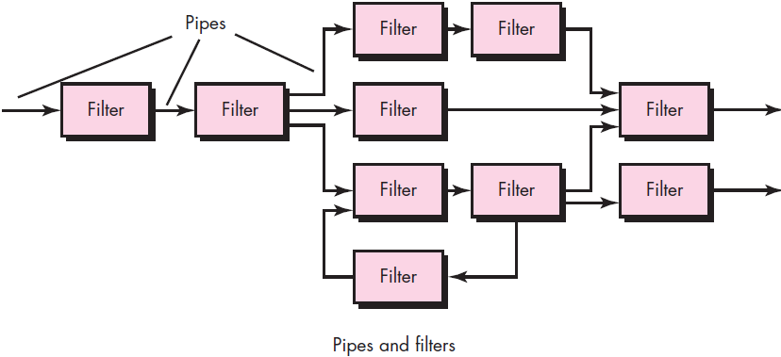
Architectural styles A Brief Taxonomy of Architectural Styles
Architecture styles:
Data-flow architectures
Notes:
Data-flow architectures:
This architecture is applied when input data are to be transformed through a series of computational or manipulative components into output data. A pipe-and-filter pattern (Figure above) has a set of components, called filters, connected by pipes that transmit data from one component to the next.
Each filter works independently of those components upstream and downstream, is designed to expect data input of a certain form, and produces data output (to the next filter) of a specified form. However, the filter does not require knowledge of the workings of its neighboring filters.
If the data flow degenerates into a single line of transforms, it is termed batch sequential. This structure accepts a batch of data and then applies a series of sequential components (filters) to transform it.

Slide 22
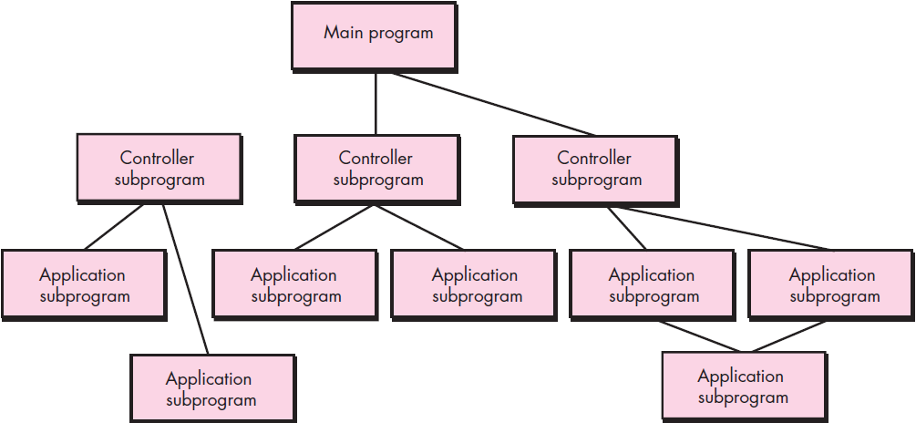
Architectural styles A Brief Taxonomy of Architectural Styles
Architecture styles:
Call and return architectures
Main program/subprogram architectures
Remote procedure call architectures
Notes:
Call and return architectures:
This architectural style enables you to achieve a program structure that is relatively easy to modify and scale. A number of sub styles exist within this category:
Main program/subprogram architectures:
This classic program structure decomposes function into a control hierarchy where a “main” program invokes a number of program components that in turn may invoke still other components. Figure above illustrates an architecture of this type.
Remote procedure call architectures:
The components of a main program/subprogram architecture are distributed across multiple computers on a network.

Slide 23
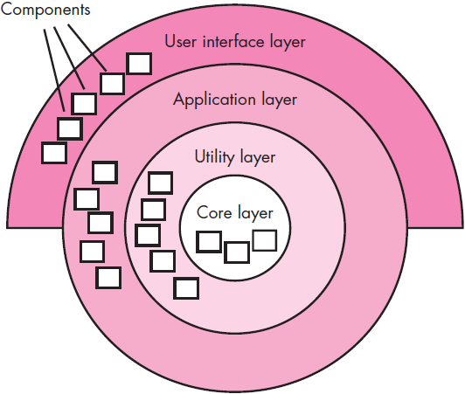
Architectural styles A Brief Taxonomy of Architectural Styles
Architecture styles:
Object-oriented architectures
Layered architectures
Notes:
Object-oriented architectures:
The components of a system encapsulate data and the operations that must be applied to manipulate the data. Communication and coordination between components are accomplished via message passing.
Layered architectures:
The basic structure of a layered architecture is illustrated in Figure above. A number of different layers are defined, each accomplishing operations that progressively become closer to the machine instruction set.
At the outer layer, components service user interface operations.
At the inner layer, components perform operating system interfacing.
Intermediate layers provide utility services and application software functions.

Slide 24
Architectural styles
Architectural Patterns:
As requirements model - - developed
s/w addresses broad problems = entire application
Example:
E-commerce application
Problem:
How do we offer a broad array = goods → broad array = customers & allow those customers → purchase our goods online?
Organization and Refinement:
Design process
No. = architectural alternatives
It - - imp → establish set = design criteria
Assess architectural design i.e. derived
Notes:
As the requirements model is developed, you’ll notice that the software must address a number of broad problems that span the entire application. For example, the requirements model for virtually every e-commerce application is faced with the following problem: How do we offer a broad array of goods to a broad array of customers and allow those customers to purchase our goods online?
The requirements model also defines a context in which this question must be answered. For example, an e-commerce business that sells golf equipment to consumers will operate in a different context than an e-commerce business that sells high-priced industrial equipment to medium and large corporations. In addition, a set of limitations and constraints may affect the way in which you address the problem to be solved.
Architectural patterns address an application-specific problem within a specific context and under a set of limitations and constraints. The pattern proposes an architectural solution that can serve as the basis for architectural design.
Organization and Refinement:
Because the design process often leaves you with a number of architectural alternatives, it is important to establish a set of design criteria that can be used to assess an architectural design that is derived. The following questions provide insight into an architectural style:
Control:
How is control managed within the architecture?
Does a distinct control hierarchy exist, and if so, what is the role of components within this control hierarchy?
How do components transfer control within the system?
How is control shared among components?
What is the control topology (i.e., the geometric form that the control takes)?
Is control synchronized or do components operate asynchronously?
Data:
How are data communicated between components?
Is the flow of data continuous, or are data objects passed to the system sporadically?
What is the mode of data transfer (i.e., are data passed from one component to another or are data available globally to be shared among system components)?
Do data components (e.g., a blackboard or repository) exist, and if so, what is their role?
How do functional components interact with data components?
Are data components passive or active (i.e., does the data component actively interact with other components in the system)?
How do data and control interact within the system?

Slide 25
Architectural Design
As architectural design begins
s/w → be developed m→ put in → context
i.e. design should define external entities
Other systems, devices, people
acquired ⬅requirements model & other info. gathered during requirements engineering
Once context - - modeled & interfaces described
Identify archetypes.
Notes:
As architectural design begins, the software to be developed must be put into context (సందర్భం) – i.e. the design should define the external entities (other systems, devices, people) that the software interacts with and the nature of the interaction.
This information can generally be acquired from the requirements model and all other information gathered during requirements engineering. Once context is modeled and all external software interfaces have been described, you can identify a set of architectural archetypes.
An archetype is an abstraction (similar to a class) that represents one element of system behavior. The set of archetypes provides a collection of abstractions that must be modeled architecturally if the system is to be constructed, but the archetypes themselves do not provide enough implementation detail.
Therefore, the designer specifies the structure of the system by defining and refining software components that implement each archetype. This process continues iteratively until a complete architectural structure has been derived.

Slide 26
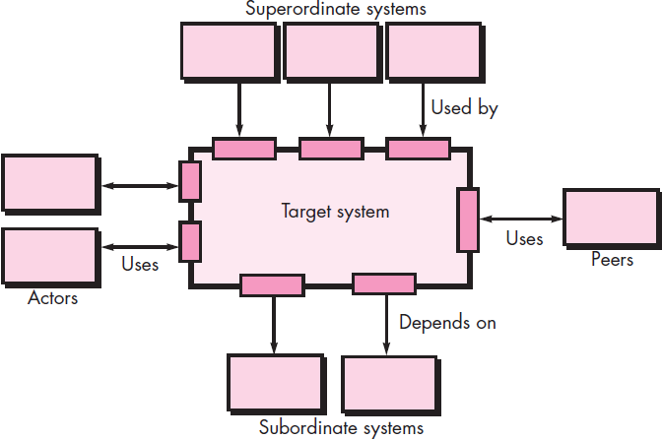
Architectural Design Representing the System in Context
Architectural Context Diagram (ACD)
Model the manner
S/W interacts w→ entities external → it’s boundaries
Generic structure = ACD (figure)
systems that interoperate w→ target system r represented as:
Superordinate systems
Subordinate systems
Peer-level systems
Actors
Small shaded rectangle
communicate target system
Notes:
At the architectural design level, a software architect uses an architectural context diagram (ACD) to model the manner in which software interacts with entities external to its boundaries. The generic structure of the architectural context diagram is illustrated in Figure above.
Referring to the figure, systems that interoperate with the target system (the system for which an architectural design is to be developed) are represented as
Superordinate systems – those systems that use the target system as part of some higher-level processing scheme.
Subordinate systems – those systems that are used by the target system and provide data or processing that are necessary to complete target system functionality.
Peer-level systems – those systems that interact on a peer-to-peer basis (i.e., information is either produced or consumed by the peers and the target system.
Actors – entities (people, devices) that interact with the target system by producing or consuming information that is necessary for requisite processing.
Each of these external entities communicates with the target system through an interface (the small shaded rectangles).
To illustrate the use of the ACD, consider the home security function of the SafeHome product. Figure shown in next slide

Slide 27
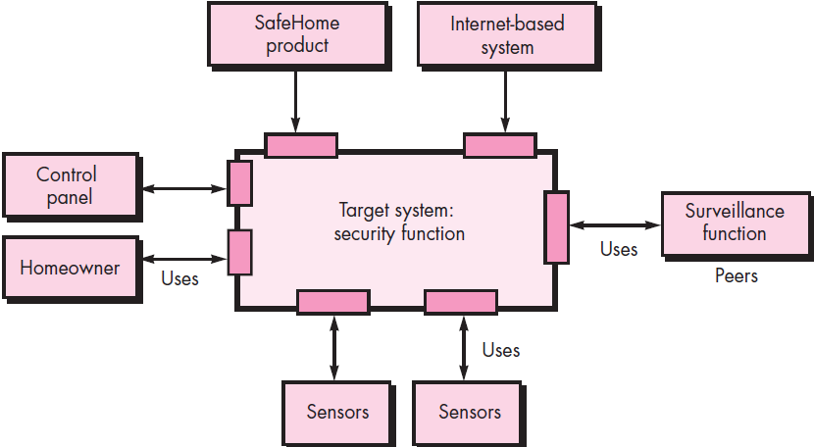
Architectural Design Representing the System in Context
Architectural Design
Defining Archetypes
Archetypes
Class | pattern
Represents
core abstraction i.e. critical → design = an architecture ← target system
Notes:
Architectural Design
Defining Archetypes
An archetype is a class or pattern that represents a core abstraction that is critical to the design of an architecture for the target system. In general, a relatively small set of archetypes is required to design even relatively complex systems. The target system architecture is composed of these archetypes, which represent stable elements of the architecture but may be instantiated many different ways based on the behavior of the system.
In many cases, archetypes can be derived by examining the analysis classes defined as part of the requirements model. Continuing the discussion of the SafeHome home security function, you might define the following archetypes:
• Node: Represents a cohesive collection of input and output elements of the home security function. For example a node might be comprised of (1) various sensors and (2) a variety of alarm (output) indicators.
• Detector: An abstraction that encompasses all sensing equipment that feeds information into the target system.
• Indicator: An abstraction that represents all mechanisms (e.g., alarm siren, flashing lights, bell) for indicating that an alarm condition is occurring.
• Controller: An abstraction that depicts the mechanism that allows the arming or disarming of a node. If controllers reside on a network, they have the ability to communicate with one another.

Slide 28
Architectural Design
Refining the Architecture into Components:
S/W architecture refined → components
Structure = system begins → emerge
H? components r chosen?
Application domain
Infrastructure domain
Describing Instantiations of the System:
Architectural design (modeled) → this point - - still relatively high level
Context = system (represented)
Archetypes indicate imp. abstractions w→ in problem domain (defined)
Overall structure = system - - apparent
Major s/w components (identified)
Notes:
As the software architecture is refined (శుద్ధి) into components, the structure of the system begins to emerge (బయట పడు).
But how are these components chosen? In order to answer this question, you begin with the classes that were described as part of the requirements model. These analysis classes represent entities within the application (business) domain that must be addressed within the software architecture.
Hence, the application domain is one source for the derivation and refinement of components.
Another source is the infrastructure domain. The architecture must accommodate many infrastructure components that enable application components but have no business connection to the application domain. For example, memory management components, communication components, database components, and task management components are often integrated into the software architecture.
Describing Instantiations of the System:
The architectural design that has been modeled to this point is still relatively high level.
The context of the system has been represented
Archetypes that indicate the important abstractions within the problem domain have been defined
The overall structure of the system is apparent (meaning visible / అగుపడే) &
The major software components have been identified
However, further refinement (recall that all design is iterative) is still necessary. To accomplish this, an actual instantiation (meaning representation) of the architecture is developed. By this I mean that the architecture is applied to a specific problem with the intent of demonstrating that the structure and components are appropriate

Slide 29
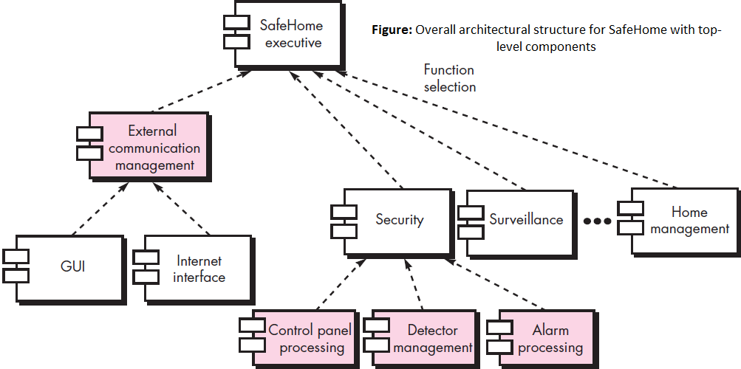
Architectural Design
Notes:
Overall architectural structure for SafeHome Security system with top-level components are shown in the figure above.

Slide 30
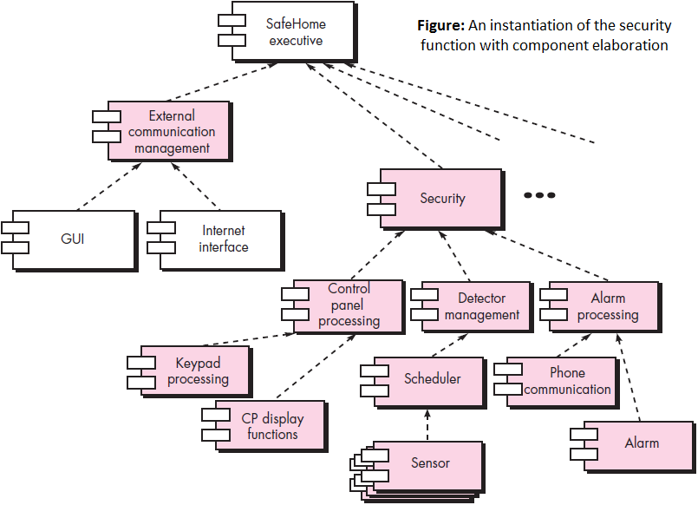
Architectural Design
Notes:
Figure above illustrates an instantiation of the SafeHome architecture for the security system. Components shown in Figure of previous slide are elaborated to show additional detail.
For example, the detector management component interacts with a scheduler infrastructure component that implements polling of each sensor object used by the security system. Similar elaboration is performed for each of the components represented in Figure of previous slide.

Slide 31
Process and Project Metrics
Notes:
What is it?
Measurement (సంపూర్ణమైన కొలతలు) enables us to gain insight (అంతర్గత నిజాలను) into the process and the project by providing a mechanism for objective evaluation.
Software process and project metrics (meaning కొలమానాలు | system or standard of measurement) are quantitative (meaning measured by the quantity of something) measures that enable you to gain insight into the efficacy (meaning effectiveness) of the software process and the projects that are conducted using the process as a framework.
Basic quality and productivity data are collected. These data are then analyzed, compared against past averages, and assessed to determine whether quality and productivity improvements have occurred.
Metrics are also used to pinpoint problem areas so that remedies can be developed and the software process can be improved.
Who does it?
Software metrics are analyzed and assessed by software managers. Measures are often collected by software engineers.
Why is it important?
If you don’t measure, judgment can be based only on subjective evaluation. With measurement, trends (either good or bad) can be spotted, better estimates can be made, and true improvement can be accomplished over time.

Slide 32
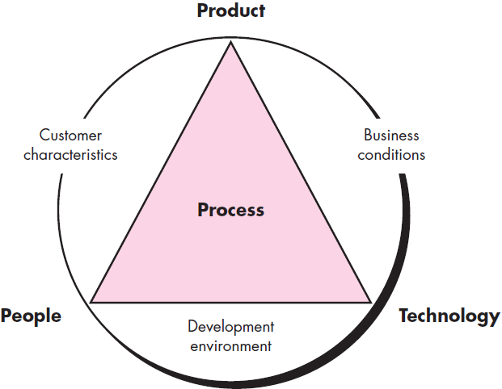
METRICS IN THE PROCESS AND PROJECT DOMAINS
Process metric:
Collected across all projects (over long period = time)
Intention - - → provide set = process indicators that lead → long term s/w process improvement.
Project metric enable s/w proj. manager →
Assess status = an outgoing project
Track potential risks
Uncover problem areas before they go critical
Adjust work flow &
Evaluate proj.’s team ability → control quality = s/w work products.
Process Metrics and Software Process Improvement:
Improve any process
Measure specific attributes = process
Develop set = meaningful metrics
Use metrics → provide indicators
Notes:
Process metrics are collected across all projects and over long periods of time. Their intent is to provide a set of process indicators that lead to long-term software process improvement.
Project metrics enable a software project manager to:
Assess the status of an ongoing project
Track potential risks
Uncover (meaning reveal) problem areas before they go “critical”
Adjust work flow or tasks &
Evaluate the project team’s ability to control quality of software work products.
Measures that are collected by a project team and converted into metrics for use during a project can also be transmitted to those with responsibility for software process improvement. For this reason, many of the same metrics are used in both the process and project domains.
Process Metrics and Software Process Improvement:
The only rational way to improve any process is to measure specific attributes of the process, develop a set of meaningful metrics based on these attributes, and then use the metrics to provide indicators that will lead to a strategy for improvement.
Note: It is important to note that process is only one of a number of “controllable factors in improving software quality and organizational performance”.
Referring to Figure above process sits at the center of a triangle connecting three factors that have a profound influence on software quality and organizational performance.
The skill and motivation of people has been shown to be the single most influential factor in quality and performance.
The complexity of the product can have a substantial impact on quality and team performance.
The technology (i.e., the software engineering methods and tools) that populates the process also has an impact.

Slide 33
METRICS IN THE PROCESS AND PROJECT DOMAINS
software metrics etiquette:
Use common sense & organizational sensitivity
Provide regular feedback → individuals
Don’t use metrics → appraise
Work w→ practitioners & teams → set goals & metrics
Never use metrics → threaten
Metrics data indicate a problem area “negative.”
Don’t obsess on a single metric to the exclusion of other important metrics.
Notes:
In addition, the process triangle exists within a circle of environmental conditions that include:
The development environment (e.g., integrated software tools)
Business conditions (e.g., deadlines, business rules) &
Customer characteristics (e.g., ease of communication and collaboration)
You can only measure the efficacy of a software process indirectly i.e. you derive a set of metrics based on the outcomes that can be derived from the process. Outcomes include measures of:
Errors uncovered before release of the software
Defects delivered to and reported by end users
Work products delivered (productivity)
Human effort expended (meaning spend | ఖర్చైన)
Calendar time expended
Schedule conformance & other measures
You can also derive process metrics by measuring the characteristics of specific software engineering tasks. For example, you might measure the effort and time spent performing the umbrella activities and the generic software engineering activities.
Software process metrics can provide significant benefit as an organization works to improve its overall level of process maturity. However, like all metrics, these can be misused, creating more problems than they solve. Grady suggests a “software metrics etiquette” i.e. appropriate for both managers & practitioners as they institute (meaning introduce | ప్రారంబించు) a process metrics program:
Use common sense and organizational sensitivity when interpreting metrics data.
Provide regular feedback to the individuals and teams who collect measures and metrics.
Don’t use metrics to appraise individuals.
Work with practitioners and teams to set clear goals and metrics that will be used to achieve them.
Never use metrics to threaten individuals or teams.
Metrics data that indicate a problem area should not be considered “negative.” These data are merely an indicator for process improvement.
Don’t obsess (meaning take control of) on a single metric to the exclusion of other important metrics.

Slide 34
METRICS IN THE PROCESS AND PROJECT DOMAINS
Project Metrics:
1st application = project metrics on s/w projects
Occurs – estimation
Metrics collected ⬅ past projects r used as basis ⬅ w?
Effort & time estimates r made ← current s/w work
As project proceeds
Effort & calendar time expended r compared → original estimates
Project manager uses these data
Intent = project metric:
Twofold
used → minimize development schedule (avoid delays)
used → assess product quality
As quality ↑
Defects ↓
Rework ↓
Cost ↓
Notes:
The first application of project metrics on most software projects occurs during estimation. Metrics collected from past projects are used as a basis from which effort and time estimates are made for current software work. As a project proceeds, measures of effort & calendar time expended are compared to original estimates (and project schedule). The project manager uses these data to monitor & control progress.
As technical work commences, other project metrics begin to have significance. Production rates represented in terms of models created, review hours, function points, and delivered source lines are measured. In addition, errors uncovered during each software engineering task are tracked. As the software evolves from requirements into design, technical metrics are collected to assess design quality and to provide indicators that will influence the approach taken to code generation and testing.
The intent of project metrics is twofold.
First, these metrics are used to minimize the development schedule by making the adjustments necessary to avoid delays and mitigate potential problems and risks.
Second, project metrics are used to assess product quality on an ongoing basis and, when necessary, modify the technical approach to improve quality.
As quality improves (↑), defects are minimized (↓), and as the defect count goes down(↓), the amount of rework required during the project is also reduced(↓). This leads to a reduction in overall project cost(↓).

Slide 35
Software Measurement
Measurements
2 Types:
Direct measures &
Indirect measures
Software metrics can be categorized similarly.
Direct measures = s/w process +de cost & effort applied.
Direct measures = product +de
lines of code (LOC) produced
execution speed
memory size &
defects reported
Indirect measures = product +de
Functionality
Quality
Complexity
Efficiency
Reliability
Maintainability
Notes:
Measurements in the physical world can be categorized in two ways:
Direct measures (e.g., the length of a bolt) &
Indirect measures (e.g., the “quality” of bolts produced, measured by counting rejects).
Software metrics can be categorized similarly.
Direct measures of the software process include cost and effort applied.
Direct measures of the product include lines of code (LOC) produced, execution speed, memory size, and defects reported over some set period of time.
Indirect measures of the product include functionality, quality, complexity, efficiency, reliability, maintainability, and many other “–abilities”.
The cost and effort required to build software, the number of lines of code produced, and other direct measures are relatively easy to collect, as long as specific conventions for measurement are established in advance.
However, the quality and functionality of software or its efficiency or maintainability are more difficult to assess and can be measured only indirectly.

Slide 36
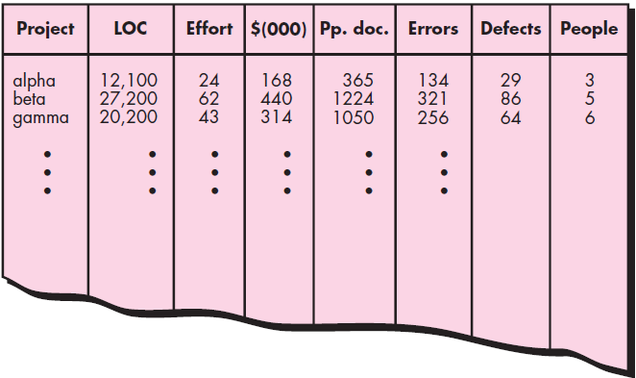
Software Measurement Size-Oriented Metrics
Size-oriented metrics
Derived
Normalizing
Quality
Productivity measures (size = s/w produced)
Table = size oriented measures (figure)
Pp. doc. Pages per Documentation
Notes:
Size-oriented software metrics are derived by normalizing (meaning సాధారణీకరణ) quality and/or productivity measures by considering the size of the software that has been produced.
If a software organization maintains simple records, a table of size-oriented measures, such as the one shown in Figure above, can be created.
The table lists each software development project that has been completed over the past few years and corresponding measures for that project. Referring to the table entry int the above figure for project alpha:
12,100 lines of code were developed with 24 person-months of effort at a cost of $168,000.
It should be noted that the effort and cost recorded in the table represent all software engineering activities (analysis, design, code, and test), not just coding.
Further information for project alpha indicates that 365 pages of documentation were developed, 134 errors were recorded before the software was released, and 29 defects were encountered after release to the customer within the first year of operation.
Three people worked on the development of software for project alpha.
In order to develop metrics that can be assimilated (meaning adopted) with similar metrics from other projects, you can choose lines of code as a normalization (meaning సాధారణీకరణ) value.
From the rudimentary (meaning basic) data contained in the table, a set of simple size-oriented metrics can be developed for each project:
• Errors per KLOC (thousand lines of code)
• Defects per KLOC
• $ per KLOC
• Pages of documentation per KLOC
In addition, other interesting metrics can be computed:
• Errors per person-month
• KLOC per person-month
• $ per page of documentation

Slide 37
Software Measurement Function-Oriented Metrics
Function-oriented s/w metrics
Measure = functionality (use)
Delivered
application as a normalization value.
most widely used function-oriented metric
Function Point (FP)
Computation = FP
based on characteristics = s/w information domain & complexity.
Notes:
Function-oriented software metrics use a measure of the functionality delivered by the application as a normalization value. The most widely used function-oriented metric is the function point (FP). Computation of the function point is based on characteristics of the software’s information domain and complexity.
The function point, like the LOC measure, is controversial.
Proponents (meaning one who supports) claim that FP is programming language independent, making it ideal for applications using conventional and nonprocedural languages, and that it is based on data that are more likely to be known early in the evolution of a project, making FP more attractive as an estimation approach.
Opponents claim that the method requires some “sleight of hand” (meaning నేర్పు గల చెయ్యి) in that computation is based on subjective rather than objective data, that counts of the information domain (and other dimensions) can be difficult to collect after the fact, and that FP has no direct physical meaning—it’s just a number.

Slide 38
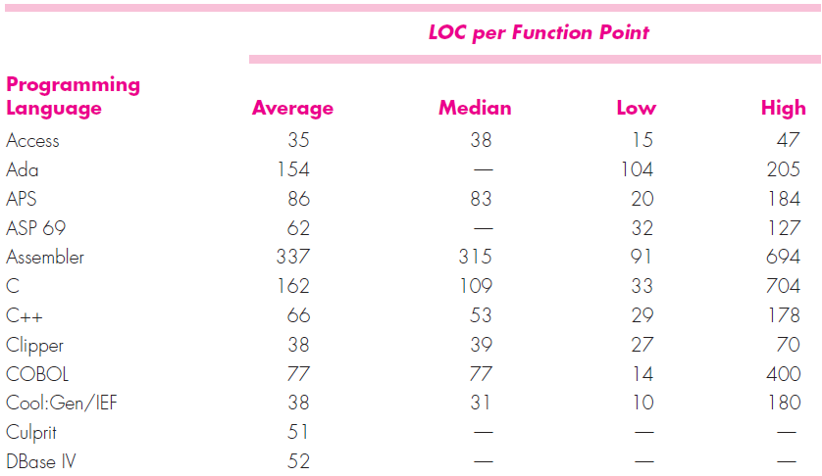
Software Measurement Reconciling LOC and FP Metrics
Relationship between LOC & FP
Programming language (depends)
Used → implement s/w & quality = design
The following table provides rough estimates = avg. No. = LOC required
build 1 FP in various prog. lang.’s.
Notes:
Reconcile meaning restore friendly relations between
The relationship between lines of code and function points depends upon the programming language that is used to implement the software and the quality of the design. A number of studies have attempted to relate FP and LOC measures.
The above mentioned table provides rough estimates of the average number of lines of code required to build one function point in various programming languages:
LOC per Function Point
Programming Language Average Median Low High
Access 35 38 15 47
Ada 154 — 104 205
APS 86 83 20 184
ASP 69 62 — 32 127
Assembler 337 315 91 694
C 162 109 33 704
C++ 66 53 29 178
Clipper 38 39 27 70
COBOL 77 77 14 400
Cool:Gen/IEF 38 31 10 180
Culprit 51 — — —
A review of these data indicates that one LOC of C++ provides approximately 2.4 times (e.g. 162/66) the “functionality” (on average) as one LOC of C.
Using the information contained in the table, it is possible to “backfire” (meaning a fire started deliberately to stop the progress of an approaching fire by creating a burned area in its path.) existing software to estimate the number of function points, once the total number of programming language statements are known.
Function points and LOC-based metrics have been found to be relatively accurate predictors of software development effort and cost.

Slide 39
Software Measurement Object-Oriented Metrics
Conventional s/w Proj. metrics c→ used → estimate object-oriented s/w Proj.’s.
Metrics provide enough granularity ← schedule & effort adjustments
Lorenz & Kidd suggest the following set = metrics ← OO projects:
No. = scenario scripts
No. = key classes
No. = support classes
Avg. no. = support classes per key class
No. = subsystems
Notes:
Conventional software project metrics (LOC or FP) can be used to estimate object-oriented software projects.
However, these metrics do not provide enough granularity for the schedule and effort adjustments that are required as you iterate through an evolutionary or incremental process. Lorenz and Kidd suggest the following set of metrics for OO projects:
Number of scenario scripts: A scenario script is a detailed sequence of steps that describe the interaction between the user and the application. Each script is organized into triplets of the form {initiator, action, participant} where initiator is the object that requests some service (that initiates a message), action is the result of the request & participant is the server object that satisfies the request.
Number of key classes: Key classes are the “highly independent components” that are defined early in object-oriented analysis. Because key classes are central to the problem domain, the number of such classes is an indication of the amount of effort required to develop the software and also an indication of the potential amount of reuse to be applied during system development.
Number of support classes: Support classes are required to implement the system but are not immediately related to the problem domain. Examples might be user interface (GUI) classes, database access and manipulation classes, and computation classes. In addition, support classes can be developed for each of the key classes. Support classes are defined iteratively throughout an evolutionary process.
Average number of support classes per key class: In general, key classes are known early in the project. Support classes are defined throughout. If the average number of support classes per key class were known for a given problem domain, estimating (based on total number of classes) would be greatly simplified.
Number of subsystems: A subsystem is an aggregation of classes that support a function that is visible to the end user of a system. Once subsystems are identified, it is easier to lay out a reasonable schedule in which work on subsystems is partitioned among project staff.

Slide 40
Software Measurement Use-Case-Oriented Metrics
Use-Case-Oriented
used widely as a method ← describing customer-level or business domain requirements.
Seem reasonable → use the use case as a normalization measure
Like FP
Use case - - defined early in the s/w process
Use cases describe user-visible functions & features
basic requirements ← system
In addition
No. = use cases - - directly proportional → size = application in LOC
Notes:
Use cases are used widely as a method for describing customer-level or business domain requirements that imply software features and functions. It would seem reasonable to use the use case as a normalization measure similar to LOC or FP.
Like FP, the use case is defined early in the software process, allowing it to be used for estimation before significant modeling and construction activities are initiated.
Use cases describe (indirectly, at least) user-visible functions and features that are basic requirements for a system. The use case is independent of programming language.
In addition, the number of use cases is directly proportional to the size of the application in LOC and to the number of test cases that will have to be designed to fully exercise the application.
Because use cases can be created at vastly different levels of abstraction, there is no standard “size” for a use case. Without a standard measure of what a use case is, its application as a normalization measure (e.g., effort expended per use case) is suspect.
Researchers have suggested use-case points (UCPs) as a mechanism for estimating project effort and other characteristics. The UCP is a function of the number of actors and transactions implied by the use-case models and is analogous (meaning similar) to the FP in some ways.

Slide 41
Software Measurement WebApp Project Metrics
Objective = WebApp projects
deliver a combination = content & functionality (end user)
Measures & metrics used ← traditional s/w engg. projects
difficult → translate → WebApps
possible → develop a database
allows access → internal productivity & quality measures derived over no. = projects.
Among the measures that c→ collected r no. =
static Web pages
dynamic Web pages
internal page links
persistent data objects
external systems interfaced
static content objects
dynamic content objects
of executable functions
Notes:
Number of static Web pages: Web pages with static content are the most common of all WebApp features. These pages represent low relative complexity and generally require less effort to construct than dynamic pages. This measure provides an indication of the overall size of the application and the effort required to develop it.
Number of dynamic Web pages: Web pages with dynamic content (end-user actions) are essential in all e-commerce applications, search engines etc.. These pages represent higher relative complexity and require more effort to construct than static pages. This measure provides an indication of the overall size of the application and the effort required to develop it.
Number of internal page links: Internal page links are pointers that provide
a hyperlink to some other Web page within the WebApp. This measure provides an indication of the degree of architectural coupling within the WebApp. As the number of page links increases, the effort expended on navigational design and construction also increases.
Number of persistent data objects: One or more persistent data objects (e.g., a database or data file) may be accessed by a WebApp. As the number of persistent data objects grows, the complexity of the WebApp also grows and the effort to implement it increases proportionally.
Number of external systems interfaced: WebApps must often interface with “backroom” business applications. As the requirement for interfacing grows, system complexity and development effort also increase.
Number of static content objects: Static content objects encompass static text-based, graphical, video, animation, and audio information that are incorporated within the WebApp. Multiple content objects may appear on a single Web page.
Number of dynamic content objects: Dynamic content objects are generated based on end-user actions and encompass internally generated text based, graphical, video, animation, and audio information that are incorporated within the WebApp. Multiple content objects may appear on a single Web page.
Number of executable functions: An executable function (e.g., a script or applet) provides some computational service to the end user. As the number of executable functions increases, modeling and construction effort also increase.

Slide 42
Metrics for Software Quality
goal = s/w engg.
High-quality system, application, | product
in time frame
satisfies a market need
Metrics like
work product errors per function point
errors uncovered per review hour &
errors uncovered per testing hour
provide insight → the efficacy = each = the activities implied by the metric
Error data
Also used → compute the defect removal efficiency (DRE)
each process framework activity
Notes:
The overriding goal of software engineering is to produce a high-quality system, application, or product within a time frame that satisfies a market need.
To achieve this goal, you must apply effective methods coupled with modern tools within the context of a mature software process. In addition, a good software engineer (and good software engineering managers) must measure if high quality is to be realized.
The quality of a system, application, or product is only as good as the requirements that describe the problem, the design that models the solution, the code that leads to an executable program, and the tests that exercise the software to uncover errors.
You can use measurement to assess the quality of the requirements and design models, the source code, and the test cases that have been created as the software is engineered.
To accomplish this real-time assessment, you apply product metrics to evaluate the quality of software engineering work products in objective, rather than subjective ways.
A project manager must also evaluate quality as the project progresses. Private metrics collected by individual software engineers are combined to provide project level results.
Although many quality measures can be collected, the primary thrust at the project level is to measure errors and defects.
Metrics derived from these measures provide an indication of the effectiveness of individual and group software quality assurance and control activities.
Metrics such as work product errors per function point, errors uncovered per review hour, and errors uncovered per testing hour provide insight into the efficacy of each of the activities implied by the metric.

Slide 43
Metrics for Software Quality Measuring Quality
Many measures = s/w quality
Correctness
Maintainability
Integrity &
Usability
provide useful indicators ← project team.
Gilb suggests definitions & measures:
Correctness
Maintainability
Integrity
Usability
Notes:
Although there are many measures of software quality, correctness, maintainability, integrity, and usability provide useful indicators for the project team. Gilb suggests definitions and measures for each.
Correctness: A program must operate correctly or it provides little value to its users. Correctness is the degree to which the software performs its required function.
Maintainability: It is the ease with which a program can be corrected if an error is encountered, adapted if its environment changes, or enhanced if the customer desires a change in requirements.
There is no way to measure maintainability directly; therefore, you must use indirect measures. A simple time-oriented metric is mean-time-to-change (MTTC), the time it takes to analyze the change request, design an appropriate modification, implement the change, test it, and distribute the change to all users.
Integrity: Software integrity has become increasingly important in the age of cyber terrorists and hackers. This attribute measures a system’s ability to withstand attacks (both accidental and intentional) to its security. Attacks can be made on all three components of software: programs, data, and documentation.
To measure integrity, two additional attributes must be defined: threat and security. Threat is the probability (which can be estimated or derived from empirical evidence) that an attack of a specific type will occur within a given time. Security is the probability (which can be estimated or derived from empirical evidence) that the attack of a specific type will be repelled. The integrity of a system can then be defined as:
Integrity = ∑[1 − (threat X (1 − security))]
Usability: If a program is not easy to use, it is often doomed (meaning cursed) to failure, even if the functions that it performs are valuable. Usability is an attempt to quantify ease of use.

Slide 44
Metrics for Software Quality Defect Removal Efficiency
Quality metric
Provides benefit at both project & process level
defect removal efficiency (DRE)
Measure = filtering ability = quality assurance & control actions
Applied throughout all process framework activities
Wn? Considered ← project as a whole, DRE - - defined as: DRE = E / E + D
E
no. = errors found before delivery = s/w → end user
D
no. = defects found after delivery
Notes:
A quality metric that provides benefit at both the project and process level is defect removal efficiency (DRE). In essence, DRE is a measure of the filtering ability of quality assurance and control actions as they are applied throughout all process framework activities. When considered for a project as a whole, DRE is defined in the following manner:
DRE = E/ E + D
Where E is the number of errors found before delivery of the software to the end user and D is the number of defects found after delivery.
The ideal value for DRE is 1. That is, no defects are found in the software. Realistically, D will be greater than 0, but the value of DRE can still approach 1 as E increases for a given value of D.
In fact, as E increases, it is likely that the final value of D will decrease (errors are filtered out before they become defects). If used as a metric that provides an indicator of the filtering ability of quality control and assurance activities, DRE encourages a software project team to institute techniques for finding as many errors as possible before delivery.
DRE can also be used within the project to assess a team’s ability to find errors before they are passed to the next framework activity or software engineering action. For example, requirements analysis produces a requirements model that can be reviewed to find and correct errors. Those errors that are not found during the review of the requirements model are passed on to design (where they may or may not be found). When used in this context, we redefine DRE as
DRE_{i} = E_{i} / E_{i} + E_{i+1}
Where E_{i} is the number of errors found during software engineering action i and E_{i+ 1} is the number of errors found during software engineering action i + 1 that are traceable to errors that were not discovered in software engineering action i.

