Slide 1
UNIT-IV
SOFTWARE TESTING STRATEGIES AND APPLICATIONS
By
Mr. T. M. Jaya Krishna _{M.Tech}

Slide 2
TESTING STRATEGIES
Notes:
Software design encompasses the set of principles, concepts, and practices that lead to the development of a high-quality system or product. Design principles establish an overriding philosophy that guides you in the design work you must perform. Design concepts must be understood before the mechanics of design practice are applied, and design practice itself leads to the creation of various representations of the software that serve as a guide for the construction activity that follows.
The goal of design is to produce a model or representation that exhibits firmness, commodity, and delight. To accomplish this, you must practice diversification (meaning enlarging) and then convergence (meaning similar characteristics ఏకీభవించటం).
Belady states that “diversification is the acquisition of a repertoire (meaning collection) of alternatives, the raw material of design: components, component solutions, and knowledge, all contained in catalogs, textbooks, and the mind.” Once this diverse set of information is assembled, you must pick and choose elements from the repertoire that meet the requirements defined by requirements engineering and the analysis model.
As this occurs, alternatives are considered and rejected and you converge (meaning develop something in common) on “one particular configuration of components, and thus the creation of the final product”.
Diversification and convergence combine intuition (meaning అంతర్ దృష్టి|వాస్తవాన్ని తెలుసుకొనుట) and judgment based on experience in building similar entities, a set of principles and/or heuristics that guide the way in which the model evolves, a set of criteria that enables quality to be judged, and a process of iteration that ultimately leads to a final design representation.
Software design changes continually as new methods, better analysis, and broader understanding evolve. Even today, most software design methodologies lack the depth, flexibility, and quantitative nature that are normally associated with more classical engineering design disciplines. However, methods for software design do exist, criteria for design quality are available, and design notation can be applied.

Slide 3
A strategic approach to software testing
Testing
Set = activities c→ planned in advance & conducted systematically
No. = s/w testing strategies h→ proposed
All provide u w→ a template ← testing & all have the following generic characteristics:
perform effective testing (technical reviews conducted)
Testing begins at the component level
Different testing techniques r appropriate ← different s/w engg. Approaches
Testing Conducted – developer = s/w
Testing & debugging (different activities)
Notes:
Testing is a set of activities that can be planned in advance and conducted systematically.
For this reason a template for software testing—a set of steps into which you can place specific test case design techniques and testing methods—should be defined for the software process.
A number of software testing strategies have been (h→) proposed in the literature. All provide you with a template for testing and all have the following generic characteristics:
To perform effective testing, you should conduct effective technical reviews. By doing this, many errors will be eliminated before testing commences.
Testing begins at the component level and works “outward” toward the integration of the entire computer-based system.
Different testing techniques are appropriate for different software engineering approaches and at different points in time.
Testing is conducted by the developer of the software and (for large projects) an independent test group.
Testing and debugging are different activities, but debugging must be accommodated in any testing strategy.
A strategy for software testing must accommodate low-level tests that are necessary to verify that a small source code segment has been correctly implemented as well as high-level tests that validate major system functions against customer requirements.
A strategy should provide guidance for the practitioner and a set of milestones for the manager. Because the steps of the test strategy occur at a time when deadline pressure begins to rise, progress must be measurable and problems should surface as early as possible.

Slide 4
A strategic approach to software testing Verification and Validation
Software testing
one element = broader topic i.e. often referred → as verification & validation
Verification:
“r we building the product right?”
Validation:
“re we building the right product?”
Notes:
Software testing is one element of a broader topic that is often referred to as verification and validation (V&V). Verification refers to the set of tasks that ensure that software correctly implements a specific function. Validation refers to a different set of tasks that ensure that the software that has been built is traceable to customer requirements.
Boehm states this another way:
Verification: “Are we building the product right?”
Validation: “Are we building the right product?”
The definition of V&V encompasses many software quality assurance activities.
Verification and validation includes a wide array of SQA activities: technical reviews, quality and configuration audits, performance monitoring, simulation, feasibility study, documentation review, database review, algorithm analysis, development testing, usability testing, qualification testing, acceptance testing, and installation testing.
Although testing plays an extremely important role in V&V, many other activities are also necessary.
Organizing for Software Testing:
For every software project, there is an inherent conflict of interest that occurs as testing begins. The people who have built the software are now asked to test the software.
This seems harmless in itself; after all, who knows the program better than its developers? Unfortunately, these same developers have interest in demonstrating that the program is error-free, that it works according to customer requirements, and that it will be completed on schedule and within budget. Each of these interests mitigate (meaning ease or reduce) against thorough testing.

Slide 5
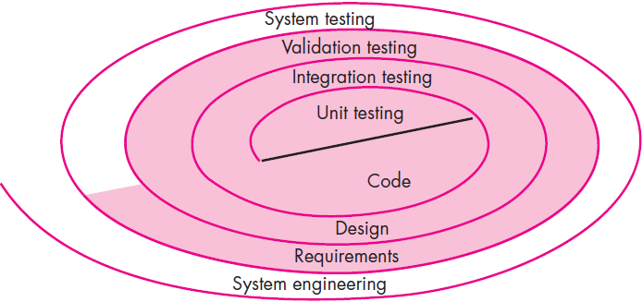
A strategic approach to software testing Software Testing Strategy—The Big Picture
s/w process m→ viewed as spiral (figure).
Initially
System engineering defines role = s/w & leads → s/w requirements analysis
Moving inward
Reach → design & finally → coding
A strategy ← s/w testing viewed in context = spiral (Figure).
Unit testing begins at the vortex = spiral
Testing progresses by
Moving outward → integration testing
Taking another turn outward → validation testing
Finally, you arrive at system testing
Notes:
The software process may be (m→) viewed as the spiral illustrated in Figure above.
Initially, system engineering defines the role of software and leads to software requirements analysis, where the information domain, function, behavior, performance, constraints, and validation criteria for software are established.
Moving inward (meaning proceeding towards inside) along the spiral, you come to design and finally to coding. To develop computer software, you spiral inward (counterclockwise) along streamlines that decrease the level of abstraction on each turn.
A strategy for software testing may also be viewed in the context of the spiral (Figure above).
Unit testing begins at the vortex (meaning సుడిగుండం) of the spiral and concentrates on each unit (e.g., component, class, or WebApp content object) of the software as implemented in source code. Testing progresses by moving outward along the spiral to integration testing, where the focus is on design and the construction of the software architecture.
Taking another turn outward on the spiral, you encounter validation testing, where requirements established as part of requirements modeling are validated against the software that has been constructed.
Finally, you arrive at system testing, where the software and other system elements are tested as a whole. To test computer software, you spiral out in a clockwise direction along streamlines that broaden the scope of testing with each turn.

Slide 6
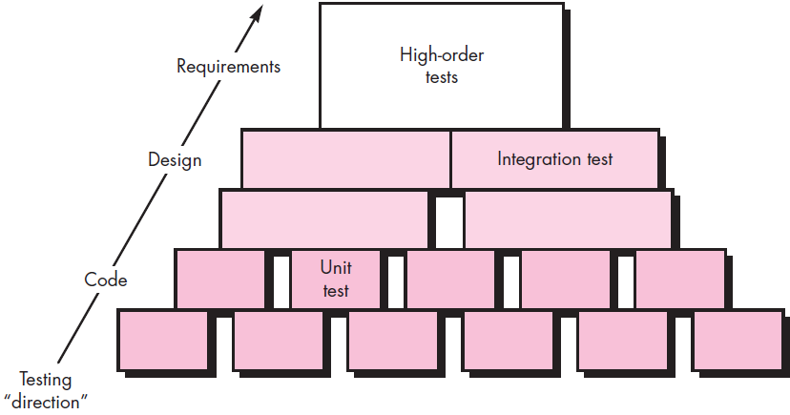
A strategic approach to software testing Software Testing Strategy—The Big Picture
Considering process ⬅ a procedural point = view testing w→ in context = s/w engg. - - series = 4 steps:
unit testing
Integration testing
Validation testing
System testing
Notes:
Considering the process from a procedural point of view, testing within the context of software engineering is actually a series of four steps that are implemented sequentially. The steps are shown in Figure above.
Initially, tests focus on each component individually, ensuring that it functions properly as a unit. Hence, the name unit testing. Unit testing makes heavy use of testing techniques that exercise specific paths in a component’s control structure to ensure complete coverage and maximum error detection.
Next, components must be assembled or integrated to form the complete software package. Integration testing addresses the issues associated with the dual problems of verification and program construction.
Test case design techniques that focus on inputs and outputs are more prevalent during integration, although techniques that exercise specific program paths may be used to ensure coverage of major control paths.
After the software has been integrated (constructed), a set of high-order tests is conducted. Validation criteria (established during requirements analysis) must be evaluated. Validation testing provides final assurance that software meets all informational, functional, behavioral, and performance requirements.
The last high-order testing step falls outside the boundary of software engineering and into the broader context of computer system engineering. Software, once validated, must be combined with other system elements (e.g., hardware, people, databases). System testing verifies that all elements mesh properly and that overall system function/performance is achieved.

Slide 7
A strategic approach to software testing Criteria for Completion of Testing
Question:
Wn? are we done testing?
H? do we know that we’ve tested enough?
definitive answer
but
few pragmatic responses.
Responses:
s/w engg. never done testing
burden simply shifts → end user
Notes:
A classic question arises every time software testing is discussed: “When are we done testing—how do we know that we’ve tested enough?” Sadly, there is no definitive answer to this question, but there are a few pragmatic (meaning practical) responses and early attempts at empirical guidance.
One response to the question is: “You’re never done testing; the burden simply shifts from you (the software engineer) to the end user.” Every time the user executes a computer program, the program is being tested. This sobering (meaning creating a more serious, sensible) fact underlines the importance of other software quality assurance activities. Another response (somewhat cynical but nonetheless accurate) is: “You’re done testing when you run out of time or you run out of money.”
Although few practitioners would argue with these responses, you need more rigorous criteria for determining when sufficient testing has been conducted.
The cleanroom software engineering approach suggests statistical use techniques that execute a series of tests derived from a statistical sample of all possible program executions by all users from a targeted population.
Note: Cleanroom software engineering emphasizes (meaning highlights or give special importance) mathematical verification of correctness before program construction commences and certification of software reliability as part of the testing activity.

Slide 8
Strategic Issues
Systemic strategy ⬅s/w testing
Fails
Series = overriding issues r addressed
Tom Gilb argues that s/ware testing strategy will succeed wn? s/w testers:
Specify product requirements long before
State testing objectives
Understand users
Testing plan -emphasize “rapid cycle testing” (develop)
“robust” software i.e. designed → test itself (build)
effective technical reviews as a filter prior → testing (use)
technical reviews → assess test strategy & test cases (conduct)
continuous improvement approach ⬅ testing process (develop)
Notes:
A systematic strategy for software testing will fail if a series of overriding issues are not addressed.
Tom Gilb argues that a software testing strategy will succeed when software testers:
Specify product requirements in a quantifiable manner long before testing commences: Although the overriding objective of testing is to find errors, a good testing strategy also assesses other quality characteristics such as portability, maintainability, and usability.
State testing objectives explicitly: The specific objectives of testing should be stated in measurable terms. For example, test effectiveness, test coverage, meantime-to-failure, the cost to find and fix defects, remaining defect density or frequency of occurrence, and test work-hours should be stated within the test plan.
Understand the users of the software and develop a profile for each user category: Use cases that describe the interaction scenario for each class of user can reduce overall testing effort by focusing testing on actual use of the product.
Develop a testing plan that emphasizes “rapid cycle testing”: Gilb recommends that a software team “learn to test in rapid cycles (2 percent of project effort) of customer-useful, at least field ‘trial able,’ increments of functionality and/or quality improvement.” The feedback generated from these rapid cycle tests can be used to control quality levels and the corresponding test strategies.
Build “robust” software that is designed to test itself: Software should be designed in a manner that uses antibugging techniques. That is, software should be capable of diagnosing certain classes of errors. In addition, the design should accommodate automated testing and regression testing.
Use effective technical reviews as a filter prior to testing: Technical reviews can be as effective as testing in uncovering errors. For this reason, reviews can reduce the amount of testing effort that is required to produce high quality software.
Conduct technical reviews to assess the test strategy and test cases themselves: Technical reviews can uncover inconsistencies, omissions, and outright errors in the testing approach. This saves time and also improves product quality.
Develop a continuous improvement approach for the testing process: The test strategy should be measured. The metrics collected during testing should be used as part of a statistical process control approach for software testing.

Slide 9
Test Strategies for Conventional Software Unit Testing
Many strategies → test s/w
System - - fully constructed & then tested
Drawback:
Result in buggy s/w
Conduct test on daily basis
Drawback:
s/w developer’s hesitate → use
Solution:
Testing strategy:
Takes incremental view = testing beginning w→ testing individual prog. Units
designed → facilitate integration = units (tested)
Culminate w→ tests that exercise constructed system
Unit testing:
internal processing logic and data structures
Notes:
There are many strategies that can be used to test software. At one extreme, you can wait until the system is fully constructed and then conduct tests on the overall system in hopes of finding errors. This approach, although appealing, simply does not work. It will result in buggy software that disappoints all stakeholders.
At the other extreme, you could conduct tests on a daily basis, whenever any part of the system is constructed. This approach, although less appealing to many, can be very effective. Unfortunately, some software developers hesitate to use it. What to do?
A testing strategy that is chosen by most software teams falls between the two extremes. It takes an incremental view of testing, beginning with the testing of individual program units, moving to tests designed to facilitate the integration of the units, and culminating (meaning ending) with tests that exercise the constructed system.
Unit Testing:
Unit testing focuses verification effort on the smallest unit of software design – the software component or module. Using the component-level design description as a guide, important control paths are tested to uncover errors within the boundary of the module.
The relative complexity of tests and the errors those tests uncover is limited by the constrained scope established for unit testing. The unit test focuses on the internal processing logic and data structures within the boundaries of a component. This type of testing can be conducted in parallel for multiple components.

Slide 10
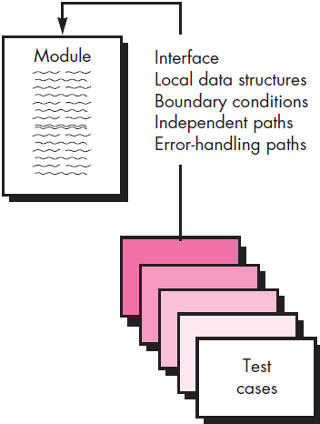
Test Strategies for Conventional Software Unit Test Considerations
Module interface - - tested
Local data structures r examined
All independent paths thru control structure r exercised
Boundary conditions r tested
All error-handling paths r tested.
Notes:
Unit Test Considerations:
Unit tests are illustrated schematically in Figure above.
The module interface is tested to ensure that information properly flows into and out of the program unit under test.
Local data structures are examined to ensure that data stored temporarily maintains its integrity during all steps in an algorithm’s execution.
All independent paths through the control structure are exercised to ensure that all statements in a module have been executed at least once.
Boundary conditions are tested to ensure that the module operates properly at boundaries established to limit or restrict processing.
And finally, all error-handling paths are tested.
Data flow across a component interface is tested before any other testing is initiated.
If data do not enter and exit properly, all other tests are moot (meaning questionable or doubtful)
Selective testing of execution paths is an essential task during the unit test. Test cases should be designed to uncover errors due to erroneous computations, incorrect comparisons, or improper control flow.
Boundary testing is one of the most important unit testing tasks. Software often fails at its boundaries. That is, errors often occur when the nth element of an n-dimensional array is processed, when the i^{th} repetition of a loop with i passes is invoked, when the maximum or minimum allowable value is encountered.

Slide 11
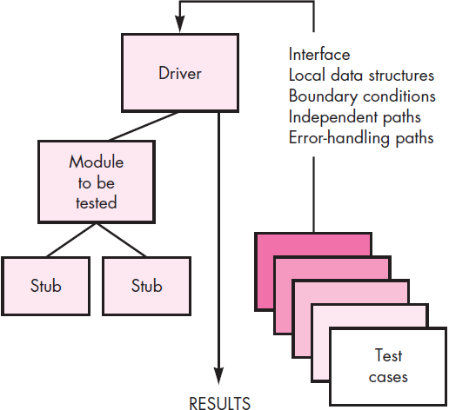
Test Strategies for Conventional Software Unit Test Procedures
Design = unit tests
before coding begins or after source code has been generated
Unit testing environment (figure:)
Driver
More than a main program
Accepts test case data
Prints results
Stub
Replace modules invoked
Component → be tested
Notes:
Unit Test Procedures:
Unit testing is normally considered as an adjunct (meaning supplement or addition) to the coding step. The design of unit tests can occur before coding begins or after source code has been generated.
Each test case should be coupled with a set of expected results. Because a component is not a stand-alone program, driver and/or stub software must often be developed for each unit test.
The unit test environment is illustrated in Figure above. In most applications a driver is nothing more than a “main program” that accepts test case data, passes such data to the component (to be tested), and prints relevant results. Stubs serve to replace modules that are subordinate (invoked by) the component to be tested.
A stub or “dummy subprogram” uses the subordinate module’s interface, may do minimal data manipulation, prints verification of entry, and returns control to the module undergoing testing.
Drivers and stubs represent testing “overhead.” That is, both are software that must be written (formal design is not commonly applied) but that is not delivered with the final software product. If drivers and stubs are kept simple, actual overhead is relatively low.
Unit testing is simplified when a component with high cohesion is designed. When only one function is addressed by a component, the number of test cases is reduced and errors can be more easily predicted and uncovered.

Slide 12
Test Strategies for Conventional Software Integration Testing
Systematic technique ← constructing s/w arch.
Objective - - → take unit-tested components & build prog. structure
Nonincremental integration:
Construct prog. using big bang approach
Incremental integration:
Constructed & tested in small increments
Different incremental integration strategies:
Top-down Integration
Bottom-up Integration
Regression Testing
Smoke Testing
Notes:
Integration Testing:
Integration testing is a systematic technique for constructing the software architecture while at the same time conducting tests to uncover errors associated with interfacing. The objective is to take unit-tested components and build a program structure that has been dictated by design.
There is often a tendency to attempt nonincremental integration; that is, to construct the program using a “big bang” approach. All components are combined in advance. The entire program is tested as a whole. And chaos (meaning confusion or disorder) usually results! A set of errors is encountered. Correction is difficult.
Once these errors are corrected, new ones appear and the process continues in a seemingly endless loop.
Incremental integration is complete opposite to that of the big bang approach. The program is constructed and tested in small increments, where errors are easier to isolate and correct; interfaces are more likely to be tested completely; and a systematic test approach may be applied.
Incremental integration strategies:
Top-down integration testing is an incremental approach to construction of the software architecture. Modules are integrated by moving downward through the control hierarchy, beginning with the main control module (main program).
Modules subordinate (and ultimately subordinate) to the main control module are incorporated into the structure in either a depth-first or breadth-first manner.
Cont. .

Slide 13
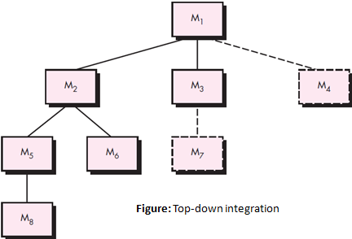
Test Strategies for Conventional Software Integration Testing – Top-down Integration
Depth first integration
Integrates all components
Major control path = prog. structure
Breadth first integration
Incorporates all components directly
Subordinate at each level
Moving horizontally
Notes:
Cont. .
Top-down Integration:
Referring to Figure above
Depth-first integration integrates all components on a major control path of the program structure. Selection of a major path is somewhat arbitrary and depends on application-specific characteristics.
For example, selecting the left-hand path, components M₁, M₂ , M₅ would be integrated first. Next, M₈ or (if necessary for proper functioning of M₂) M₆ would be integrated. Then, the central and right-hand control paths are built.
Breadth-first integration incorporates all components directly subordinate at each level, moving across the structure horizontally. From the figure, components M₂, M₃, and M₄ would be integrated first. The next control level, M₅, M₆, and so on, follows.
The integration process is performed in a series of five steps:
The main control module is used as a test driver and stubs are substituted for all components directly subordinate to the main control module.
Depending on the integration approach selected (i.e., depth or breadth first), subordinate stubs are replaced one at a time with actual components.
Tests are conducted as each component is integrated.
On completion of each set of tests, another stub is replaced with the real component.
Regression testing may be conducted to ensure that new errors have not been introduced.
The process continues from step 2 until the entire program structure is built.

Slide 14
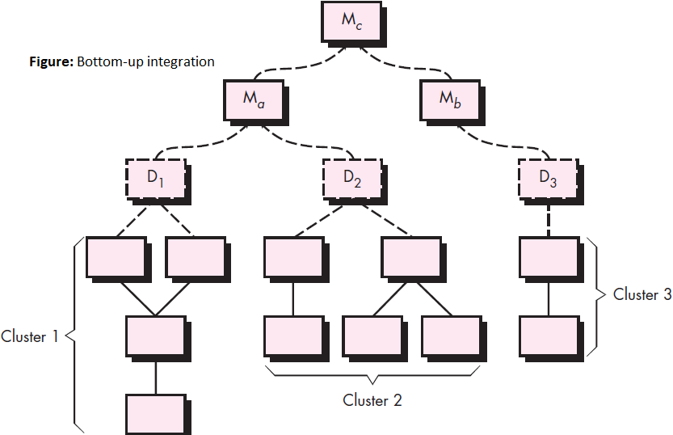
Test Strategies for Conventional Software Integration Testing – Bottom-up Integration
Begins construction & testing w→ atomic modules
Notes:
Bottom-up Integration:
Bottom-up integration testing, as its name implies, begins construction and testing with atomic modules (i.e., components at the lowest levels in the program structure).
Because components are integrated from the bottom up, the functionality provided by components subordinate to a given level is always available and the need for stubs is eliminated. A bottom-up integration strategy may be implemented with the following steps:
Low-level components are combined into clusters (sometimes called builds) that perform a specific software sub function.
A driver (a control program for testing) is written to coordinate test case input and output.
The cluster is tested.
Drivers are removed and clusters are combined moving upward in the program structure.
Integration follows the pattern illustrated in Figure above. Components are combined to form clusters 1, 2, and 3.
Each of the clusters is tested using a driver (shown as a dashed block). Components in clusters 1 and 2 are subordinate to Ma. Drivers D1 and D2 are removed and the clusters are interfaced directly to Ma.
Similarly, driver D3 for cluster 3 is removed prior to integration with module Mb. Both Ma and Mb will ultimately be integrated with component Mc, and so forth. As integration moves upward, the need for separate test drivers lessens.
In fact, if the top two levels of program structure are integrated top down, the number of drivers can be reduced substantially and integration of clusters is greatly simplified.

Slide 15
Test Strategies for Conventional Software Integration Testing – Regression Testing
Context = integration test strategy
regression testing
reexecution = some subset = tests
already been conducted → ensure that changes have propagated unintended side effects
Regression testing
Conducted manually
reexecuting subset = all test cases | using automated capture/playback tools
Enables s/w engg. → capture test cases & results ⬅ playback & comparison
Notes:
Each time a new module is added as part of integration testing, the software changes. New data flow paths are established, new I/O may occur, and new control logic is invoked. These changes may cause problems with functions that previously worked flawlessly.
In the context of an integration test strategy, regression testing is the reexecution of some subset of tests that have already been conducted to ensure that changes have not propagated (meaning promote or reproduce or spread) unintended side effects.
In a broader context, successful tests (of any kind) result in the discovery of errors, and errors must be corrected. Whenever software is corrected, some aspect of the software configuration (the program, its documentation, or the data that support it) is changed.
Regression testing helps to ensure that changes (due to testing or for other reasons) do not introduce unintended behavior or additional errors.
Regression testing may be conducted manually, by reexecuting a subset of all test cases or using automated capture/playback tools. Capture/playback tools enable the software engineer to capture test cases and results for subsequent playback and comparison. The regression test suite (the subset of tests to be executed) contains three different classes of test cases:
A representative sample of tests that will exercise all software functions.
Additional tests that focus on software functions that are likely to be affected by the change.
Tests that focus on the software components that have been changed.

Slide 16
Test Strategies for Conventional Software Integration Testing – Smoke Testing
Designed as pacing mechanism (Time critical projects)
Assess project frequently
Smoke-testing approach encompasses following activities
s/w components translated → code r integrate → build (+des data files, libraries, reusable modules etc..)
Series = tests designed → expose errors
Keep build ⬅ properly performing it’s function
build - - integrated w→ other builds
Entire product - - smoke tested daily
Notes:
Smoke testing is an integration testing approach that is commonly used when product software is developed. It is designed as a pacing (meaning walk at a steady speed, especially without a particular destination and as an expression of anxiety or annoyance.) mechanism for time-critical projects, allowing the software team to assess the project on a frequent basis. In essence, the smoke-testing approach encompasses the following activities:
Software components that have been translated into code are integrated into a build. A build includes all data files, libraries, reusable modules, and engineered components that are required to implement one or more product functions.
A series of tests is designed to expose errors that will keep the build from properly performing its function. The intent should be to uncover “showstopper (meaning obstacle to further progress)” errors that have the highest likelihood of throwing the software project behind schedule.
The build is integrated with other builds, and the entire product (in its current form) is smoke tested daily. The integration approach may be top down or bottom up.
The daily frequency of testing the entire product may surprise some readers. However, frequent tests give both managers and practitioners a realistic assessment of integration testing progress.
Smoke testing provides a number of benefits when it is applied on complex, time critical software projects:
Integration risk is minimized. Because smoke tests are conducted daily, incompatibilities & other show-stopper errors are uncovered early, thereby reducing the likelihood of serious schedule impact when errors are uncovered.
The quality of the end product is improved. Because the approach is construction (integration) oriented, smoke testing is likely to uncover functional errors as well as architectural and component-level design errors. If these errors are corrected early, better product quality will result.
Error diagnosis and correction are simplified. Like all integration testing approaches, errors uncovered during smoke testing are likely to be associated with “new software increments”—that is, the software that has just been added to the build(s) is a probable cause of a newly discovered error.
Progress is easier to assess. With each passing day, more of the software has been integrated and more has been demonstrated to work. This improves team morale and gives managers a good indication that progress is being made.

Slide 17
Test Strategies for Conventional Software Integration Testing – Strategic options
advantages = 1 strategy tend → result in disadvantages ← other strategy
major disadvantage = top-down approach
need ← stubs
major disadvantage = bottom-up integration
program as an entity does exist until the last module - - added.
Selection = integration strategy depends on
s/w characteristics & sometimes, project schedule
Notes:
There has been much discussion about the relative advantages and disadvantages of top-down versus bottom-up integration testing.
In general, the advantages of one strategy tend to result in disadvantages for the other strategy.
The major disadvantage of the top-down approach is the need for stubs and the attendant testing difficulties that can be associated with them. Problems associated with stubs may be offset by the advantage of testing major control functions early.
The major disadvantage of bottom-up integration is that “the program as an entity does not exist until the last module is added”.
Selection of an integration strategy depends upon software characteristics and, sometimes, project schedule. In general, a combined approach (sometimes called sandwich testing) that uses top-down tests for upper levels of the program structure, coupled with bottom-up tests for subordinate levels may be the best compromise.
As integration testing is conducted, the tester should identify critical modules. A critical module has one or more of the following characteristics:
addresses several software requirements
has a high level of control (resides relatively high in the program structure)
is complex or error prone
has definite performance requirements.
Critical modules should be tested as early as is possible. In addition, regression tests should focus on critical module function.

Slide 18
Test Strategies for Conventional Software Integration Testing – Integration test work products
Work products
test plan & test procedure & becomes part = s/w configuration (incorporates)
Testing - - divided in → phases & builds that address specific characteristics = s/w
Functional & Behavioral
Example: integration testing ← SafeHome security (test phases)
User interacting
Sensor processing
Communications functions
Alarm processing
Notes:
An overall plan for integration of the software and a description of specific tests is documented in a Test Specification.
This work product incorporates a test plan and a test procedure and becomes part of the software configuration.
Testing is divided into phases and builds that address specific functional and behavioral characteristics of the software.
For example, integration testing for the SafeHome security system might be divided into the following test phases:
User interaction (command input and output, display representation, error processing and representation)
Sensor processing (acquisition of sensor output, determination of sensor conditions, actions required as a consequence of conditions)
Communications functions (ability to communicate with central monitoring station)
Alarm processing (tests of software actions that occur when an alarm is encountered)
Each of these integration test phases delineates (meaning describes) a broad functional category within the software and generally can be related to a specific domain within the software architecture.
Therefore, program builds (groups of modules) are created to correspond to each phase. The following criteria and corresponding tests are applied for all test phases:
Interface integrity. Internal and external interfaces are tested as each module (or cluster) is incorporated into the structure.
Functional validity. Tests designed to uncover functional errors are conducted.
Information content. Tests designed to uncover errors associated with local or global data structures are conducted.
Performance. Tests designed to verify performance bounds established during software design are conducted.

Slide 19
Test Strategies for Object Oriented Software Unit Testing in the OO Context
encapsulated class - - usually the focus = unit testing
operations (methods) r smallest testable units
You can no longer test a single operation in isolation ↔ part = class
Class testing ← OO s/w ≡ = unit testing ← conventional s/w
unit testing = conventional s/w focuses on algorithmic detail
Class testing ← OO s/w - - driven by
Operations encapsulated by class & state behavior = class
Notes:
The objective of testing, stated simply, is to find the greatest possible number of errors with a manageable amount of effort applied over a realistic time span.
Although this fundamental objective remains unchanged for object-oriented software, the nature of object-oriented software changes both testing strategy and testing tactics.
Unit Testing in the OO Context:
When object-oriented software is considered, the concept of the unit changes. Encapsulation drives the definition of classes and objects. This means that each class and each instance of a class packages attributes (data) and the operations that manipulate these data.
An encapsulated class is usually the focus of unit testing. However, operations (methods) within the class are the smallest testable units. Because a class can contain a number of different operations, and a particular operation may exist as part of a number of different classes, the tactics applied to unit testing must change.
You can no longer test a single operation in isolation (the conventional view of unit testing) but rather as part of a class. To illustrate, consider a class hierarchy in which an operation X is defined for the superclass and is inherited by a number of subclasses.
Each subclass uses operation X, but it is applied within the context of the private attributes and operations that have been defined for the subclass. Because the context in which operation X is used varies in subtle ways, it is necessary to test operation X in the context of each of the subclasses.
This means that testing operation X in a stand-alone fashion (the conventional unit-testing approach) is usually ineffective in the object-oriented context.
Class testing for OO software is the equivalent of unit testing for conventional software. Unlike unit testing of conventional software, which tends to focus on the algorithmic detail of a module and the data that flow across the module interface, class testing for OO software is driven by the operations encapsulated by the class and the state behavior of the class.

Slide 20
Test Strategies for Object Oriented Software Integration Testing in the OO Context
2 strategies ← integrating testing = OO systems:
Thread-based testing
Set = classes required → respond → 1 i/p | event ← the system
Each thread (individually)
Integrated
Tested
Use-based testing
Begins construction = system
Testing those classes that use server class (if any)
Notes:
There are two different strategies for integration testing of OO systems:
The first, thread-based testing, integrates the set of classes required to respond to one input or event for the system. Each thread is integrated and tested individually. Regression testing is applied to ensure that no side effects occur.
The second integration approach, use-based testing, begins the construction of the system by testing those classes (called independent classes) that use very few (if any) server classes.
After the independent classes are tested, the next layer of classes, called dependent classes, that use the independent classes are tested. This sequence of testing layers of dependent classes continues until the entire system is constructed.
The use of drivers and stubs also changes when integration testing of OO systems is conducted. Drivers can be used to test operations at the lowest level and for the testing of whole groups of classes. A driver can also be used to replace the user interface so that tests of system functionality can be conducted prior to implementation of the interface.
Stubs can be used in situations in which collaboration between classes is required but one or more of the collaborating classes has not yet been fully implemented.
Cluster testing is one step in the integration testing of OO software. Here, a cluster of collaborating classes (determined by examining the CRC and object-relationship model) is exercised by designing test cases that attempt to uncover errors in the collaborations.

Slide 21
Validation Testing Validation criteria
Begins at completion = integration testing
At validation testing distinctions disappear
Between conventional, object oriented & WebApps
Testing focuses on user visible actions & user-recognizable output ⬅ the system
Def:
Validation succeeds wn? s/w functions
reasonably expected by the customer
Validation criteria:
test plan outlines the classes = tests → conducted
test procedure designed → ensure that all functional requirements r satisfied
all behavioral characteristics r achieved
all content - - accurate & properly presented
all performance requirements r attained
documentation - - correct
usability & other requirements r met
Notes:
Validation testing begins at the culmination (meaning completion) of integration testing, when individual components have been exercised, the software is completely assembled as a package, and interfacing errors have been uncovered and corrected.
At the validation or system level, the distinction between conventional software, object-oriented software, and WebApps disappears.
Testing focuses on user-visible actions and user-recognizable output from the system. Validation can be defined in many ways, but a simple definition (according to albeit harsh) is that validation succeeds when software functions in a manner that can be reasonably expected by the customer.
Validation-Test Criteria:
Software validation is achieved through a series of tests that demonstrate conformity with requirements. A test plan outlines the classes of tests to be conducted, and a test procedure defines specific test cases that are designed to ensure that all functional requirements are satisfied, all behavioral characteristics are achieved, all content is accurate and properly presented, all performance requirements are attained, documentation is correct, and usability and other requirements are met (e.g., transportability, compatibility, error recovery, maintainability).
After each validation test case has been conducted, one of two possible conditions exists: (1) The function or performance characteristic conforms to specification and is accepted or (2) a deviation from specification is uncovered and a deficiency list is created. Deviations or errors discovered at this stage in a project can rarely be corrected prior to scheduled delivery. It is often necessary to negotiate with the customer to establish a method for resolving deficiencies.

Slide 22
Validation Testing Configuration Review
ensure that
all elements = s/w configuration
h→ properly developed
r cataloged &
have necessary detail → bolster the support activities.
Notes:
An important element of the validation process is a configuration review. The intent of the review is to ensure that all elements of the software configuration have been properly developed, are cataloged, and have the necessary detail to bolster (meaning support or strengthen)the support activities. The configuration review, sometimes called an audit.

Slide 23
Validation Testing Alpha and Beta Testing
Alpha Test (conducted)
developer’s site
representative group = end users
Developer present
Beta Test (conducted)
one or more end-user sites
Developer present
“live” application = s/w in an environment
controlled by developer
Customer records
All problems & reports
Acceptance Test (Performed)
Wn? custom s/w - - delivered → customer under contract
Series = specific tests → uncover errors before accepting the s/w ⬅ developer
Notes:
The alpha test is conducted at the developer’s site by a representative group of end users. The software is used in a natural setting with the developer “looking over the shoulder” of the users and recording errors and usage problems. Alpha tests are conducted in a controlled environment.
The beta test is conducted at one or more end-user sites. Unlike alpha testing, the developer generally is not present. Therefore, the beta test is a “live” application of the software in an environment that cannot be controlled by the developer.
The customer records all problems (real or imagined) that are encountered during beta testing and reports these to the developer at regular intervals. As a result of problems reported during beta tests, you make modifications and then prepare for release of the software product to the entire customer base.
A variation on beta testing, called customer acceptance testing, is sometimes performed when custom software is delivered to a customer under contract.
The customer performs a series of specific tests in an attempt to uncover errors before accepting the software from the developer. In some cases (e.g., a major corporate or governmental system) acceptance testing can be very formal and encompass many days or even weeks of testing.

Slide 24
Validation Testing System Testing
series = different tests
primary purpose
fully exercise the computer-based system
each test
different purpose
all work → verify
system elements h→ properly integrated & perform allocated functions
Types:
Recovery Testing
Security Testing
Stress Testing
Performance Testing
Deployment Testing
Notes:
software is only one element of a larger computer-based system. Ultimately, software is incorporated with other system elements (e.g., hardware, people, information), and a series of system integration and validation tests are conducted. These tests fall outside the scope of the software process and are not conducted solely by software engineers. However, steps taken during software design and testing can greatly improve the probability of successful software integration in the larger system.
A classic system-testing problem is “finger pointing.” This occurs when an error is uncovered, and the developers of different system elements blame each other for the problem.
Rather than indulging in such nonsense, you should anticipate potential interfacing problems and
1) design error-handling paths that test all information coming from other elements of the system
2) conduct a series of tests that simulate bad data or other potential errors at the software interface
3) record the results of tests to use as “evidence” if finger pointing does occur &
4) participate in planning and design of system tests to ensure that software is adequately tested.
System testing is actually a series of different tests whose primary purpose is to fully exercise the computer-based system. Although each test has a different purpose, all work to verify that system elements have been properly integrated and perform allocated functions.
Types of system tests that are worthwhile for software-based systems:
Recovery Testing Security Testing Stress Testing
Performance Testing Deployment Testing

Slide 25
Validation Testing System Testing
series = different tests
primary purpose
fully exercise the computer-based system
each test
different purpose
all work → verify
system elements h→ properly integrated & perform allocated functions
Types:
Recovery Testing
Security Testing
Stress Testing
Performance Testing
Deployment Testing
Notes:
System testing is actually a series of different tests whose primary purpose is to fully exercise the computer-based system. Although each test has a different purpose, all work to verify that system elements have been properly integrated and perform allocated functions.
Types of system tests that are worthwhile for software-based systems:
Recovery Testing:
Recovery testing is a system test that forces the software to fail in a variety of ways and verifies that recovery is properly performed. If recovery is automatic (performed by the system itself), re-initialization, checkpointing mechanisms, data recovery, and restart are evaluated for correctness. If recovery requires human intervention, the mean-time-to-repair (MTTR) is evaluated to determine whether it is within acceptable limits.
Security Testing:
Security testing attempts to verify that protection mechanisms built into a system will, in fact, protect it from improper penetration.
Stress Testing:
Stress testing executes a system in a manner that demands resources in abnormal quantity, frequency, or volume. For example, (1) special tests may be designed that generate ten interrupts per second, when one or two is the average rate, (2) input data rates may be increased by an order of magnitude to determine how input functions will respond, (3) test cases that require maximum memory or other resources are executed, (4) test cases that may cause thrashing in a virtual operating system are designed, (5) test cases that may cause excessive hunting for disk-resident data are created.

Slide 26
Validation Testing System Testing
series = different tests
primary purpose
fully exercise the computer-based system
each test
different purpose
all work → verify
system elements h→ properly integrated & perform allocated functions
Types:
Recovery Testing
Security Testing
Stress Testing
Performance Testing
Deployment Testing
Notes:
Sensitivity Testing:
A variation of stress testing is a technique called sensitivity testing. In some situations (the most common occur in mathematical algorithms), a very small range of data contained within the bounds of valid data for a program may cause extreme and even erroneous processing or profound performance degradation. Sensitivity testing attempts to uncover data combinations within valid input classes that may cause instability or improper processing.
Performance Testing:
Performance testing is designed to test the run-time performance of software within the context of an integrated system. Performance testing occurs throughout all steps in the testing process. Even at the unit level, the performance of an individual module may be assessed as tests are conducted. However, it is not until all system elements are fully integrated that the true performance of a system can be ascertained.
Deployment Testing:
Deployment testing, sometimes called configuration testing, exercises the software in each environment in which it is to operate. In addition, deployment testing examines all installation procedures and specialized installation software (e.g., “installers”) that will be used by customers, and all documentation that will be used to introduce the software to end users.

Slide 27
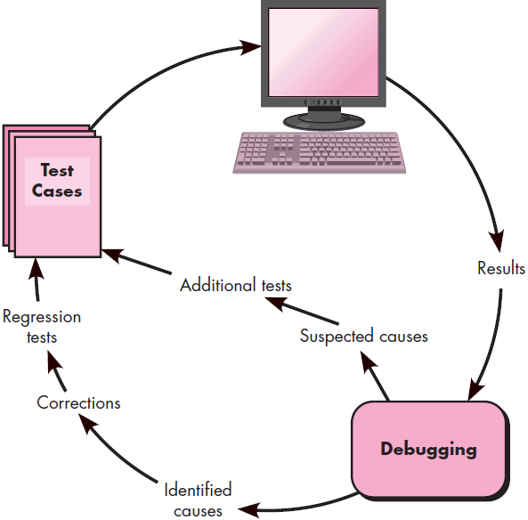
THE ART OF DEBUGGING The Debugging Process
Debugging occurs
Consequence = successful testing
Wn? test case uncovers an error
Debugging - - process that results in the removal = error.
The Debugging Process:
Debugging - - testing
Often occurs as consequence = testing
begins w→ execution = test case (figure)
results r assessed
two outcomes:
Cause (found & corrected)
Cause (found)
Notes:
Software testing is a process that can be systematically planned and specified. Test case design can be conducted, a strategy can be defined, and results can be evaluated against prescribed expectations.
Debugging occurs as a consequence of successful testing. That is, when a test case uncovers an error, debugging is the process that results in the removal of the error. Although debugging can and should be an orderly process, it is still very much an art.
As a software engineer, you are often confronted with a “symptomatic” indication of a software problem as you evaluate the results of a test. That is, the external manifestation of the error and its internal cause may have no obvious relationship to one another.
The Debugging Process:
Debugging is not testing but often occurs as a consequence of testing. Referring to Figure above.
the debugging process begins with the execution of a test case. Results are assessed and a lack of correspondence between expected and actual performance is encountered. In many cases, the non corresponding data are a symptom of an underlying cause as yet hidden. The debugging process attempts to match symptom with cause, thereby leading to error correction.
The debugging process will usually have one of two outcomes:
the cause will be found and corrected or (2) the cause will not be found.
In the latter case, the person performing debugging may suspect a cause, design a test case to help validate that suspicion, and work toward error correction in an iterative fashion.

Slide 28
THE ART OF DEBUGGING The Debugging Process, Psychological Considerations
Why is debugging so difficult?
Few characteristics = bugs provide some clues:
Symptom & cause m→ geographically remote.
Symptom disappear (temporarily)
Symptom caused – human error etc. .
Psychological Considerations:
some evidence
Debugging skill
an innate human trait
Some r good at it
Notes:
Why is debugging so difficult?
In all likelihood, human psychology has more to do with an answer than software technology.
However, a few characteristics of bugs provide some clues:
The symptom and the cause may be geographically remote. That is, the symptom may appear in one part of a program, while the cause may actually be located at a site that is far removed. Highly coupled components exacerbate this situation.
The symptom may disappear (temporarily) when another error is corrected.
The symptom may actually be caused by non errors (e.g., round-off inaccuracies).
The symptom may be caused by human error that is not easily traced.
The symptom may be a result of timing problems, rather than processing problems.
It may be difficult to accurately reproduce input conditions (e.g., a real-time application in which input ordering is indeterminate).
The symptom may be intermittent. This is particularly common in embedded systems that couple hardware and software inextricably.
The symptom may be due to causes that are distributed across a number of tasks running on different processors.
During debugging, you’ll encounter errors that range from mildly annoying (e.g., an incorrect output format) to catastrophic (e.g., the system fails, causing serious economic or physical damage).
Psychological Considerations:
Unfortunately, there appears to be some evidence that debugging prowess (meaning skill) is an innate (meaning natural or inborn or hereditary) human trait (meaning distinguishing quality or characteristic). Some people are good at it and others aren’t.
Commenting on the human aspects of debugging, Shneiderman states:
Debugging is one of the more frustrating parts of programming. It has elements of problem solving or brain teasers, coupled with the annoying recognition that you have made a mistake.
Heightened (meaning become more intense) anxiety and the unwillingness to accept the possibility of errors increases the task difficulty. Fortunately, there is a great sigh of relief and a lessening of tension when the bug is ultimately . . . Corrected.

Slide 29
THE ART OF DEBUGGING Debugging Strategies
Debugging
straightforward application = scientific method
developed over 2,500 years
Basis = debugging
locate the problem’s source [the cause]
through working hypotheses
predict new values → examined
Example:
lamp in my house work.
Cause
main circuit breaker
plug the suspect lamp →a working socket
Notes:
Debugging Strategies:
Regardless of the approach i.e. taken, debugging has one overriding objective – to find & correct the cause of a software error or defect. The objective is realized by a combination of systematic evaluation, intuition, and luck. Bradley describes the debugging approach in this way:
Debugging is a straightforward application of the scientific method that has been developed over 2,500 years. The basis of debugging is to locate the problem’s source [the cause] by binary partitioning, through working hypotheses (meaning belief or idea) that predict new values to be examined.
Take a simple non-software example: A lamp in my house does not work. If nothing in the house works, the cause must be in the main circuit breaker or outside; I look around to see whether the neighborhood is blacked out. I plug the suspect lamp into a working socket and a working appliance into the suspect circuit. So goes the alternation of hypothesis and test.
In general, three debugging strategies have been proposed: (1) brute force, (2) backtracking & (3) cause elimination. Each of these strategies can be conducted manually, but modern debugging tools can make the process much more effective.
Debugging tactics:
Brute force category of debugging is probably the most common & least efficient method for isolating the cause of a software error. You apply brute force debugging methods when all else fails.
Using a “let the computer find the error” philosophy, memory dumps are taken, run-time traces are invoked, &program is loaded with output statements. You hope that somewhere you’ll find a clue based on the of information that is produced that can lead to the cause of an error.
Although the mass of information produced may ultimately lead to success, it more frequently leads to wasted effort and time. Thought must be expended first!
Backtracking is a fairly common debugging approach that can be used successfully in small programs.
Beginning at the site where a symptom has been uncovered, the source code is traced backward (manually) until the cause is found. Unfortunately, as the number of source lines increases, the number of potential backward paths may become unmanageably large.
The third approach to debugging “cause elimination“ is manifested by induction or deduction and introduces the concept of binary partitioning.
Data related to the error occurrence are organized to isolate potential causes. A “cause hypothesis” is devised and the aforementioned data are used to prove or disprove the hypothesis.
Alternatively, a list of all possible causes is developed and tests are conducted to eliminate each. If initial tests indicate that a particular cause hypothesis shows promise, data are refined in an attempt to isolate the bug.

Slide 30
THE ART OF DEBUGGING Debugging Strategies - Automated Debugging
Debugging approaches
supplemented w→ debugging tools
provide you w→ semi automated support
debugging strategies r attempted
Example:
IDE’s → capture some lang. specific predetermined errors (like missing = end = stmt’s, etc..)
Notes:
Each of these debugging approaches can be supplemented with debugging tools that can provide you with semi automated support as debugging strategies are attempted.
Hailpern and Santhanam summarize the state of these tools when they note, “. . . many new approaches have been proposed and many commercial debugging environments are available.
Integrated development environments (IDEs) provide a way to capture some of the language specific predetermined errors (e.g., missing end-of-statement characters, undefined variables, and so on) without requiring compilation.”
A wide variety of debugging compilers, dynamic debugging aids (“tracers”), automatic test-case generators, and cross-reference mapping tools are available. However, tools are not a substitute for careful evaluation based on a complete design model and clear source code.

Slide 31
THE ART OF DEBUGGING Correcting the Error
Bug found
Correct it
Van Vleck suggests 3 questions before making correction:
Is the cause = the bug reproduced in another part = the program?
Wh? “next bug” m→ introduced by the fix I’m about → make?
Wh? could we have done → prevent this bug in the first place?
Notes:
Once a bug has been found, it must be corrected. Van Vleck suggests three simple questions that you should ask before making the “correction” that removes the cause of a bug:
Is the cause of the bug reproduced in another part of the program? In many situations, a program defect is caused by an erroneous pattern of logic that may be reproduced elsewhere. Explicit consideration of the logical pattern may result in the discovery of other errors.
What “next bug” might be introduced by the fix I’m about to make? Before the correction is made, the source code (or, better, the design) should be evaluated to assess coupling of logic and data structures. If the correction is to be made in a highly coupled section of the program, special care must be taken when any change is made.
What could we have done to prevent this bug in the first place? This question is the first step toward establishing a statistical software quality assurance approach. If you correct the process as well as the product, the bug will be removed from the current program and may be eliminated from all future programs.

Slide 32
Testing Conventional Applications
Notes:
Software design encompasses the set of principles, concepts, and practices that lead to the development of a high-quality system or product. Design principles establish an overriding philosophy that guides you in the design work you must perform. Design concepts must be understood before the mechanics of design practice are applied, and design practice itself leads to the creation of various representations of the software that serve as a guide for the construction activity that follows.
The goal of design is to produce a model or representation that exhibits firmness, commodity, and delight. To accomplish this, you must practice diversification (meaning enlarging) and then convergence (meaning similar characteristics ఏకీభవించటం).
Belady states that “diversification is the acquisition of a repertoire (meaning collection) of alternatives, the raw material of design: components, component solutions, and knowledge, all contained in catalogs, textbooks, and the mind.” Once this diverse set of information is assembled, you must pick and choose elements from the repertoire that meet the requirements defined by requirements engineering and the analysis model.
As this occurs, alternatives are considered and rejected and you converge (meaning develop something in common) on “one particular configuration of components, and thus the creation of the final product”.
Diversification and convergence combine intuition (meaning అంతర్ దృష్టి|వాస్తవాన్ని తెలుసుకొనుట) and judgment based on experience in building similar entities, a set of principles and/or heuristics that guide the way in which the model evolves, a set of criteria that enables quality to be judged, and a process of iteration that ultimately leads to a final design representation.
Software design changes continually as new methods, better analysis, and broader understanding evolve. Even today, most software design methodologies lack the depth, flexibility, and quantitative nature that are normally associated with more classical engineering design disciplines. However, methods for software design do exist, criteria for design quality are available, and design notation can be applied.

Slide 33
Software Testing Fundamentals Testability
goal = testing
find errors
good test
a high probability = finding an error
Testability [James Bach]
H? easily [a computer program] can be tested.”
The following characteristics lead → testable s/w:
Operability
Observability
Controllability
Decomposability
Simplicity
Understandability
Notes:
The goal of testing is to find errors, and a good test is one that has a high probability of finding an error. Therefore, you should design and implement a computer based system or a product with “testability” in mind. At the same time, the tests themselves must exhibit a set of characteristics that achieve the goal of finding the most errors with a minimum of effort.
Testability: James Bach provides the following definition for testability: “Software testability is simply how easily [a computer program] can be tested.” The following characteristics lead to testable software:
Operability:“The better it works, the more efficiently it can be tested.” If a system is designed and implemented with quality in mind, relatively few bugs will block the execution of tests, allowing testing to progress without fits and starts.
Observability: What you see is what you test.” Inputs provided as part of testing produce distinct outputs. System states and variables are visible or queriable during execution. Incorrect output is easily identified. Internal errors are automatically detected and reported. Source code is accessible.
Controllability: “The better we can control the software, the more the testing can be automated and optimized.” All possible outputs can be generated through some combination of input, and I/O formats are consistent and structured. All code is executable through some combination of input. Tests can be conveniently specified, automated, and reproduced.
Decomposability: “By controlling the scope of testing, we can more quickly isolate problems and perform smarter retesting.” The software system is built from independent modules that can be tested independently.
Simplicity.: “The less there is to test, the more quickly we can test it.”
Stability: “The fewer the changes, the fewer the disruptions to testing.”
Understandability: “The more information we have, the smarter we will test.”

Slide 34
Software Testing Fundamentals Test Characteristics
Kaner, Falk, & Nguyen suggests attributes = good test:
good test – high probability = finding an error
good test - - redundant
good test s→ “best = breed”
good test s→ neither too simple nor too complex
Notes:
Kaner, Falk, and Nguyen suggest the following attributes of a “good” test:
A good test has a high probability of finding an error: To achieve this goal, the tester must understand the software and attempt to develop a mental picture of how the software might fail. Ideally, the classes of failure are probed. For example, one class of potential failure in a graphical user interface is the failure to recognize proper mouse position. A set of tests would be designed to exercise the mouse in an attempt to demonstrate an error in mouse position recognition.
A good test is not redundant. Testing time and resources are limited: There is no point in conducting a test that has the same purpose as another test. Every test should have a different purpose (even if it is subtly different).
A good test should be “best of breed”: In a group of tests that have a similar intent, time and resource limitations may mitigate toward the execution of only a subset of these tests. In such cases, the test that has the highest likelihood of uncovering a whole class of errors should be used.
A good test should be neither too simple nor too complex: Although it is sometimes possible to combine a series of tests into one test case, the possible side effects associated with this approach may mask errors. In general, each test should be executed separately.

Slide 35
Internal View & External Views
Any engineered product c→ tested (2 ways):
Knowing specified function – product has been designed → perform (Black box testing)
Knowing the internal workings = product (White box testing)
Topic Beyond Syllabus necessary to discuss
Notes:
Any engineered product (and most other things) can be tested in one of two ways:
Knowing the specified function that a product has been designed to perform, tests can be conducted that demonstrate each function is fully operational while at the same time searching for errors in each function.
Knowing the internal workings of a product, tests can be conducted to ensure that “all gears mesh,” that is, internal operations are performed according to specifications and all internal components have been adequately exercised.
The first test approach takes an external view and is called black-box testing. The second requires an internal view and is termed white-box testing.

Slide 36
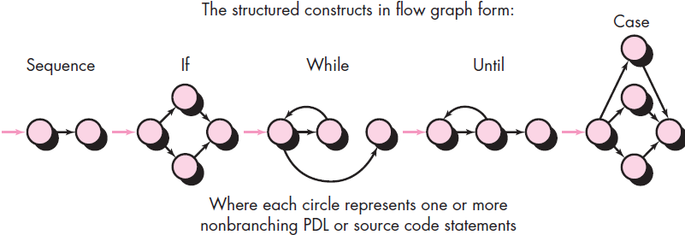
Basis Path Testing
Basis path testing
White box testing technique
enables test-case designer
derive a logical complexity measure = procedural design &
Use – measure as a guide ← defining a basis set = execution paths
Test cases derived → exercise basis set r guaranteed
execute every stmt in prog. at least one time during testing
Before we consider the basis path method, a simple notation ← representation = control flow, called a flow graph introduced shown in figure:
Notes:
Basis path testing is a white-box testing technique first proposed by Tom McCabe. The basis path method enables the test-case designer to derive a logical complexity measure of a procedural design and use this measure as a guide for defining a basis set of execution paths. Test cases derived to exercise the basis set are guaranteed to execute every statement in the program at least one time during testing.
Flow Graph Notation:
Before we consider the basis path method, a simple notation for the representation of control flow, called a flow graph (or program graph) must be introduced. The flow graph depicts logical control flow using the notation illustrated in Figure above.

Slide 37
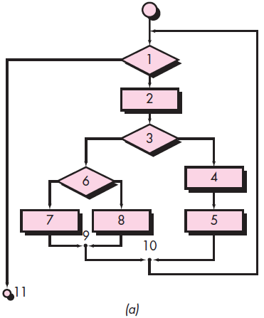
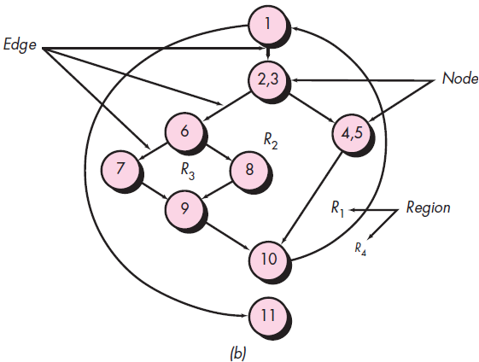
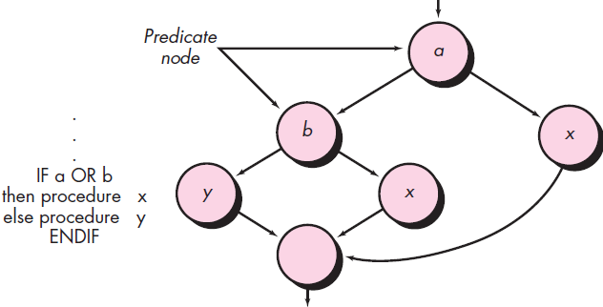
Basis Path Testing Flow Graph Notation
Notes:
To illustrate the use of a flow graph, consider the procedural design representation in Figure-a above. Here, a flowchart is used to depict program control structure. Figure-b above maps the flowchart into a corresponding flow graph (assuming that no compound conditions are contained in the decision diamonds of the flowchart).
Referring to Figure-b above, each circle, called a flow graph node, represents one or more procedural statements. A sequence of process boxes and a decision diamond can map into a single node. The arrows on the flow graph, called edges or links, represent flow of control and are analogous to flowchart arrows.
An edge must terminate at a node, even if the node does not represent any procedural statements (e.g., see the flow graph symbol for the if-then-else construct). Areas bounded by edges and nodes are called regions. When counting regions, we include the area outside the graph as a region.
When compound conditions are encountered in a procedural design, the generation of a flow graph becomes slightly more complicated. A compound condition occurs when one or more Boolean operators (logical OR, AND, NAND, NOR) is present in a conditional statement.
Referring to Figure above (Compound logic) the program design language (PDL) segment translates into the flow graph shown. Note that a separate node is created for each of the conditions a and b in the statement IF a OR b. Each node that contains a condition is called a predicate node and is characterized by two or more edges emanating from it.

Slide 38
Basis Path Testing Independent Program Paths
Independent path
Any path thru prog.
Introduces at least 1 new set = processing stmt’s | condition
In terms = flow graph
move along at least 1 edge
has not been traversed before path - - defined
Example:
Path 1: 1-11
Path 2: 1-2-3-4-5-10-1-11
Path 3: 1-2-3-6-8-9-10-1-11
Path 4: 1-2-3-6-7-9-10-1-11
Notes:
An independent path is any path through the program that introduces at least one new set of processing statements or a new condition. When stated in terms of a flow graph, an independent path must move along at least one edge that has not been traversed before the path is defined. For example, a set of independent paths for the flow graph illustrated in figure above are:
Path 1: 1-11
Path 2: 1-2-3-4-5-10-1-11
Path 3: 1-2-3-6-8-9-10-1-11
Path 4: 1-2-3-6-7-9-10-1-11
Note that each new path introduces a new edge. The path
1-2-3-4-5-10-1-2-3-6-8-9-10-1-11
is not considered to be an independent path because it is simply a combination of already specified paths and does not traverse any new edges. Paths 1 through 4 constitute a basis set for the flow graph in figure above.
That is, if you can design tests to force execution of these paths (a basis set), every statement in the program will have been guaranteed to be executed at least one time and every condition will have been executed on its true and false sides. It should be noted that the basis set is not unique. In fact, a number of different basis sets can be derived for a given procedural design.
How do you know how many paths to look for? The computation of cyclomatic complexity provides the answer. Cyclomatic complexity is a software metric that provides a quantitative measure of the logical complexity of a program.
When used in the context of the basis path testing method, the value computed for cyclomatic complexity defines the number of independent paths in the basis set of a program and provides you with an upper bound for the number of tests that must be conducted to ensure that all statements have been executed at least once.
Complexity is computed in one of three ways:
The number of regions of the flow graph corresponds to the cyclomatic complexity.
Cyclomatic complexity V(G) for a flow graph G is defined as V(G)=E–N+2
where E is the number of flow graph edges and N is the number of flow graph nodes.
Cyclomatic complexity V(G) for a flow graph G is also defined as V(G)=P+1
where P is the number of predicate nodes contained in the flow graph G.

Slide 39
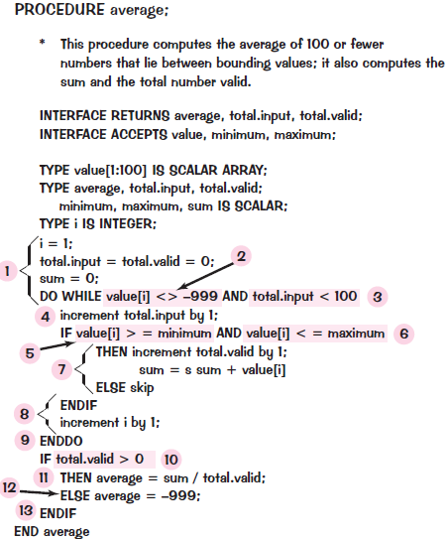
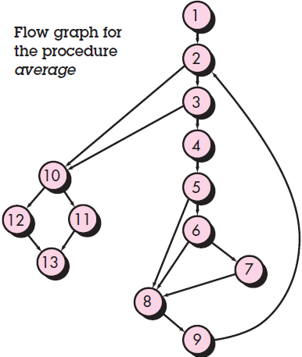
Basis Path Testing Deriving Test Cases
Basis path testing
Procedural design | source code (applied)
Procedure average depicted in PDL (figure)
Used as example
Notes:
The basis path testing method can be applied to a procedural design or to source code. Here basis path testing is presented as a series of steps. The procedure average, depicted in PDL in Figure above (right), will be used as an example to illustrate each step in the test-case design method. Note that average, although an extremely simple algorithm, contains compound conditions and loops. The following steps can be applied to derive the basis set:
Using the design or code as a foundation, draw a corresponding flow graph: A flow graph is created using the symbols and construction rules. The corresponding flow graph is shown in Figure above (left).
Determine the cyclomatic complexity of the resultant flow graph. The cyclomatic complexity V(G) is determined by applying the algorithms.
V(G) = 6 regions V(G) = 17 edges – 13 nodes + 2 = 6
V(G) = 5 predicate nodes + 1 = 6
Determine a basis set of linearly independent paths. The value of V(G) provides the upper bound on the number of linearly independent paths through the program control structure. In the case of procedure average, we expect to specify six paths:
Path 1: 1-2-10-11-13 Path 2: 1-2-10-12-13 Path 3: 1-2-3-10-11-13
Path 4: 1-2-3-4-5-8-9-2- . . . Path 5: 1-2-3-4-5-6-8-9-2- . . . Path 6: 1-2-3-4-5-6-7-8-9-2- . . .
The ellipsis (. . .) following paths 4, 5, and 6 indicates that any path through the remainder of the control structure is acceptable.
Prepare test cases that will force execution of each path in the basis set. Data should be chosen so that conditions at the predicate nodes are appropriately set as each path is tested. Each test case is executed and compared to expected results. Once all test cases have been completed, the tester can be sure that all statements in the program have been executed at least once.

Slide 40
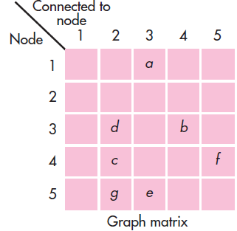
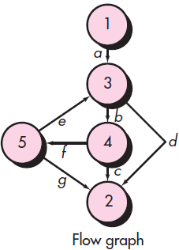
Basis Path Testing Graph Matrices
graph matrix
Data structure
Developing s/w tool
Assists in basis path testing
Square matrix
Size - - eq. no. = nodes on flow graph
Row & column corresponds → identified node
Matrix entries correspond → connections (edges)
Example flow graph & graph matrix (figure)
Notes:
A data structure, called a graph matrix, can be quite useful for developing a software tool that assists in basis path testing.
A graph matrix is a square matrix whose size (i.e., number of rows and columns) is equal (eq.) to the number of nodes on the flow graph. Each row and column corresponds to an identified node, and matrix entries correspond to connections (an edge) between nodes. A simple example of a flow graph and its corresponding graph matrix is shown in Figure above.
Referring to the figure, each node on the flow graph is identified by numbers, while each edge is identified by letters. A letter entry is made in the matrix to correspond to a connection between two nodes. For example, node 3 is connected to node 4 by edge b.
To this point, the graph matrix is nothing more than a tabular representation of a flow graph. However, by adding a link weight to each matrix entry, the graph matrix can become a powerful tool for evaluating program control structure during testing.
The link weight provides additional information about control flow. In its simplest form, the link weight is 1 (a connection exists) or 0 (a connection does not exist). But link weights can be assigned other, more interesting properties:
The probability that a link (edge) will be execute.
The processing time expended during traversal of a link
The memory required during traversal of a link
The resources required during traversal of a link.

Slide 41
White-Box Testing
glass-box testing (also named)
test-case design philosophy
uses the control structure described as part = component-level design → derive test cases
Using white-box testing methods, you can derive test cases that:
guarantee that all independent paths w→in a module – exercised at least once
exercise all logical decisions on their true & false sides
execute all loops at their boundaries & w→in their operational bounds
exercise internal data structures → ensure their validity
Notes:
White-box testing, sometimes called glass-box testing, is a test-case design philosophy that uses the control structure described as part of component-level design to derive test cases. Using white-box testing methods, you can derive test cases that :
guarantee that all independent paths within a module have been exercised at least once
exercise all logical decisions on their true and false sides
execute all loops at their boundaries and within their operational bounds &
exercise internal data structures to ensure their validity.

Slide 42
Black-Box Testing
Behavioral testing (also named)
Focuses on functional requirements = s/w.
Enable → derive sets = i/p conditions that will fully exercise all functional requirements = prog.
Alternative → white-box testing ↔ - - a complementary approach i.e. likely → uncover different class = errors than white-box methods
Attempts → find errors in following categories:
incorrect or missing functions
interface errors
errors in data structures or external database access
behavior or performance errors &
Initialization & termination errors
Notes:
Black-box testing, also called behavioral testing, focuses on the functional requirements of the software. That is, black-box testing techniques enable you to derive sets of input conditions that will fully exercise all functional requirements for a program.
Black-box testing is not an alternative to white-box techniques. Rather, it is a complementary approach that is likely to uncover a different class of errors than white-box methods. Black-box testing attempts to find errors in the following categories:
incorrect or missing functions
interface errors
errors in data structures or external database access
behavior or performance errors &
initialization and termination errors
Unlike white-box testing, which is performed early in the testing process, black-box testing tends to be applied during later stages of testing. Because black-box testing purposely disregards control structure, attention is focused on the information domain. Tests are designed to answer the following questions:
How is functional validity tested?
How are system behavior and performance tested?
What classes of input will make good test cases?
Is the system particularly sensitive to certain input values?
How are the boundaries of a data class isolated?
What data rates and data volume can the system tolerate?
What effect will specific combinations of data have on system operation?
By applying black-box techniques, you derive a set of test cases that satisfy the following criteria:
test cases that reduce, by a count that is greater than one, the number of additional test cases that must be designed to achieve reasonable testing
test cases that tell you something about the presence or absence of classes of errors, rather than an error associated only with the specific test at hand.

Slide 43
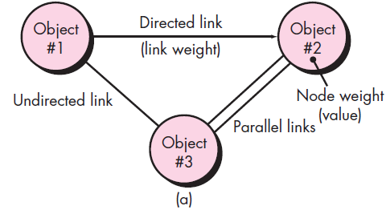
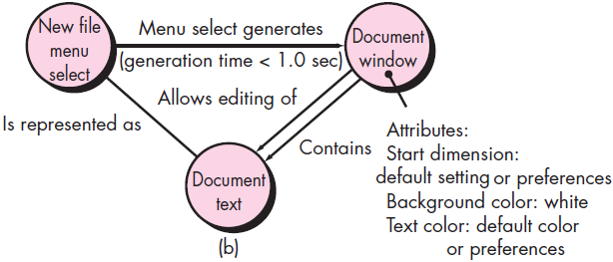
Black-Box Testing Graph-Based Testing Methods
First step:
Understand objects & relationship that connect these objects.
Accomplish this
Creating graph (figure)
Directed link
Relationship – 1 direction only
Bidirectional link
Relationship – both directions
Parallel links
Relationship established b/n graph nodes
Notes:
The first step in black-box testing is to understand the objects that are modeled in software and the relationships that connect these objects. Once this has been accomplished, the next step is to define a series of tests that verify “all objects have the expected relationship to one another”.
Stated in another way, software testing begins by creating a graph of important objects and their relationships and then devising a series of tests that will cover the graph so that each object and relationship is exercised and errors are uncovered.
To accomplish these steps, you begin by creating a graph—a collection of nodes that represent objects, links that represent the relationships between objects, node weights that describe the properties of a node (e.g., a specific data value or state behavior), and link weights that describe some characteristic of a link. The symbolic representation of a graph is shown in Figure (a) above.
Nodes are represented as circles connected by links that take a number of different forms. A directed link (represented by an arrow) indicates that a relationship moves in only one direction. A bidirectional link, also called a symmetric link, implies that the relationship applies in both directions. Parallel links are used when a number of different relationships are established between graph nodes.
As a simple example, consider a portion of a graph for a word-processing application Figure (b) where
Object #1 = newFile (menu selection)
Object #2 = documentWindow
Object #3 = documentText
Referring to the figure, a menu select on newFile generates a document window. The node weight of documentWindow provides a list of the window attributes that are to be expected when the window is generated. The link weight indicates that the window must be generated in less than 1.0 second.
An undirected link establishes a symmetric relationship between the newFile menu selection and documentText, and parallel links indicate relationships between documentWindow and documentText.

Slide 44
Black-Box Testing Equivalence Partitioning
Black-box testing method
Divides i/p domain = prog. in → classes = data ➔ w? test cases c→ derived
Test case design
Based on evaluation = equivalence classes ← an i/p condition
If set = objects c→ linked by relationships – symmetric, transitive & reflexive
Equivalence class - - present
Represents set = valid | invalid states ← i/p conditions
Notes:
Equivalence partitioning is a black-box testing method that divides the input domain of a program into classes of data from (➔) which (w?) test cases can be derived. An ideal test case single-handedly uncovers a class of errors (e.g., incorrect processing of all character data) that might otherwise require many test cases to be executed before the general error is observed.
Test-case design for equivalence partitioning is based on an evaluation of equivalence classes for an input condition. Using concepts introduced in the preceding section, if a set of objects can be linked by relationships that are symmetric, transitive, and reflexive, an equivalence class is present.
An equivalence class represents a set of valid or invalid states for input conditions. Typically, an input condition is either a specific numeric value, a range of values, a set of related values, or a Boolean condition. Equivalence classes may be defined according to the following guidelines:
If an input condition specifies a range, one valid and two invalid equivalence classes are defined.
If an input condition requires a specific value, one valid and two invalid equivalence classes are defined.
If an input condition specifies a member of a set, one valid and one invalid equivalence class are defined.
If an input condition is Boolean, one valid and one invalid class are defined.
By applying the guidelines for the derivation of equivalence classes, test cases for each input domain data item can be developed and executed. Test cases are selected so that the largest number of attributes of an equivalence class are exercised at once.

Slide 45
Black-Box Testing Boundary Value Analysis & Orthogonal Array Testing
Greater no. = errors occurs at boundaries = i/p domain ↔ in the “center.”
It - - ← this reason that boundary value analysis (BVA)
developed as a testing technique
Leads → selection = test cases that exercise bounding values
Orthogonal Array Testing:
applied → problems
i/p domain - - relatively small but too large → accommodate exhaustive testing
useful in finding region faults
faulty logic w→n s/w component
Notes:
A greater number of errors occurs at the boundaries of the input domain rather than in the “center.” It is for this reason that boundary value analysis (BVA) has been developed as a testing technique. Boundary value analysis leads to a selection of test cases that exercise bounding values.
Boundary value analysis is a test-case design technique that complements equivalence partitioning. Rather than selecting any element of an equivalence class, BVA leads to the selection of test cases at the “edges” of the class. Rather than focusing solely on input conditions, BVA derives test cases from the output domain as well.
Guidelines for BVA are similar in many respects to those provided for equivalence partitioning:
1. If an input condition specifies a range bounded by values a and b, test cases should be designed with values a and b and just above and just below a and b.
2. If an input condition specifies a number of values, test cases should be developed that exercise the minimum and maximum numbers. Values just above and below minimum and maximum are also tested.
3. Apply guidelines 1 and 2 to output conditions. For example, assume that a temperature versus pressure table is required as output from an engineering analysis program. Test cases should be designed to create an output report that produces the maximum (and minimum) allowable number of table entries.
4. If internal program data structures have prescribed boundaries (e.g., a table has a defined limit of 100 entries), be certain to design a test case to exercise the data structure at its boundary.
Orthogonal array testing can be applied to problems in which the input domain is relatively small but too large to accommodate exhaustive testing. The orthogonal array testing method is particularly useful in finding region faults – an error category associated with faulty logic within a software component.

Slide 46
Object-Oriented Testing Methods
Overall approach → OO test-case design h→ suggested by Berard:
Each test case s→
uniquely identified & explicitly associated w→ class → be tested
Purpose = test s→ stated
A list = testing steps s→ developed ← each test & should contain:
List = specified states
List = messages & operations
List = exceptions
List = external conditions
Supplementary information – aid in understanding or implementing test
Notes:
Test-case design methods for object-oriented software continue to evolve. However, an overall approach to OO test-case design has been suggested by Berard:
Each test case should be (s→) uniquely identified and explicitly associated with the class to be tested.
The purpose of the test should be (s→) stated.
A list of testing steps should be developed for each test and should contain:
A list of specified states for the class that is to be tested
A list of messages and operations that will be exercised as a consequence of the test
A list of exceptions that may occur as the class is tested
A list of external conditions (i.e., changes in the environment external to the software that must exist in order to properly conduct the test)
Supplementary information that will aid in understanding or implementing the test
Unlike conventional test-case design, which is driven by an input-process-output view of software or the algorithmic detail of individual modules, object-oriented testing focuses on designing appropriate sequences of operations to exercise the states of a class.

Slide 47
Object-Oriented Testing Methods Test-Case Design Implications of OO Concepts
As class evolves thru requirements & design models
Target ← test-case design
Reason
Attributes & operations r encapsulated, testing operations outside = class - - unproductive
Inheritance also present additional challenges – test case design
Multiple inheritance complicates testing
Notes:
As a class evolves (meaning develop or progress or adapt or transform) through the requirements and design models, it becomes a target for test-case design.
Because attributes and operations are encapsulated, testing operations outside of the class is generally unproductive (meaning useless or not very much useful). Although encapsulation is an essential design concept for OO, it can create a minor obstacle when testing.
As Binder notes, “Testing requires reporting on the concrete (meaning visible)and abstract state of an object.”
Yet, encapsulation can make this information somewhat difficult to obtain. Unless built-in operations are provided to report the values for class attributes, a snapshot of the state of an object may be difficult to acquire.
Inheritance may also present you with additional challenges during test-case design. I have already noted that each new usage context requires retesting, even though reuse has been achieved.
In addition, multiple inheritance complicates testing further by increasing the number of contexts for which testing is required.
If subclasses instantiated from a superclass are used within the same problem domain, it is likely that the set of test cases derived for the superclass can be used when testing the subclass.
However, if the subclass is used in an entirely different context, the superclass test cases will have little applicability and a new set of tests must be designed.

Slide 48
Object-Oriented Testing Methods Applicability of Conventional Test-Case Design Methods
white-box testing methods
Applied → operations defined ← class
Basis path, loop testing, or data flow techniques
Help → ensure – every stmt in an operation h→ tested
Black-box testing methods
Appropriate ← OO systems
They r ← systems developed using conventional s/w engg. methods
Use cases
useful input in the design = black-box & state based tests
Notes:
The white-box testing methods can be applied to the operations defined for a class.
Basis path, loop testing, or data flow techniques can help to ensure that every statement in an operation has been tested.
However, the concise structure of many class operations causes some to argue that the effort applied to white-box testing might be better redirected to tests at a class level.
Black-box testing methods are as appropriate for OO systems as they are for systems developed using conventional software engineering methods.
Use cases can provide useful input in the design of black-box and state based tests.

Slide 49
Object-Oriented Testing Methods Fault-Based Testing
Object = fault-based testing w→ in an OO system - - →
design tests that have a high likelihood = uncovering plausible faults
Reason
product | system must conform → customer requirements
preliminary planning required → perform fault based testing begins with the analysis model
tester looks ← plausible faults
determine whether these faults exist, test cases r designed → exercise the design or code
Notes:
The object of fault-based testing within an OO system is to design tests that have a high likelihood of uncovering plausible (meaning reasonable or acceptable or thinkable) faults.
Because the product or system must conform (meaning match) to customer requirements, preliminary planning required to perform fault based testing begins with the analysis model. The tester looks for plausible faults (i.e., aspects of the implementation of the system that may result in defects). To determine whether these faults exist, test cases are designed to exercise the design or code.
If real faults in an OO system are perceived to be implausible, then this approach is really no better than any random testing technique. However, if the analysis and design models can provide insight into what is likely to go wrong, then fault-based testing can find significant numbers of errors with relatively low expenditures of effort.
Integration testing looks for plausible faults in operation calls or message connections. Three types of faults are encountered in this context: unexpected result, wrong operation/message used, and incorrect invocation.
It is important to note that integration testing attempts to find errors in the client object, not the server. Stated in conventional terms, the focus of integration testing is to determine whether errors exist in the calling code, not the called code.

Slide 50
Object-Oriented Testing Methods Test Cases and the Class Hierarchy
Inheritance
Obviate the need ← thorough testing = all derived classes
actually complicate the testing process
Example:
Base class
operations inherited() & redefined()
Derived class
redefined() has tested
New design & code
Inherited()?
Calls redefined() & behavior has changed
Mishandle new behavior
Needs new tests (design & code changed)
Notes:
Test Cases and the Class Hierarchy:
Inheritance does not obviate (meaning prevent) the need for thorough testing of all derived classes. In fact, it can actually complicate the testing process.
Consider the following situation:
A class Base contains operations inherited() and redefined(). A class Derived redefines redefined() to serve in a local context. There is little doubt that Derived::redefined() has to be tested because it represents a new design and new code. But does Derived::inherited() have to be retested?
Therefore, it needs new tests even though the design and code have not changed. It is important to note, however, that only a subset of all tests for Derived::inherited() may have to be conducted.
If part of the design and code for inherited() does not depend on redefined() (i.e., that does not call it nor call any code that indirectly calls it), that code need not be retested in the derived class.
Base::redefined() and Derived::redefined() are two different operations with different specifications and implementations. Each would have a set of test requirements derived from the specification and implementation. Those test requirements probe for plausible faults: integration faults, condition faults, boundary faults, and so forth.
But the operations are likely to be similar. Their sets of test requirements will overlap. The better the OO design, the greater is the overlap. New tests need to be derived only for those Derived::redefined() requirements that are not satisfied by the Base::redefined() tests.

Slide 51
Scenario-Based Test Design
Page number 520
Testing Surface Structure and Deep Structure
Page number 522
Software Engineering A Practitioners Approach - Roger S Pressman 7th Edition

