Slide 1
UNIT-III
Introduction to PHP: The Problems with other technologies (Servlets and JSP), Downloading, installing, configuring PHP, Programming in a Web environment and The anatomy of a PHP Page.

Slide 2
Servlet is a java based server side web technology.
Servlets are used at server side. When user request a webpage HTTP request is send to appropriate web server.
Servlet is a small Java program that runs within a Web server which can receive requests from clients and return responses.
A servlet is an object that receives the request and generates the response based on the request.
It can be thought of as a java applet that runs on a server instead of a browser.
Problems with Servlets:
In many java Servlet based applications, processing the request and generating the response are both handled by a single servlet class.
Changing the look and feel of an application or adding support for a new type of client requires servlet code to be updated and recompiled.
If your application is build on using servlet technology, it is very difficult for enhancement and bug fixing.
It is time taking to design an application interface using web page development tools because HTML elements are embedded in to the servlet code manually.
To over come this we use JSP.

Slide 3
JSP → Java Server Pages, is a technology for developing web pages that include dynamic content.
JSP not only contains standard markup language elements like HTML tags but also contains special JSP elements which allow the server to insert the dynamic content in the page.
When a user request a JSP page, server executes JSP elements and merge the results with static parts of the page and sends the dynamically composed page back to the browser.
Problems with JSP:
JSP pages must be compiled on the server when first accessed and produces a noticeable delay when accessing the JSP page for the first time.
JSP pages require about double the disk space to hold the page(along with JSP page, resultant class file is stored in server).
Database connectivity is not as easy as it should be.
JSP requires a compiler to be shipped with the web server.
To deploy and run Java Server Pages, a compatible web server with a servlet container, such as Apache Tomcat is needed.

Slide 4
INTRODUCTION TO PHP

Slide 5
History
PHP → Personal Home Page in 1995 – by Rasmus Lerdorf ¹– developed Perl/CGI script².
Converting the data entered in an HTML form into symbolic variables encourages exportation into other system.
PHP 2.0 in 1997 named as PHP/FI (Personal Home Page/Form Interpreter).
PHP 3.0 with parsing engine in june1998 with 50,000 users
At 1999 an internet based research and analysis company(Netcraft) reported an estimate of a user base of 1 million, making PHP the most popular scripting language in the world.
May 22,2000 PHP 4.0 was released with zend³ scripting engine.
PHP 4.0 has several enterprise level improvements like
Improved resource handling (scalability is increased)
Object oriented support
Native session handling support
Encryption⁴(MCrypt – library)
ISAPI Support (Internet Server API)
Native COM (enables IPC, dynamic object creation)/DCOM (provides a set of interfaces allowing clients and servers to communicate within the same computer )Support
Native java support
Notes:
Rasmus Lerdorf is an independent software development contractor.
Perl/CGI script performs two tasks logging visitors information and displaying the count of visitors to the web page.
Zend → name of two core developers namely Zeev Suraski and Andi Gutmans.
Encryption → offering users both full and hash encryption using encryption algorithms including Blowfish, MD5, SHA1, and TripleDES.

Slide 6
PHP 5.0 released with new features like
Vastly improved object oriented capabilities like explicit constructor, destructors, object cloning etc…
Try/catch exception handling.
Improved XML and Web services Support.
Native support for SQLite (database server).
According to Netcraft PHP 5.0 installed on almost 19 million domains.
PHP is a widely-used general-purpose scripting language that is especially suited for Web development and can be embedded into HTML.
Hypertext Preprocessor – Acronym for PHP.
Features of PHP
No need to explicitly create, typecast, destroy a variable – loosely typed language.
Automatically destroy variables and return resources to the system when the script completes – handle administrative aspects.
Create Adobe flash and PDF files.
Authenticate users against login credentials stored in flat files, databases.
Communicate with wide variety protocols including LDAP, IMAP,POP3,NNTP, and DNS.
Available for free of charged, free of licensing restrictions.

Slide 7
DOWNLOADING INSTALLING AND CONFIGURING PHP

Slide 8
To Download the PHP
Go to the official website http://www.php.net.
At the bottom right corner of the page click on the link “mirror sites” which will redirect to http://www.php.net/mirrors.php
Now Select the link based on country code and click on the downloads link. For example if the country is India, select the link(s) of country code “in”.
Now click on downloads link at the top of the page.
Once you are in downloads page, choose one of the available distributions.
Source → If Linux is your target server platform, or if you plan to compile from source for the Windows platform (building from source on windows is not recommended).
Windows zip package → Plan to use PHP in conjunction with Apache on Windows
Windows installer → Offers a convenient Windows installer interface for installing and configuring PHP, and support for automatically configuring the IIS and other servers. Also we can use this version in conjunction with Apache but it is not recommended.
Download the appropriate distribution as per your target server platform.

Slide 9
To Install the Apache and PHP on windows
(apache 2 is considered)
Start the apache installer by double clicking the icon which contains the name as “apache_x.x.xx-win 32-x86-no-ssl.msi”.
The installation process begins with a welcome screen. Take a moment to read the screen and then click Next.
The license agreement is displayed next. Carefully read through the license. Assuming that you agree with the license stipulations, click Next.
A screen containing various items pertinent to the Apache server is displayed next, read through this information and then click Next.
You will be prompted for various items pertinent to the server’s operation¹.
You’ll also be prompted as to whether Apache should run as a service for all users or only for the current user². When you’re finished, click Next.
You are prompted for a Setup Type: Typical or Custom.
You’re prompted for the Destination folder. By default, this is C:\Program Files\Apache Group. When you are finished click Next.
Click the install button for installation of Apache.
Notes:
including the network domain, the server name, and the administrator’s e-mail address. If you know this information, fill it in now; otherwise, just enter localhost for the first two items and put in any e-mail address for the last. You can always change this information later in the httpd.conf file.
If you want Apache to automatically start with the operating system, which is recommended, then choose to install Apache as a service for all users.

Slide 10
Unzip the PHP Package, placing the contents in to c:\php6\.
Navigate to the c:\apache2\conf and open httpd.conf for editing.
Now add the following three lines to the httpd.conf file. Consider adding them directly below the block of LoadModule entries located in the bottom of the Global Environment section:
LoadModule php6_module c:/php6/php6apache2.dll
AddType application/x-httpd-php .php
PHPIniDir “c:\php6”
Rename the php.ini-dist file to php.ini and save it to the c:\php6 directory.
If you are using windows Platform (NT, 2000, XP or vista) navigate to start → settings → control panel → Administrative Tools →Services.
Locate Apache in the list and make sure that it is started.
If it is not started, highlight the label and click Start the Service, located to the left of the label. If it is started, highlight the label and click Restart the Service, so that the changes made to the httpd.conf file take effect.
Ensure that the startup type for apache is automatic choosing the properties by right clicking on it(apache).

Slide 11
IIS
In order to take advantage of FastCGI, you’ll need to install IIS version 5.1 or greater.
IIS 5.1 is available for win 2000 professional, win 2000 server, XP professional.
To verify IIS is installed , go to Start → Run and execute the “inetmgr” command at the prompt.
If not installed, insert the Windows XP Professional CD into the CD-ROM drive and navigate to start → control panel → add/remove programs and select add/remove windows components.
From here check the box next to the IIS and click next then click ok.
To Install IIS7(win vista) - go to Start →Settings →Control Panel → Programs and Features and click the link “Turn Windows Features On and Off”. (fig:-1)
Once the installation is complete restart the os.
Configure the Fast CGI to manage PHP processes by navigating to start → run and then type inetmgr and press enter button.
Click on add module mapping after clicking on the handler mapping and enter the details as shown in fig-2

Slide 12
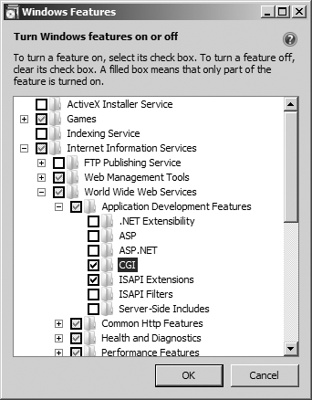
Fig:-1 Enabling IIS on vista
Back

Slide 13
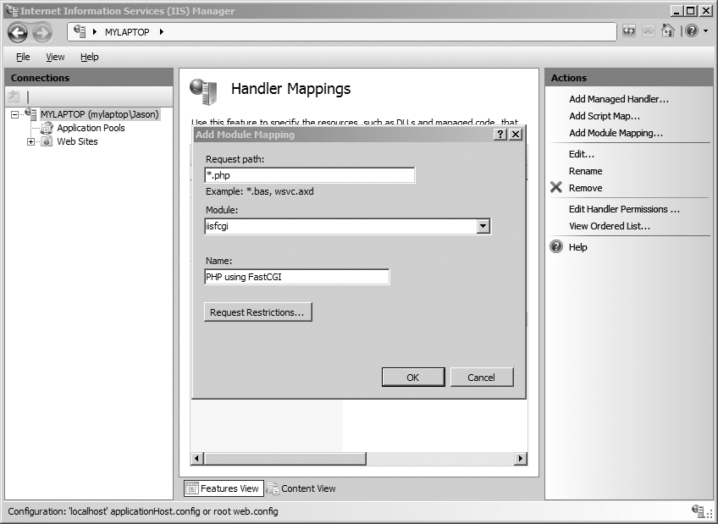
Back

Slide 14
Now test your installation by attempt to execute the PHP script.
Open text editor and add the following lines as below:
<?php
phpinfo();
?>
If you are running Apache, save the file within the htdocs directory as phpinfo.php
If you’re running IIS, save the file within C:\inetpub\wwwroot\
Now open browser and access the file http://localhost/phpinfo.php (fig:-3)
Configuring PHP
PHP software have some extensions, to use these we need to uncomment the appropriate line within the file named as php.ini
For example to enable XML-RPC extension, do the following:
Open the php.ini file and locate the extension_dir directive and assign it c:\php\ext\
Locate the line ;extension=php_xmlrpc.dll . Uncomment the line by removing the preceding semicolon, save and close the file.
Restart the web server.

Slide 15
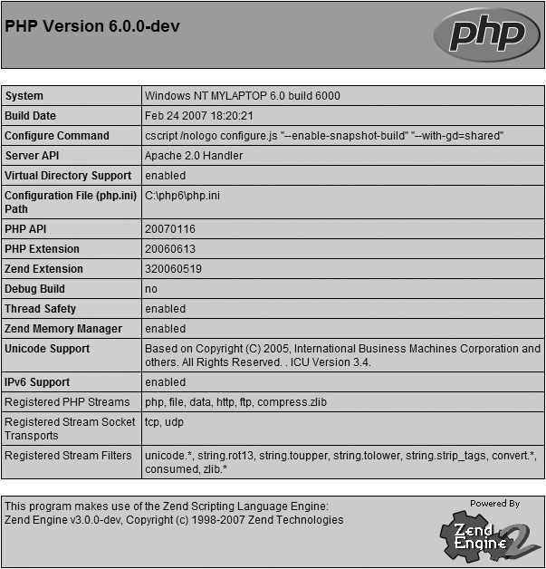
Back

Slide 16
We can also configure the php at runtime .
PHP is installed as CGI binary → php.ini file is reread every time when PHP is invoked.
PHP is installed as apache module → php.ini file is only read once, when apache daemon is first started. So it is necessary to restart the apache before any of the changes take effect.
php.ini file is a global configuration file for PHP like httpd.conf is a global configuration file for apache.
It addresses 12 different aspects of PHP’s behavior like Language options, safe mode, syntax highlighting, miscellaneous, resource limits, error handling and logging, data handling, paths and directories, file uploads, Fopen wrappers, dynamic extensions, module settings.
php.ini is a text file consisting of comments and directives and their corresponding values. A sample snippet from the file is given below:
;
; Allow the <? tag
;
short_open_tag = Off

Slide 17
Lines beginning with semicolon are comments.
When PHP is running as an Apache module, you can modify many of the directives through either the httpd.conf file or the .htaccess file.
Language options
engine = On | Off
Scope: PHP_INI_ALL; Default value: On
This parameter is responsible for determining whether the PHP engine is available.
Turning it off prevents you from using PHP at all.
short_open_tag = On | Off
Scope: PHP_INI_ALL; Default value: On
PHP script components are enclosed within escape syntax. There are four different escape formats, the shortest of which is known as short open tags, which looks like this:
<?
echo "Some PHP statement";
?>

Slide 18
asp_tags = On | Off
Scope: PHP_INI_ALL; Default value: Off
PHP supports ASP-style script delimiters, which look like this:
<%
echo "Some PHP statement";
%>
Safe mode
When you deploy PHP in a multiuser environment, as a safeguard for using PHP on shared servers, PHP can be run in a restricted, or safe mode.
Enabling safe mode will disable some of the functions like parse_ini_file(), chmod(), chown(), chgrp()…
safe_mode = On | Off
Scope: PHP_INI_SYSTEM; Default value: Off
Enabling the safe_mode directive results in PHP being run under the aforementioned constraints.

Slide 19
safe_mode_gid = On | Off
Scope: PHP_INI_SYSTEM; Default value: Off
When safe mode is enabled, an enabled safe_mode_gid enforces a GID (group ID) check when opening files.
When safe_mode_gid is disabled, a more restrictive UID (user ID) check is enforced.
Syntax Highlighting
PHP can display and highlight source code. You can control the color of strings, comments, keywords, the background, default text, and HTML components of the highlighted source through the following directives.
highlight.string = string
Scope: PHP_INI_ALL; Default value: #DD0000
highlight.comment = string
Scope: PHP_IN
highlight.keyword = string
Scope: PHP_INI_ALL; Default value: #007700

Slide 20
Code editors are like adobe Dreamweaver cs3,notepad++ and so on…
Also we can choose the web hosting provider based on the following categories like:
Dedicated server hosting – to have the complete control over server’s administration while not having to purchase or maintain the server hardware or hosting facility or network connection.
Shared server hosting – don’t want to be bothered with managing the server, require modest server resources
Virtual server hosting – A virtual private server blurs the line between a dedicated and shared server, providing each user with a dedicated operating system.

Slide 21
PROGRAMMING IN A WEB ENVIRONMENT AND ANATOMY OF PHP PAGE

Slide 22
Anatomy of PHP or Default Syntax
The default delimiter syntax opens with <?php and concludes with ?>
<?php
statements
?>

